Slide 1
Bird Photography
David Raybould

Slide 2
I hope to be able to give you some pointers about what I consider a fascinating aspect of photography

Slide 3
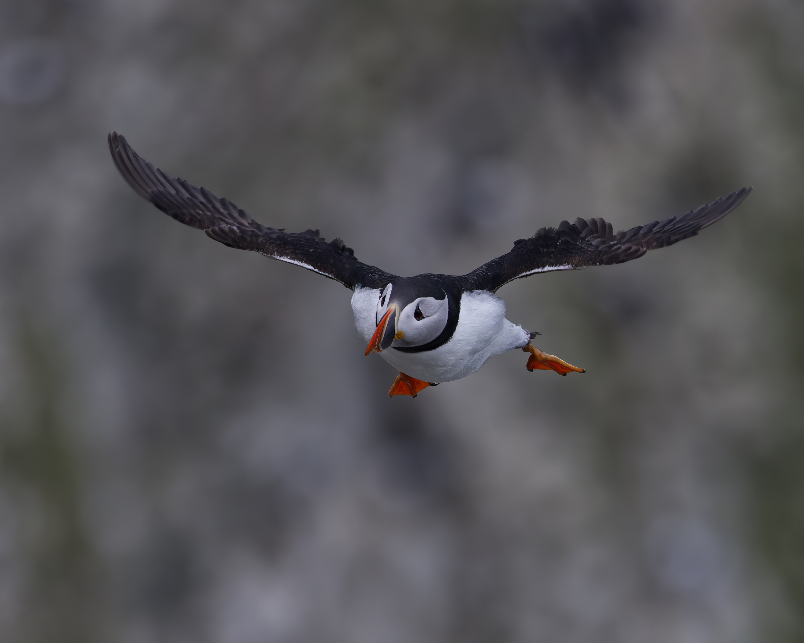

Slide 4
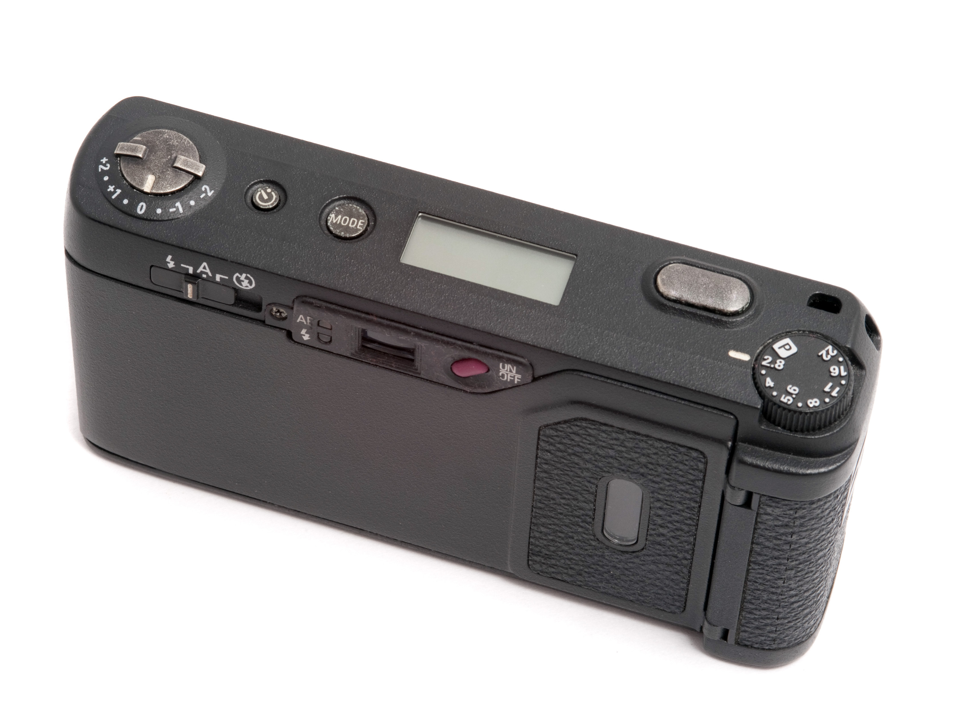
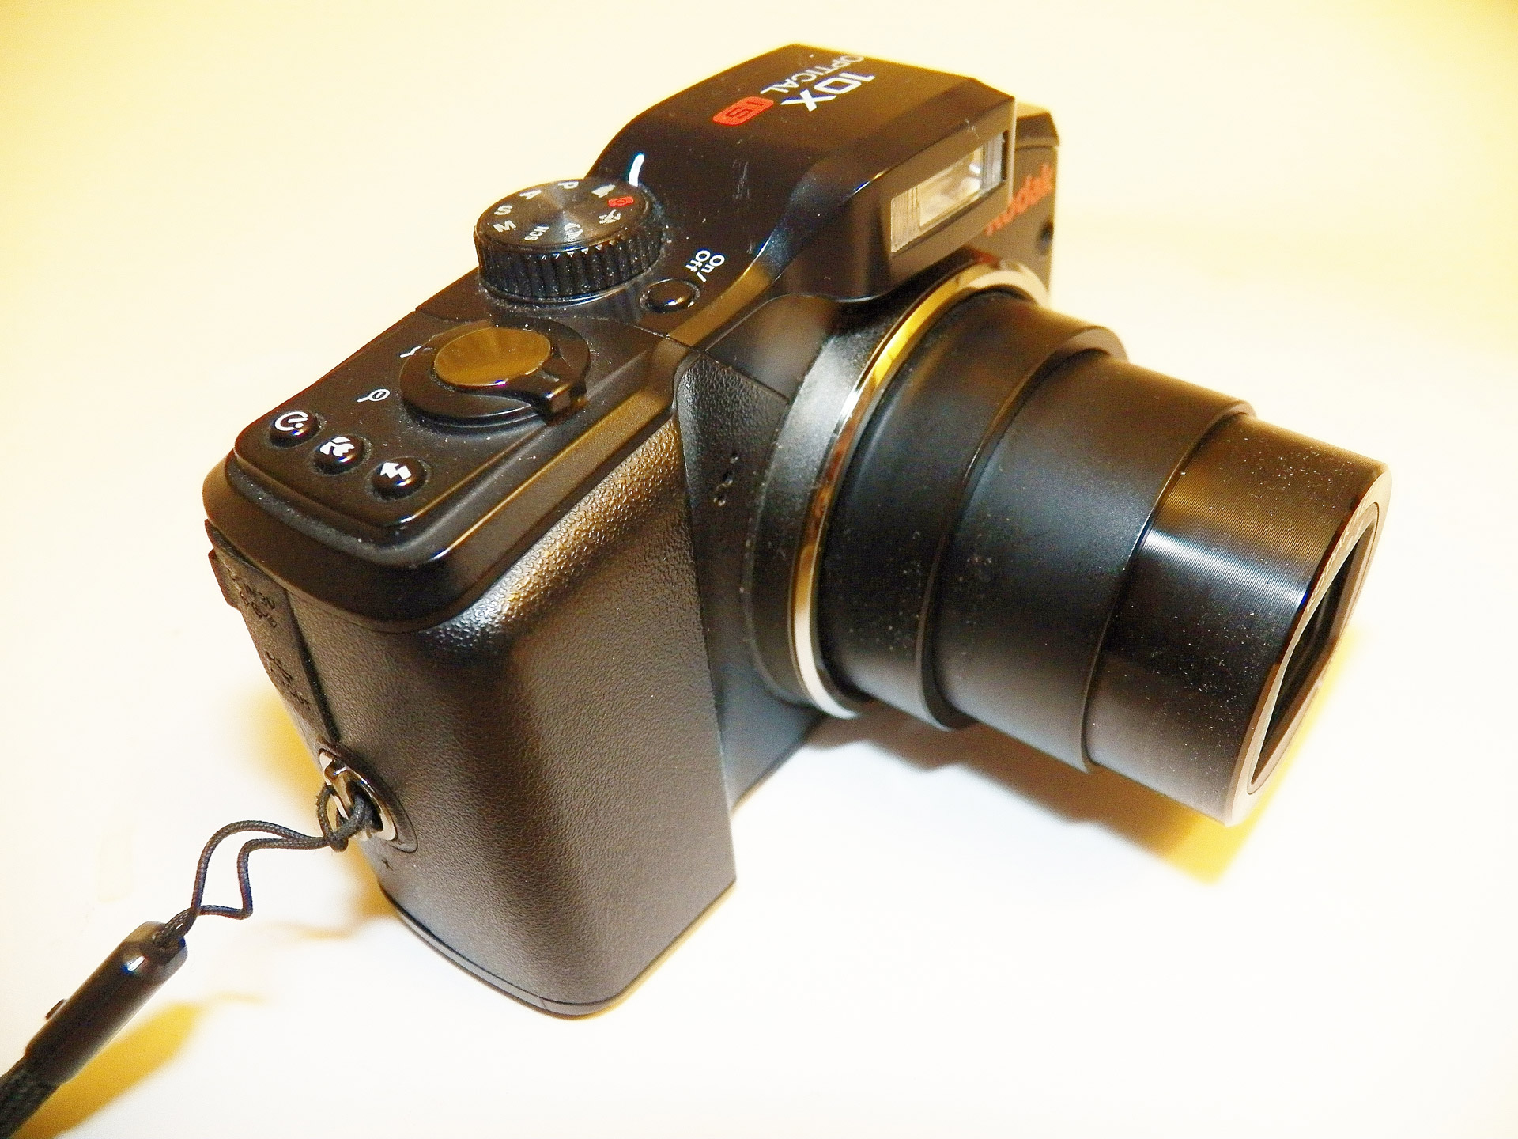
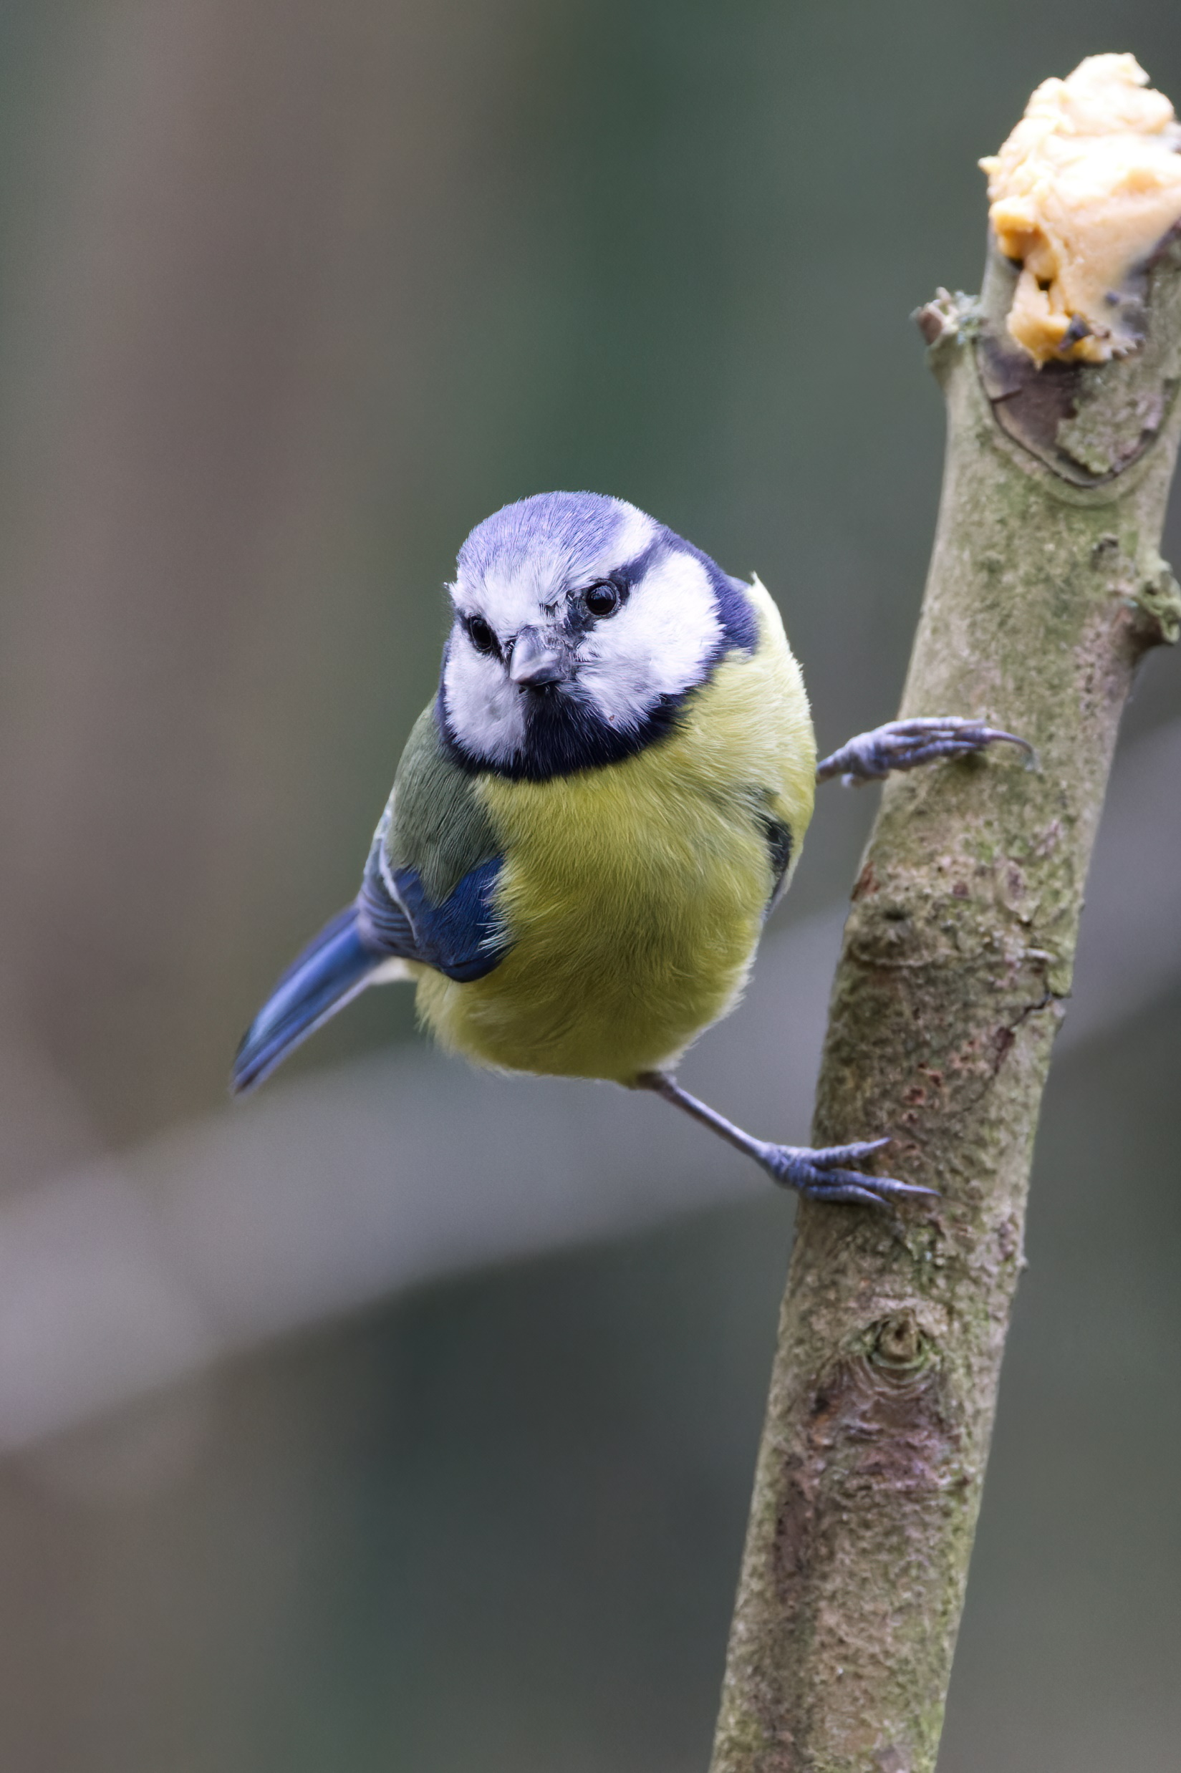
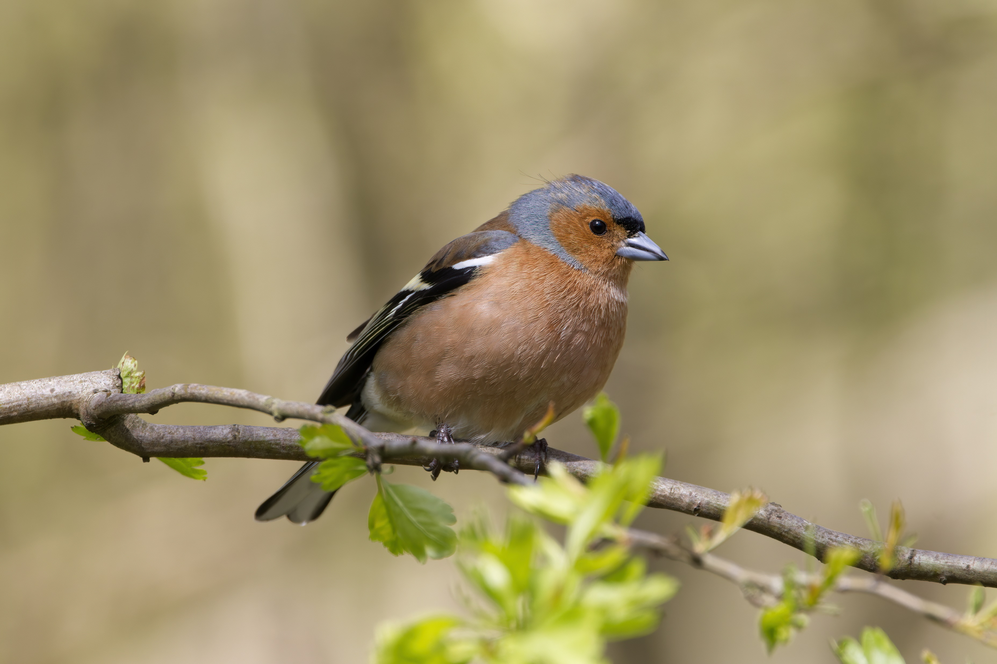
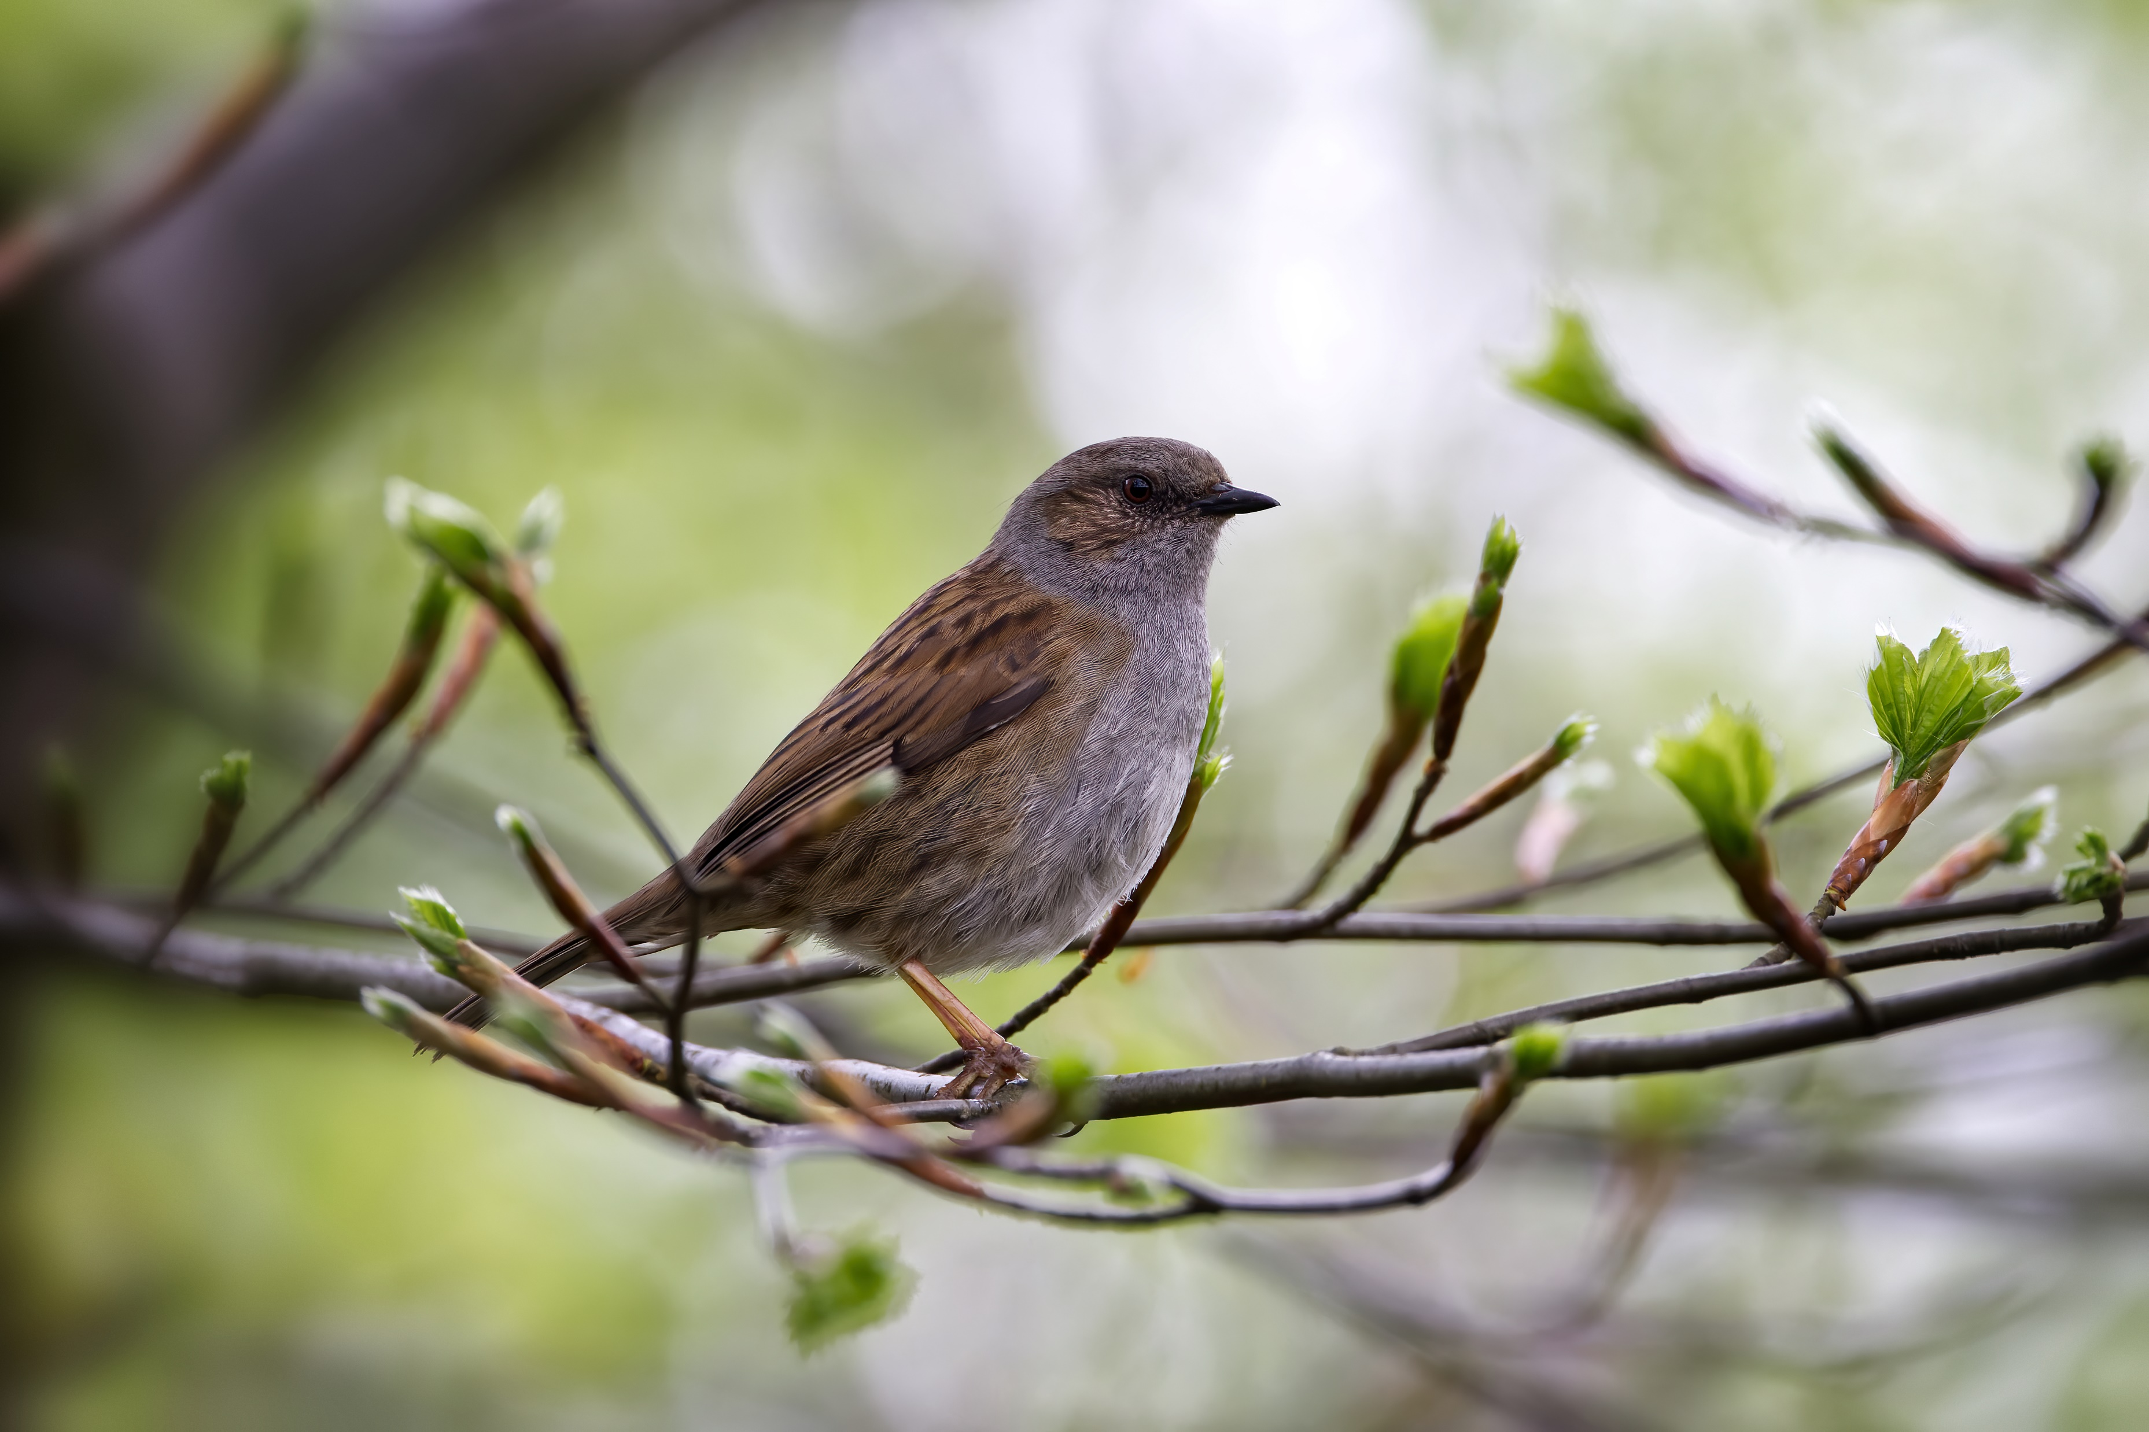
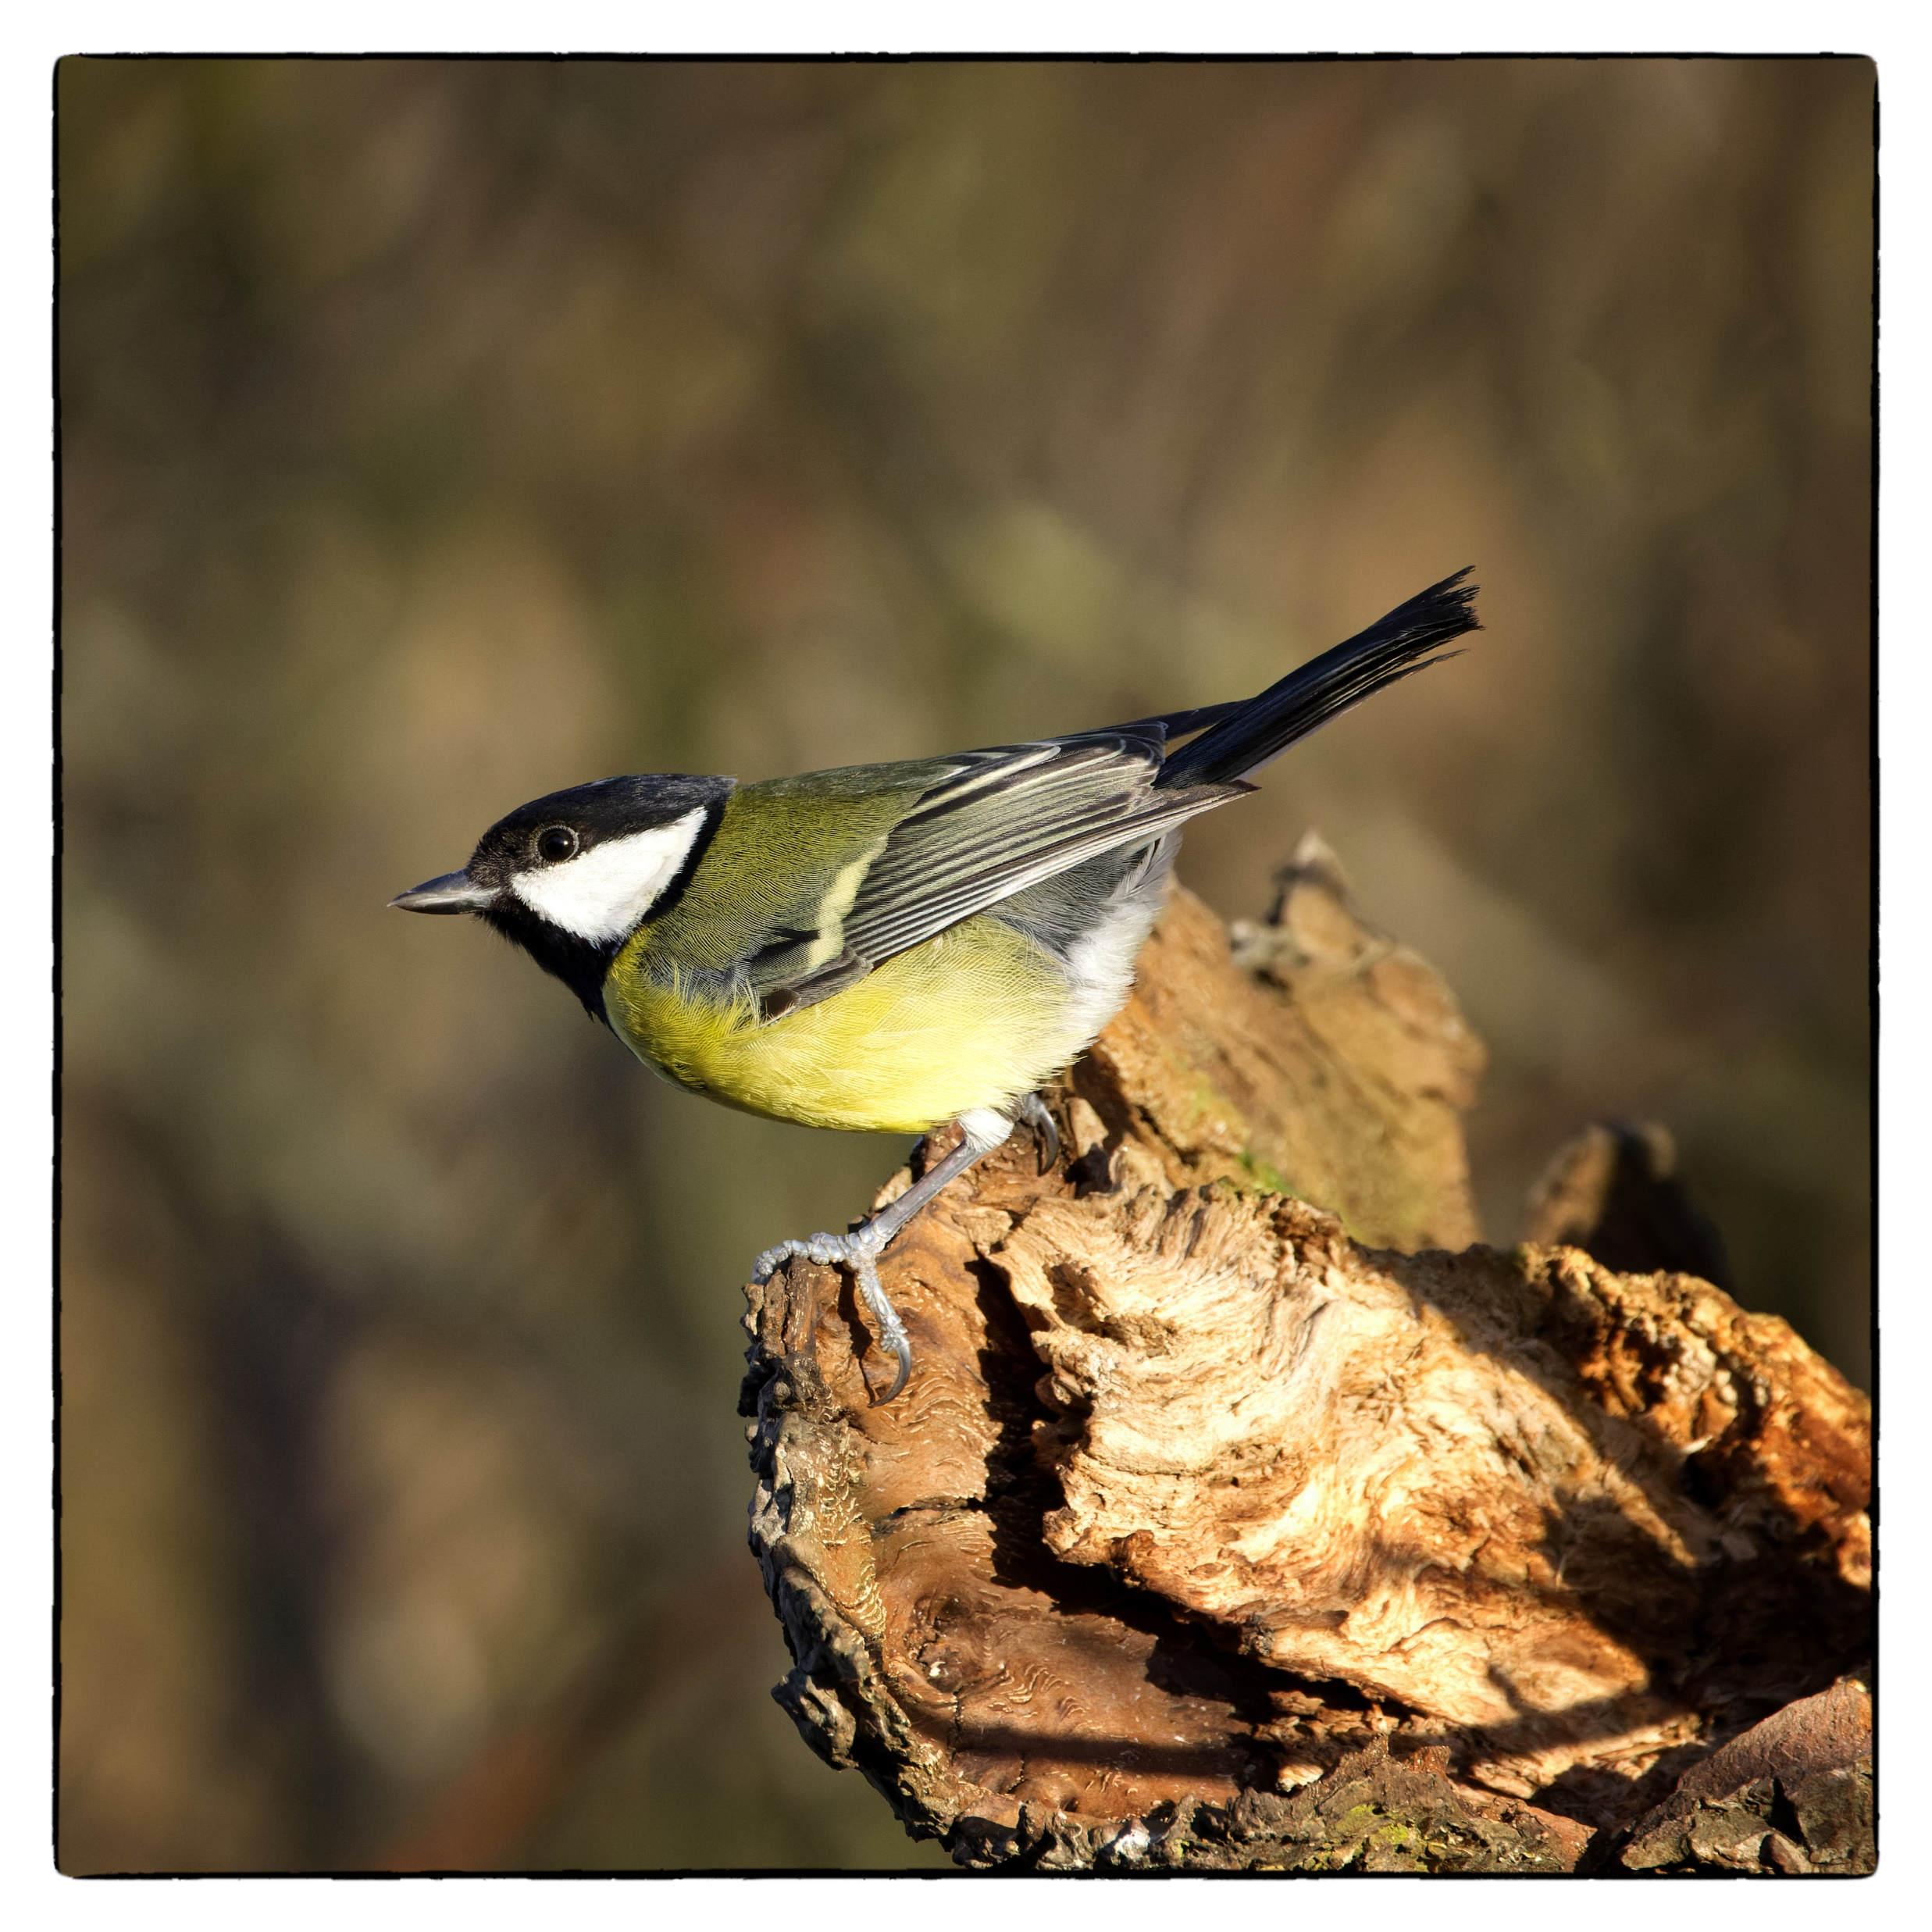
It doesn’t need expensive equipment or travel
This Photo by Unknown Author is licensed under CC BY

Slide 5
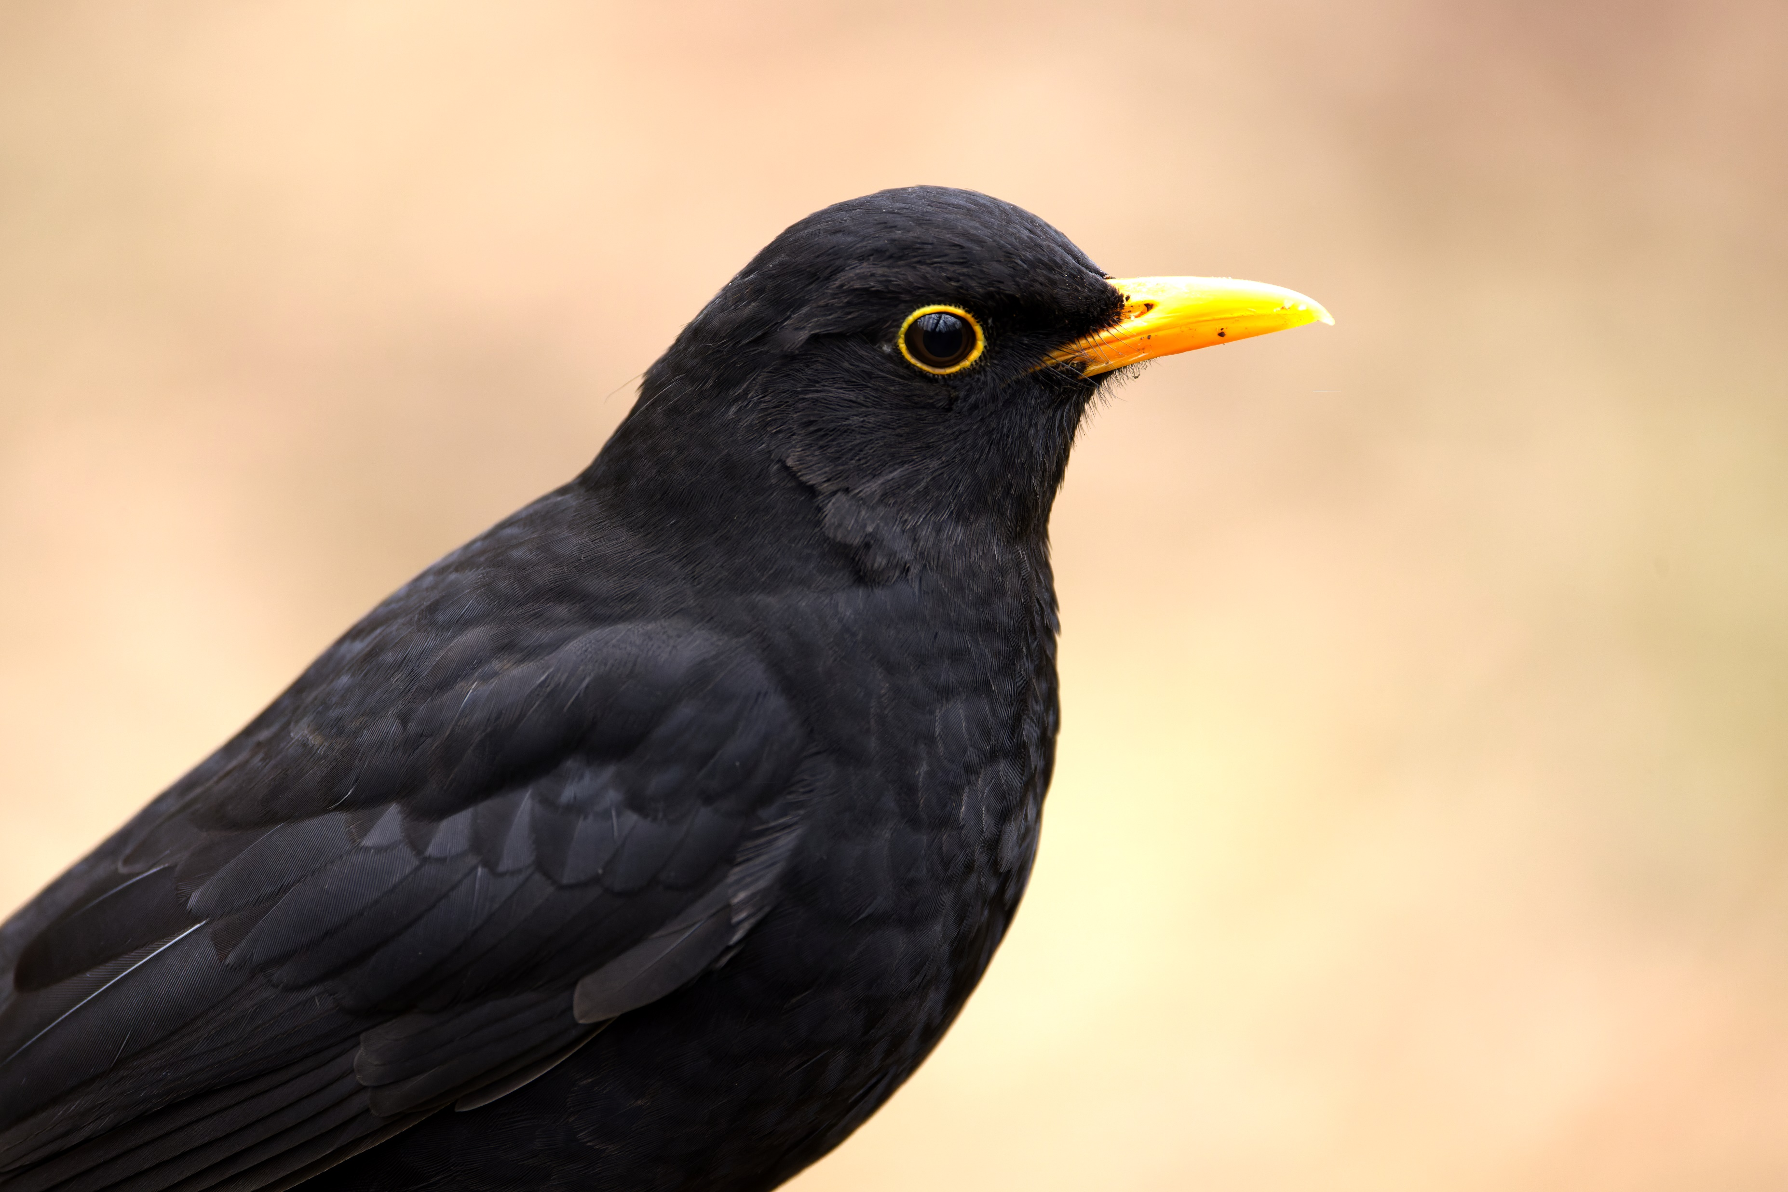

Slide 6
Garden Birds are a great way to start

Slide 7
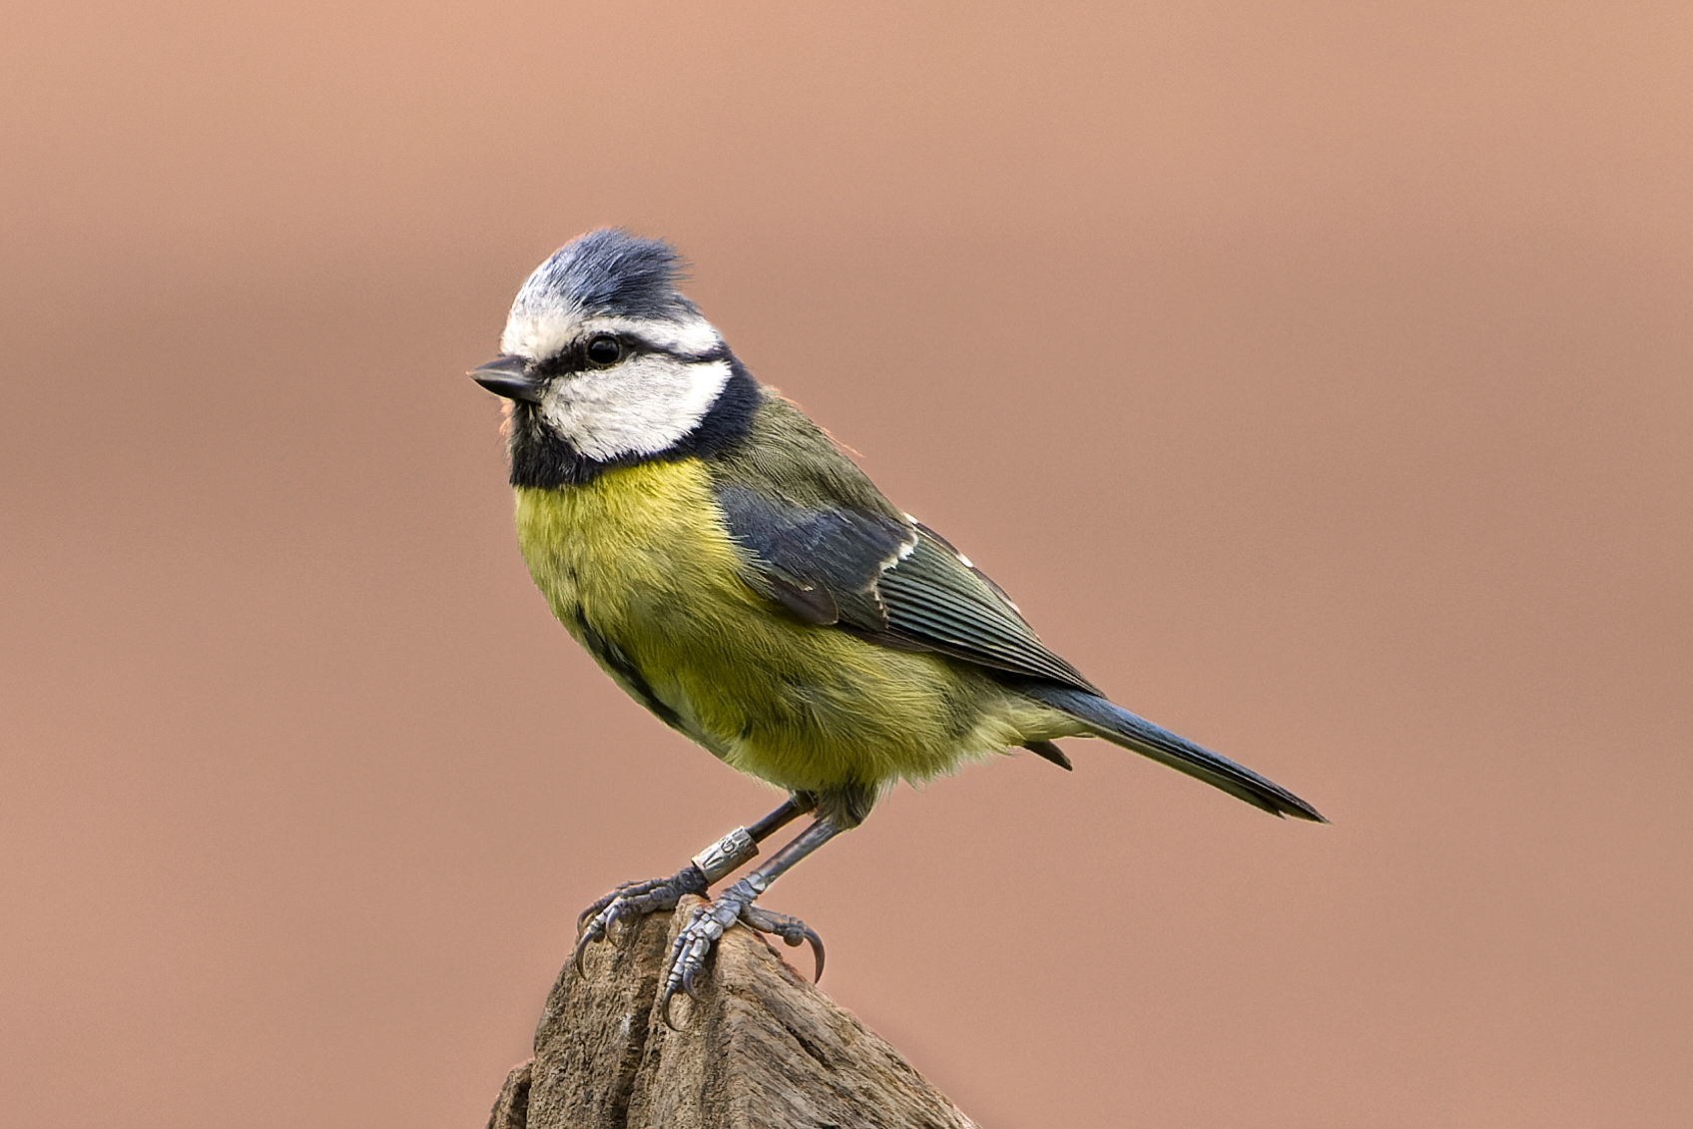

Slide 8
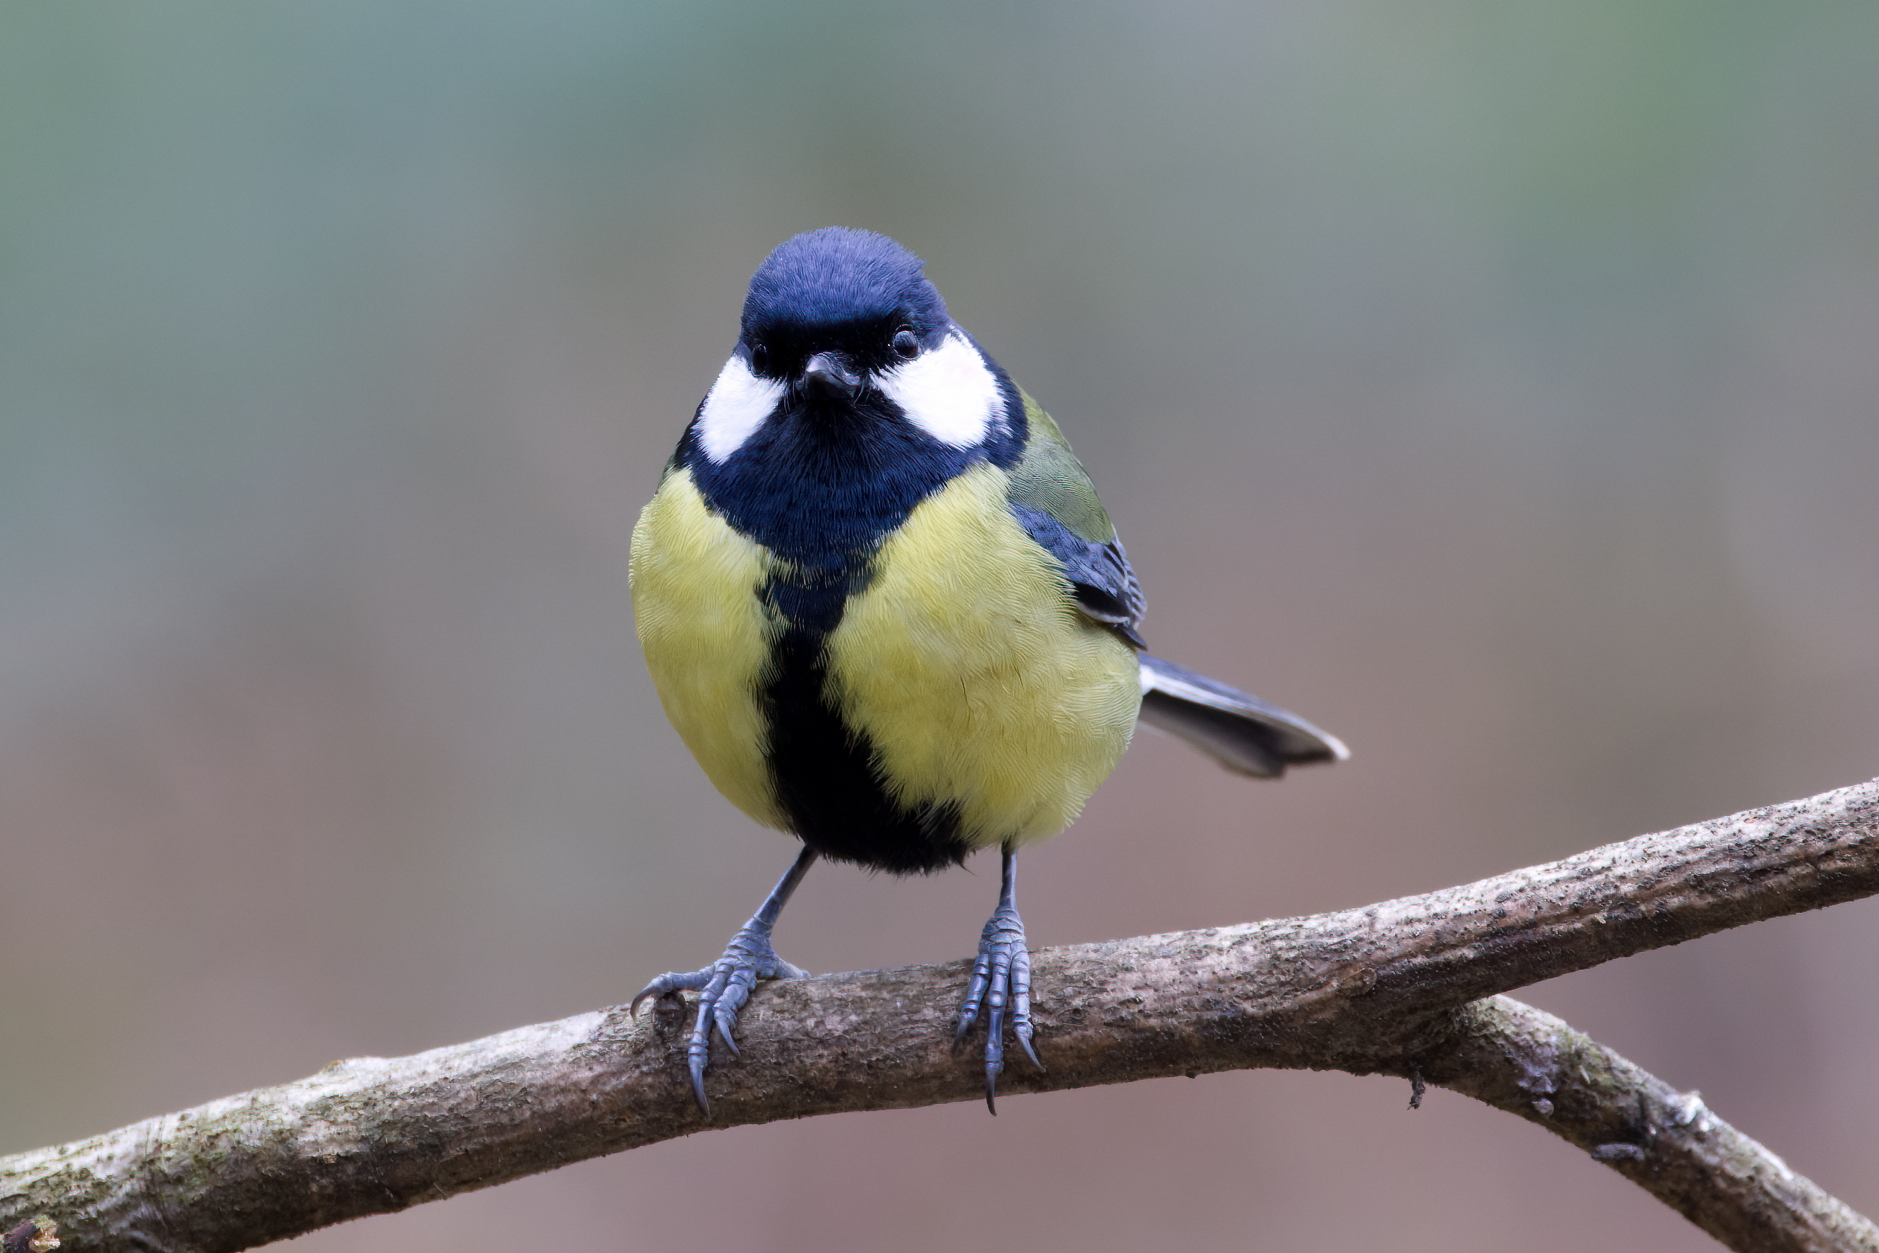

Slide 9
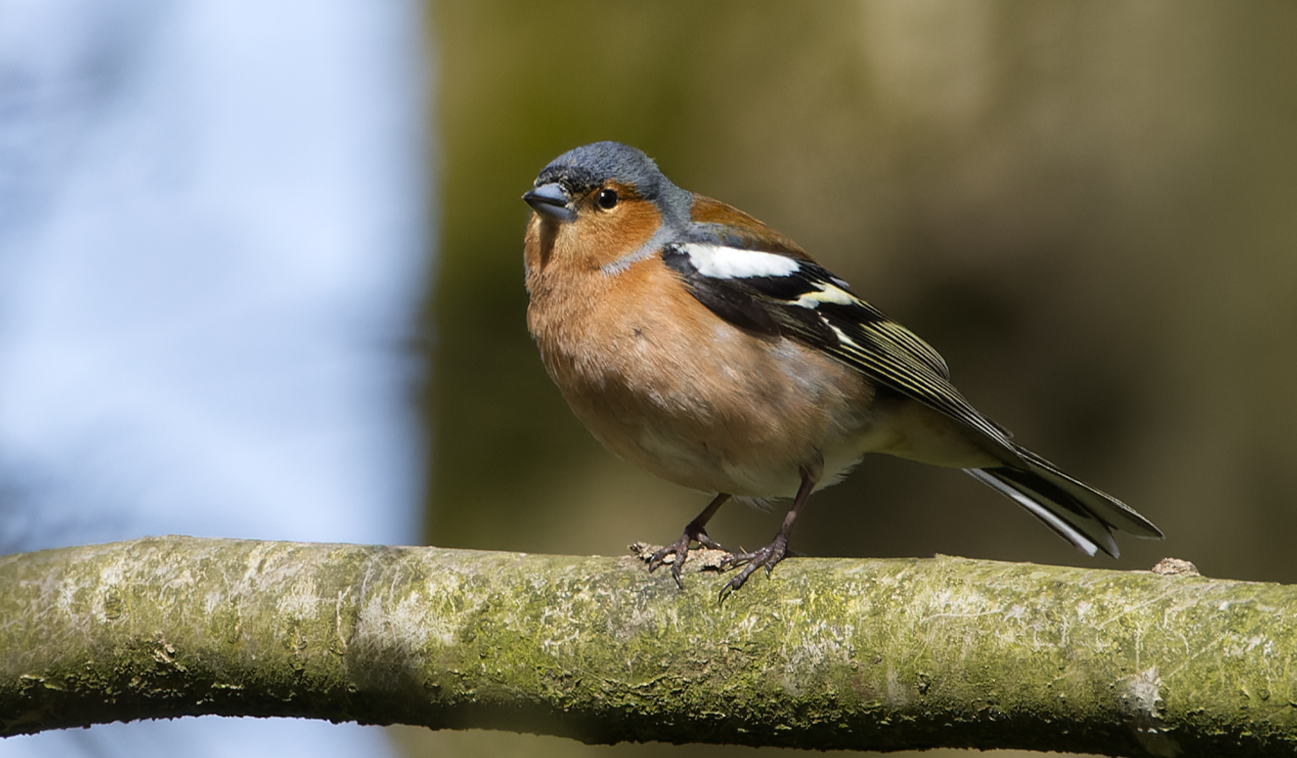

Slide 10
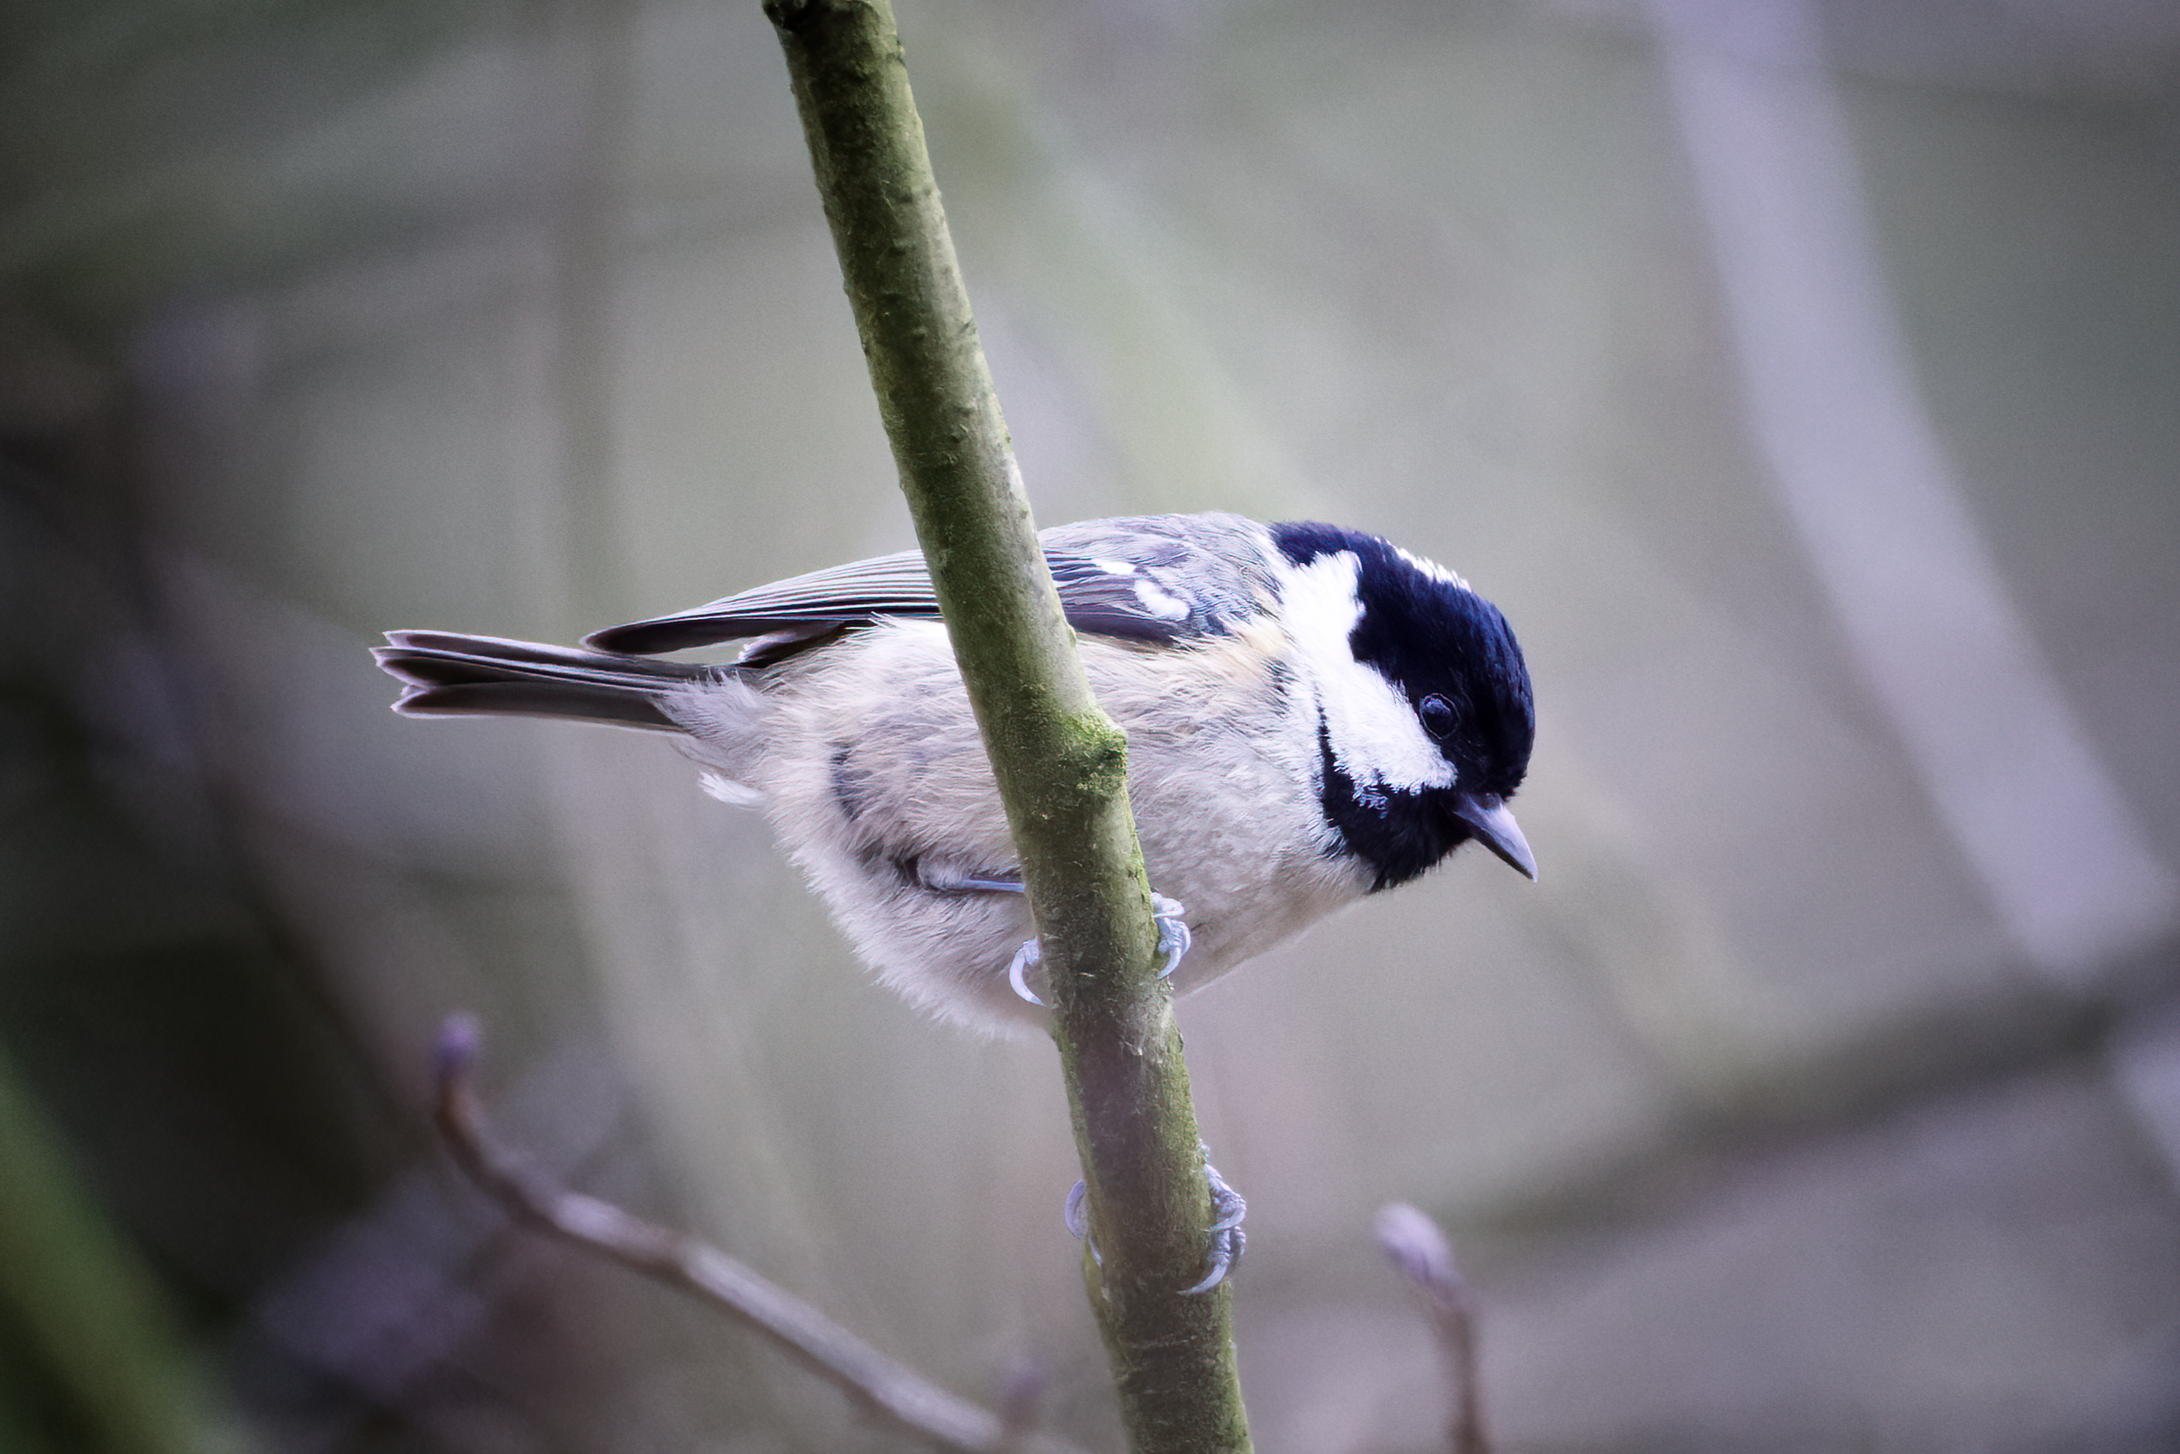

Slide 11
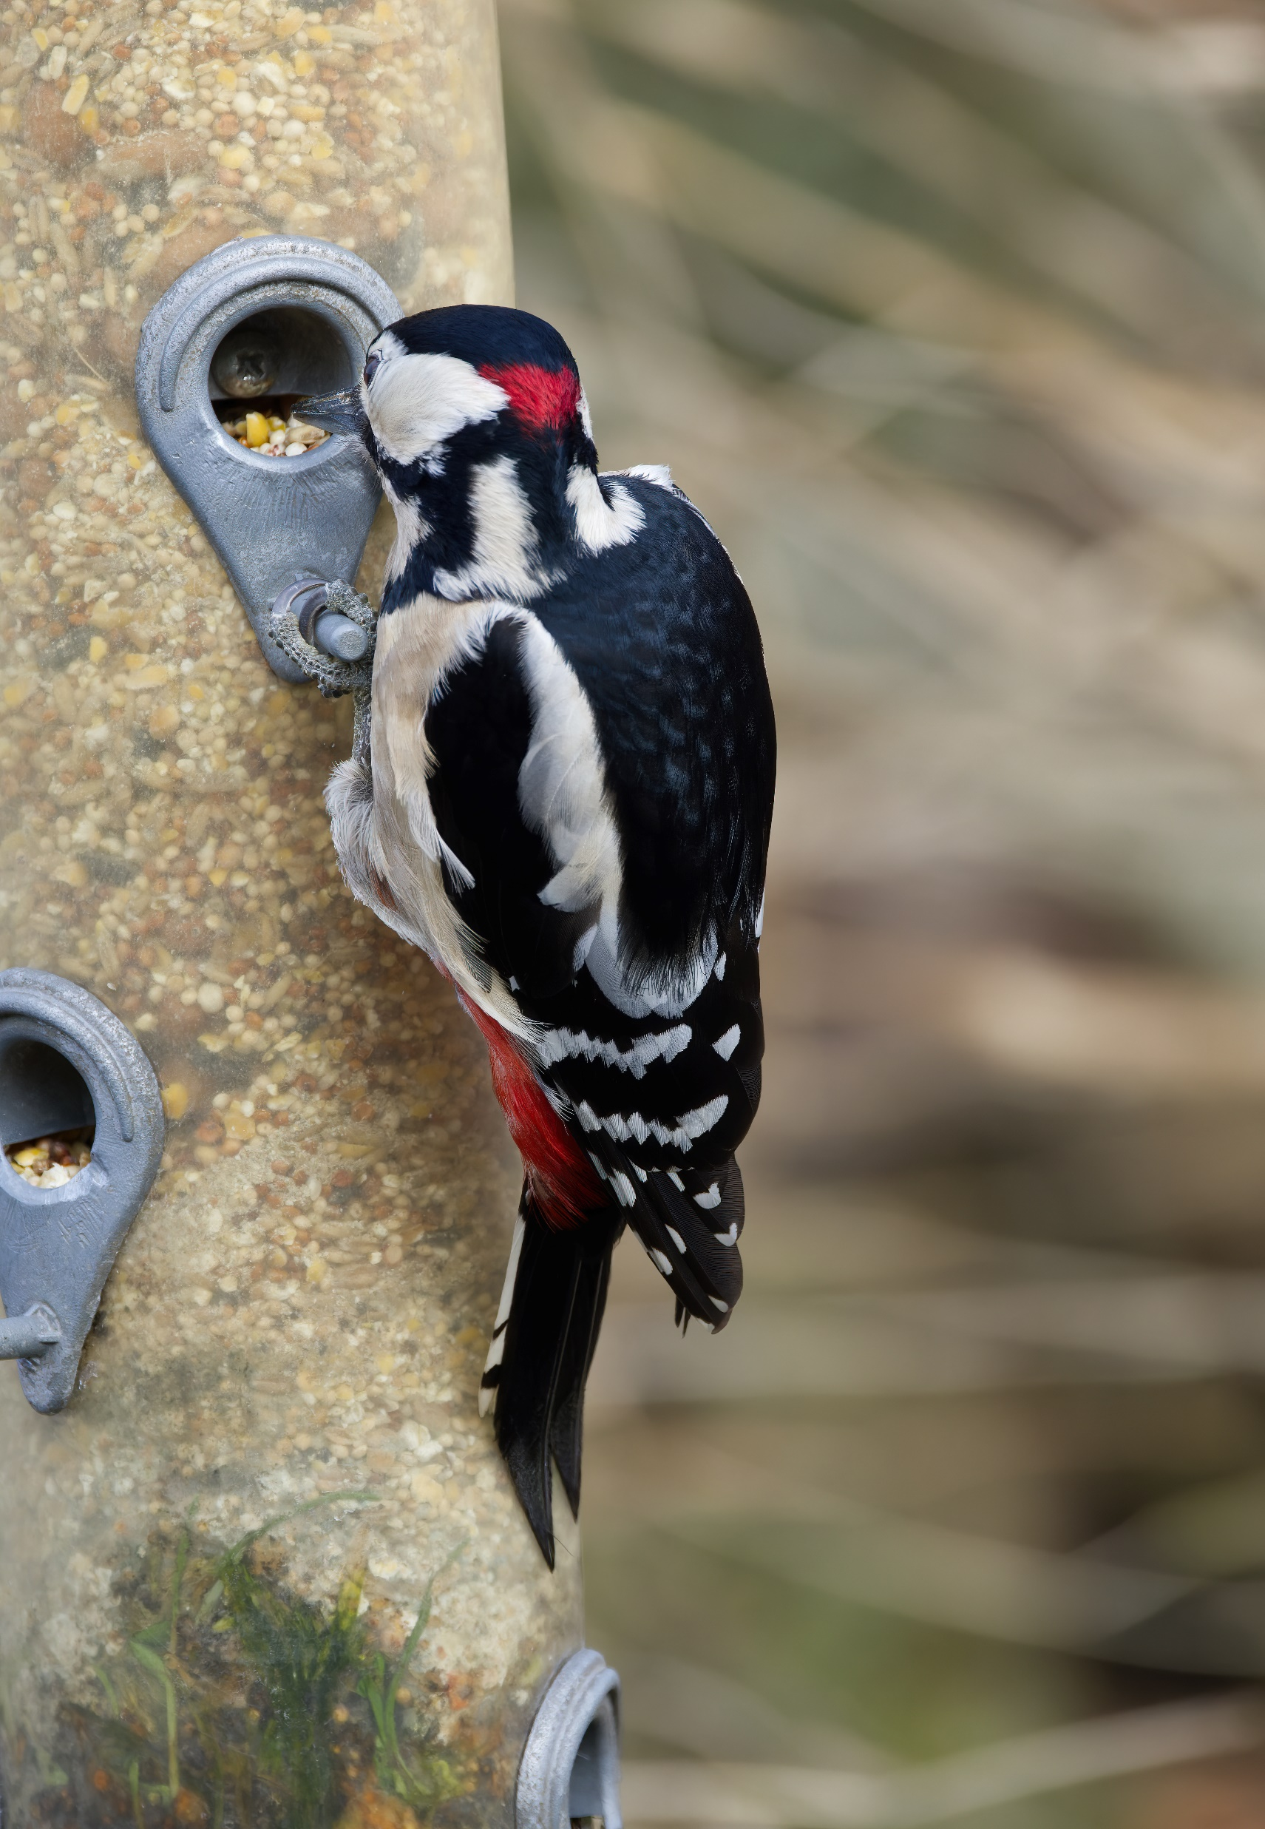

Slide 12
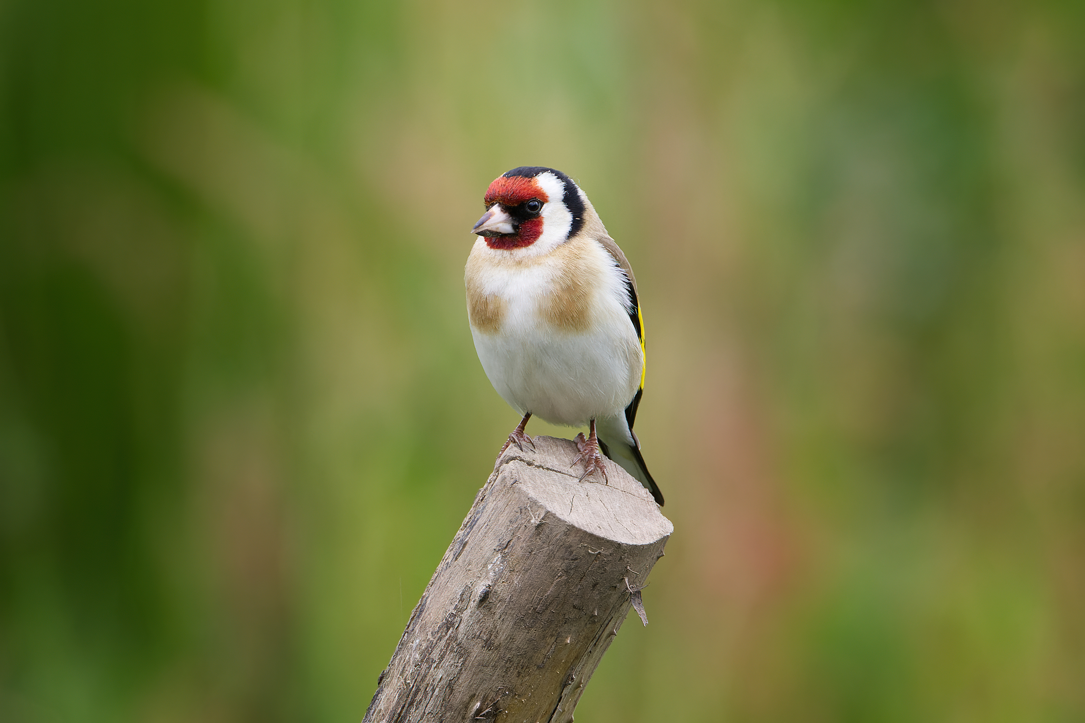

Slide 13
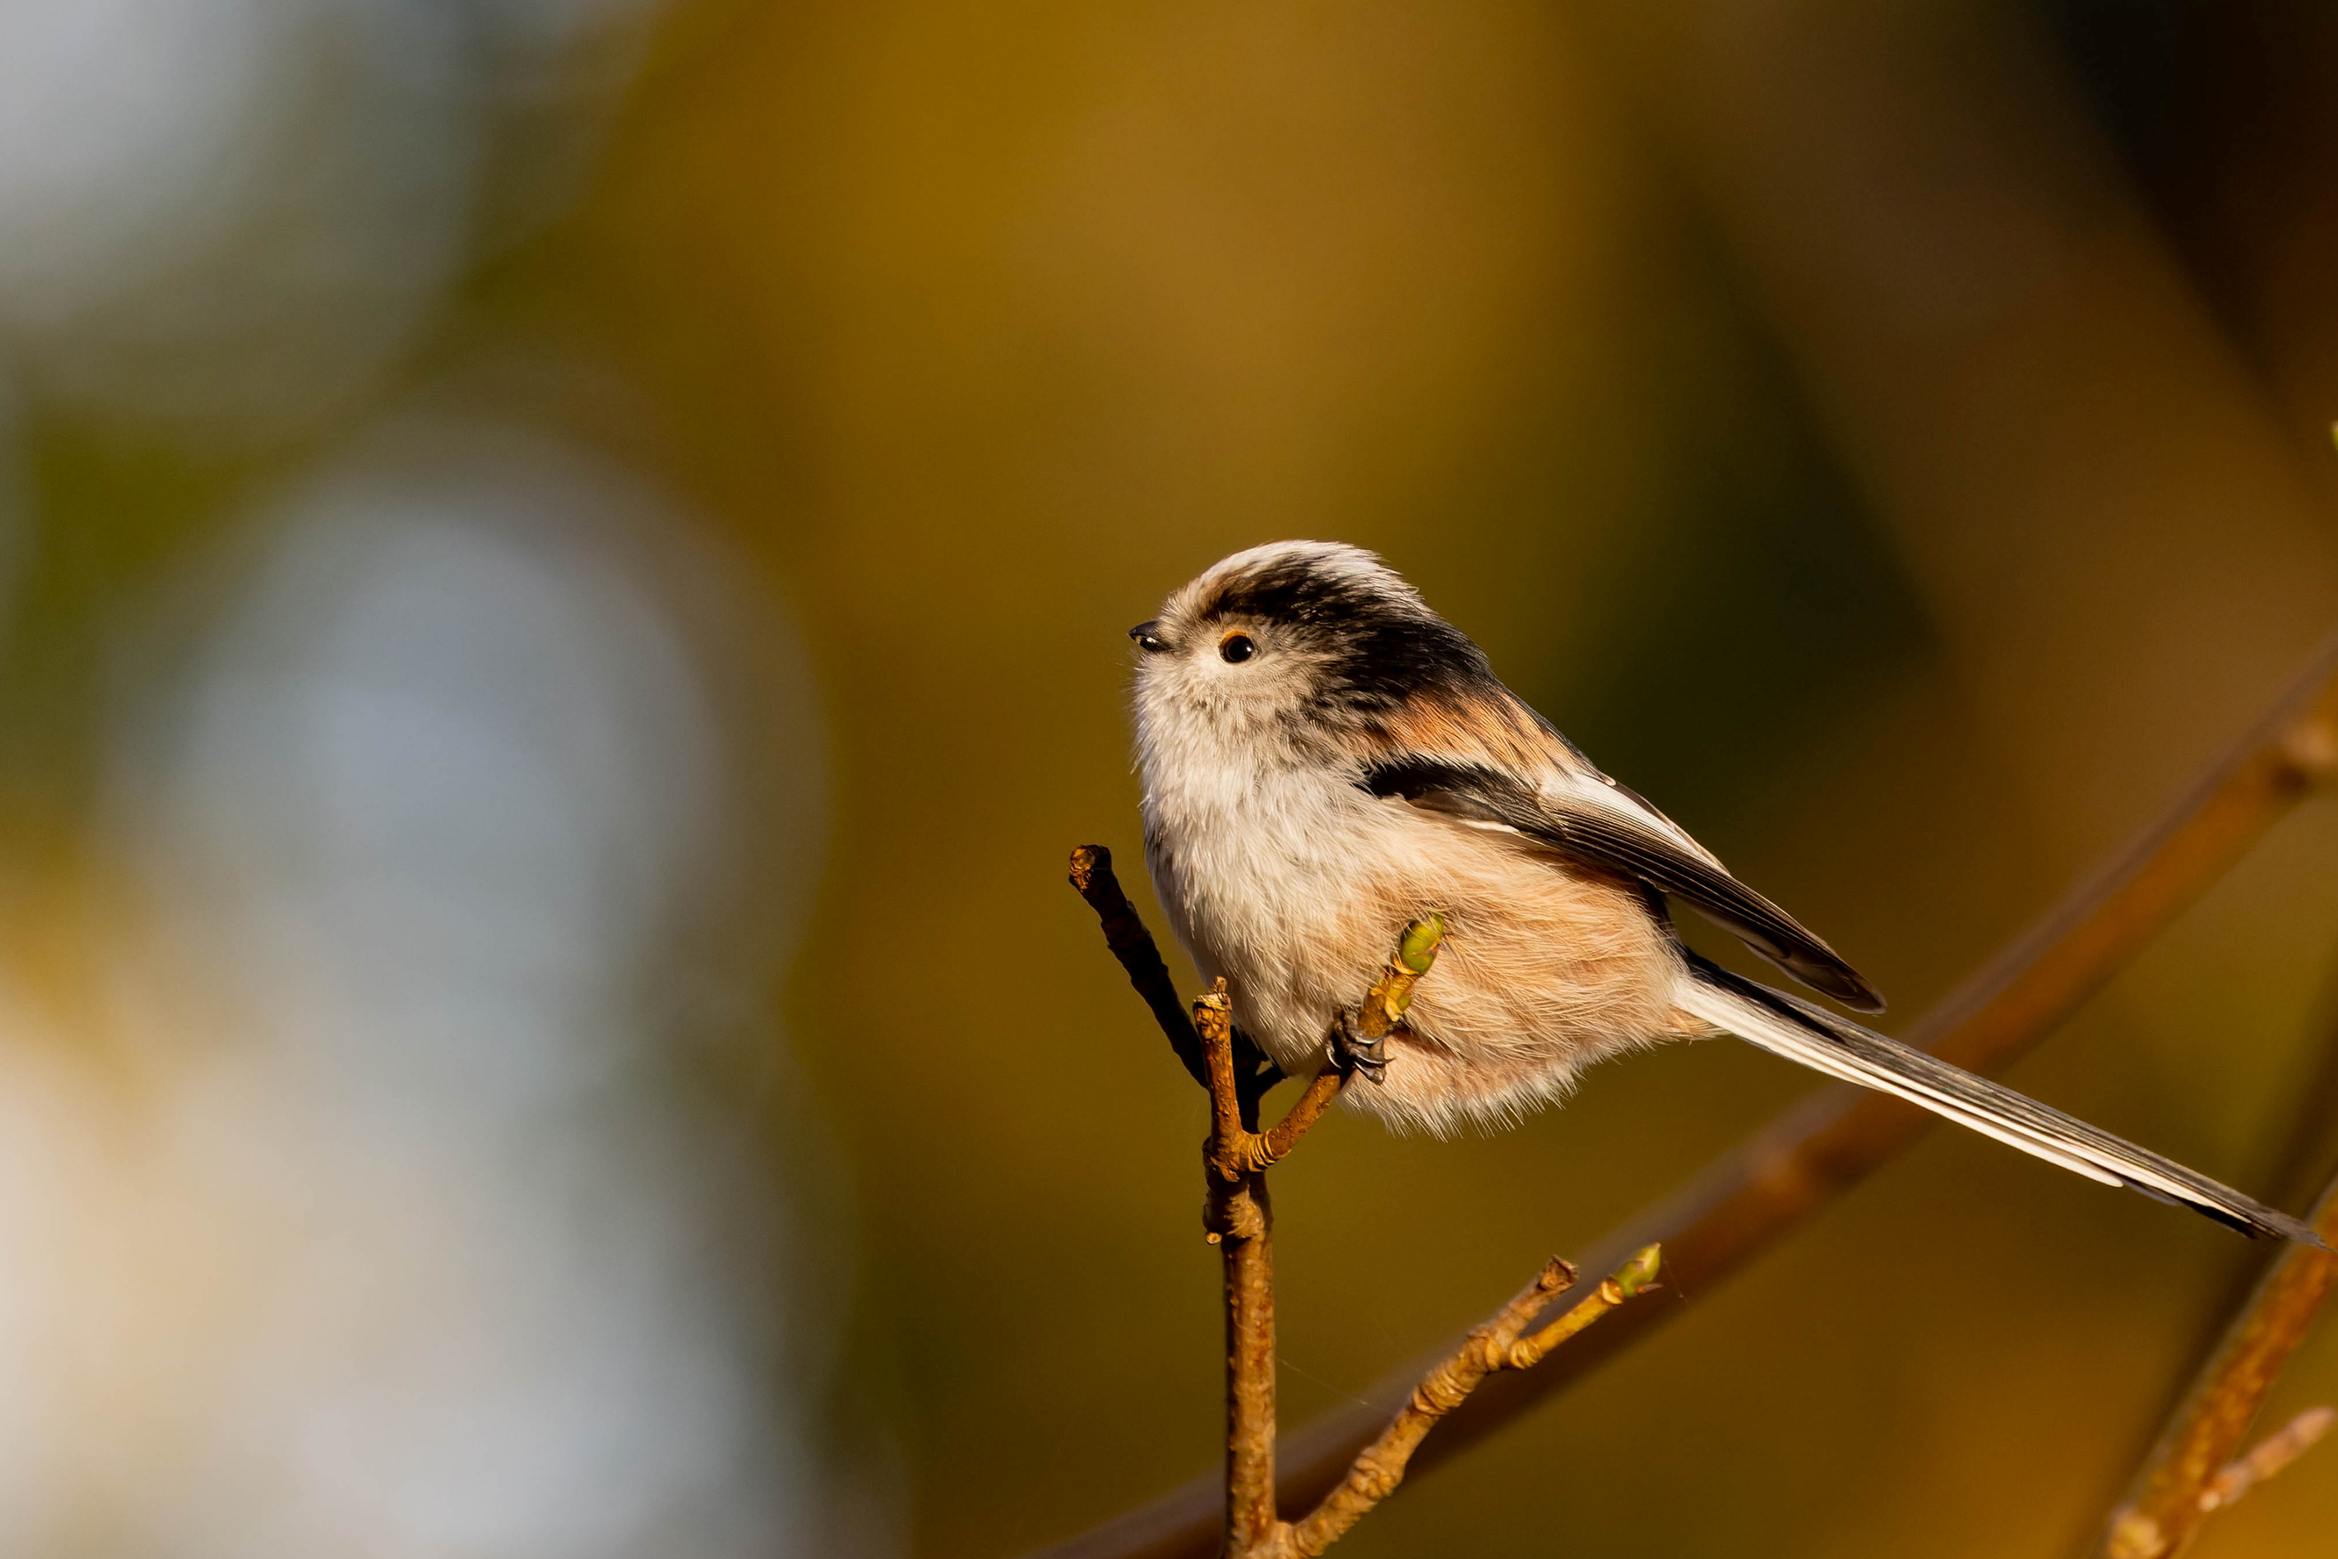

Slide 14
Consider what you want to capture?
- The bird or
- The bird in its environment

Slide 15
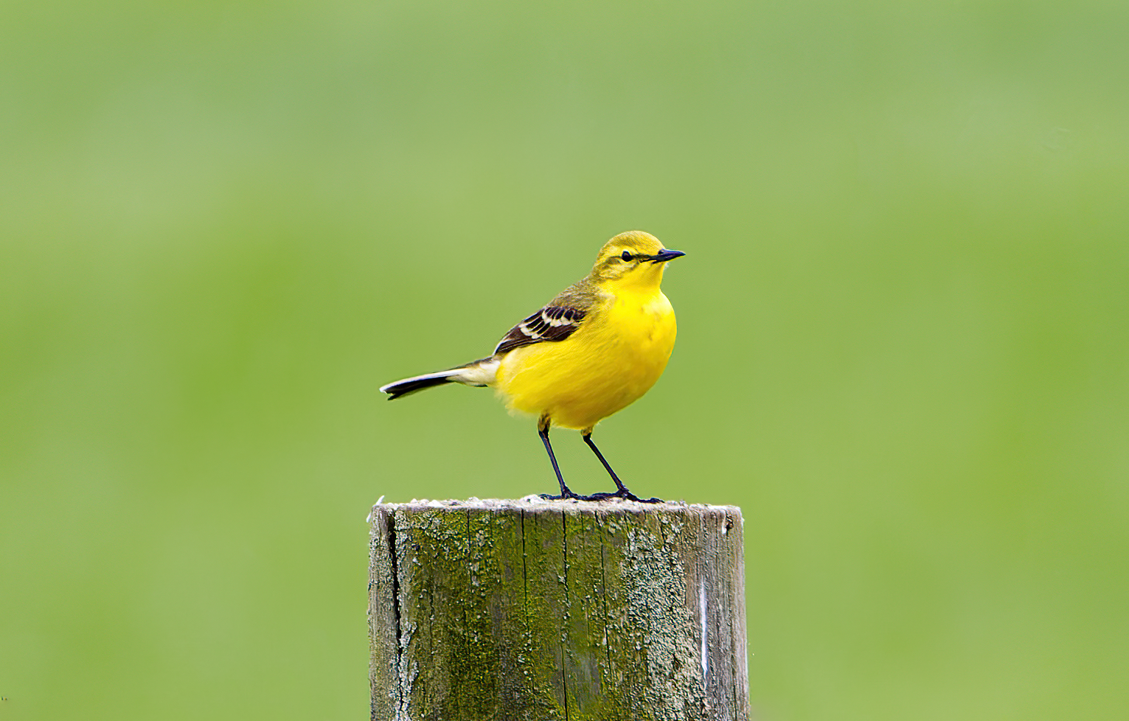

Slide 16
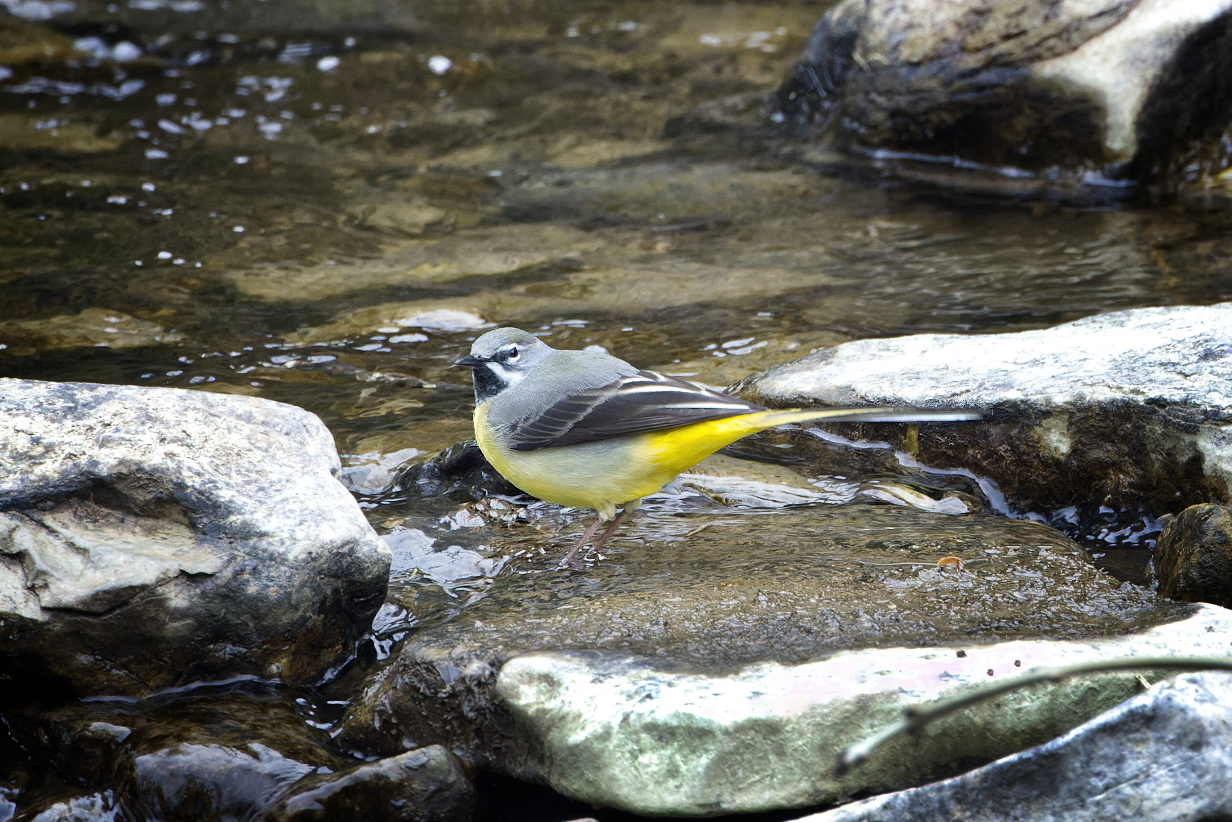

Slide 17
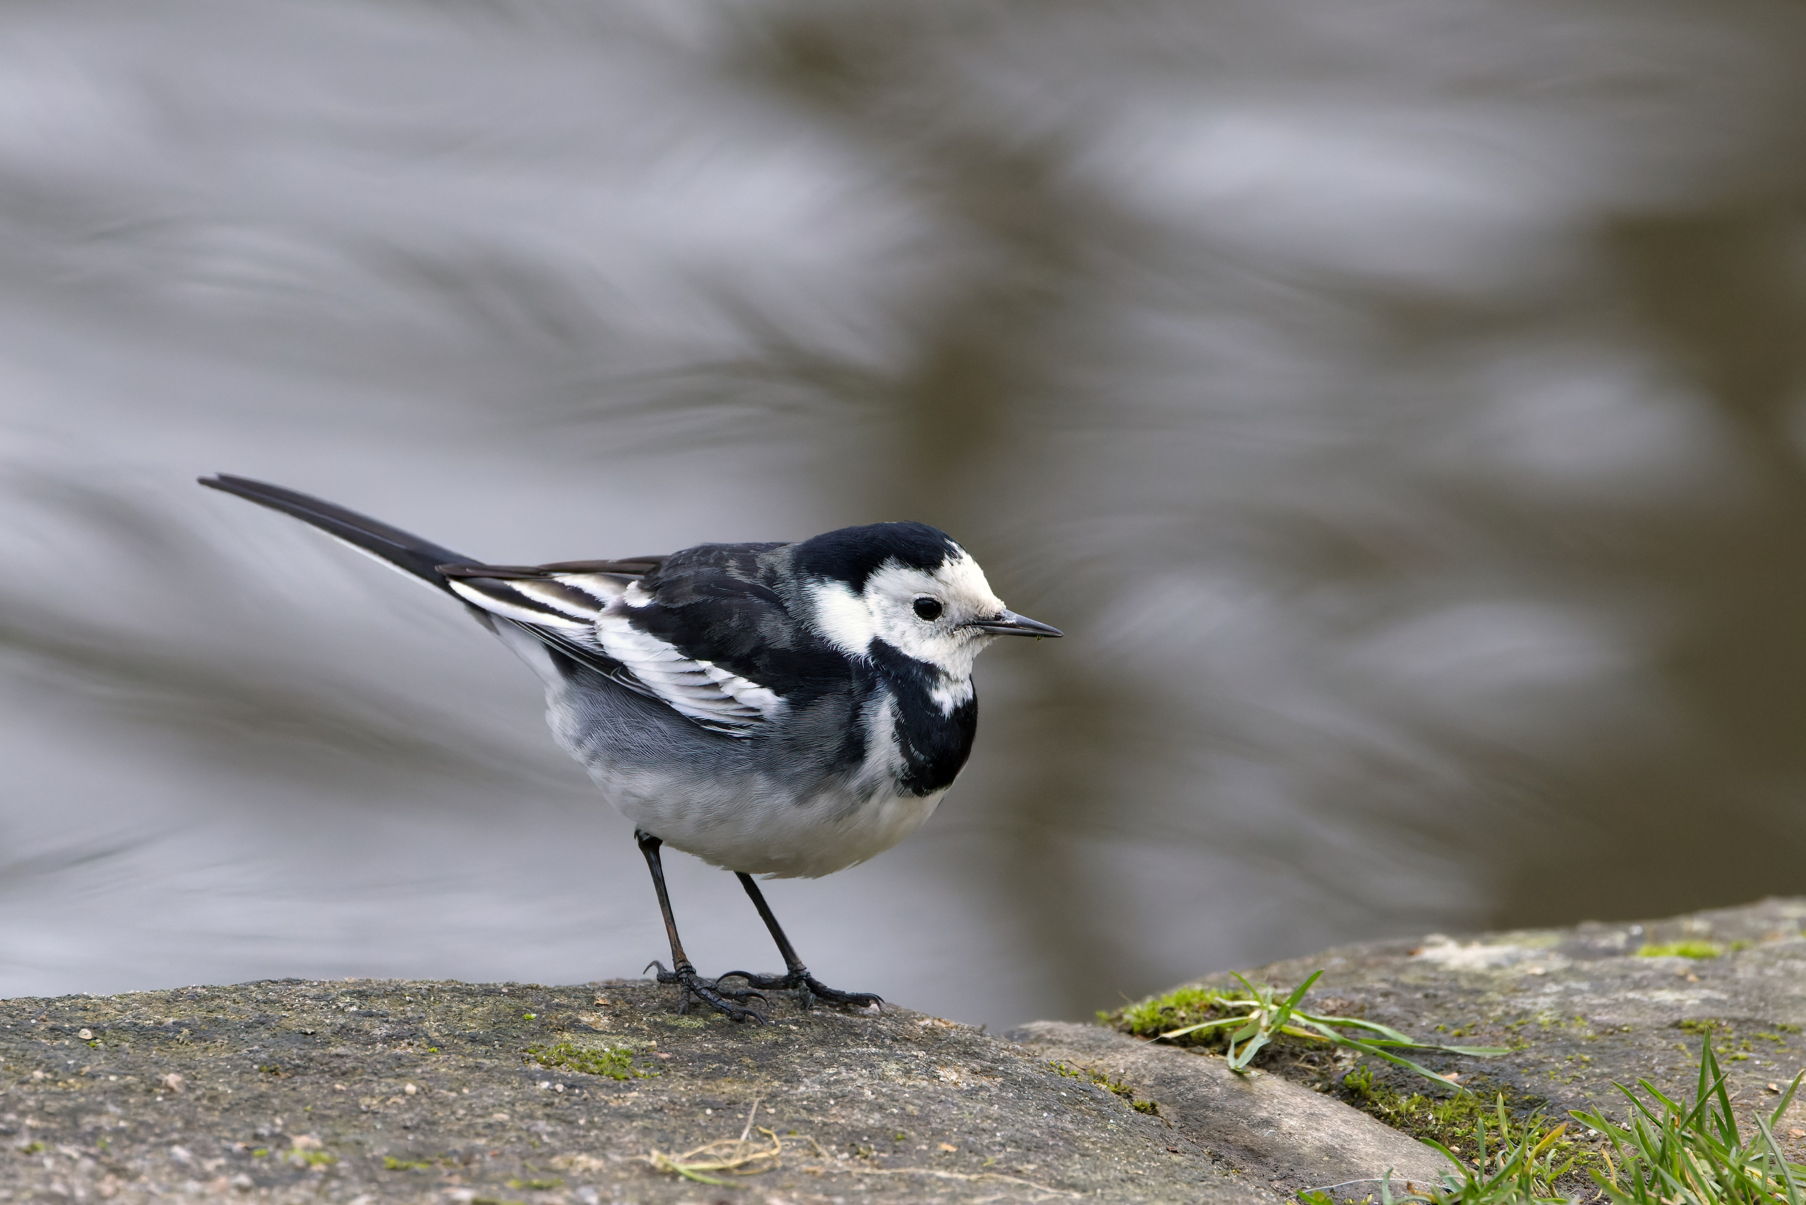

Slide 18
- Behaviour

Slide 19
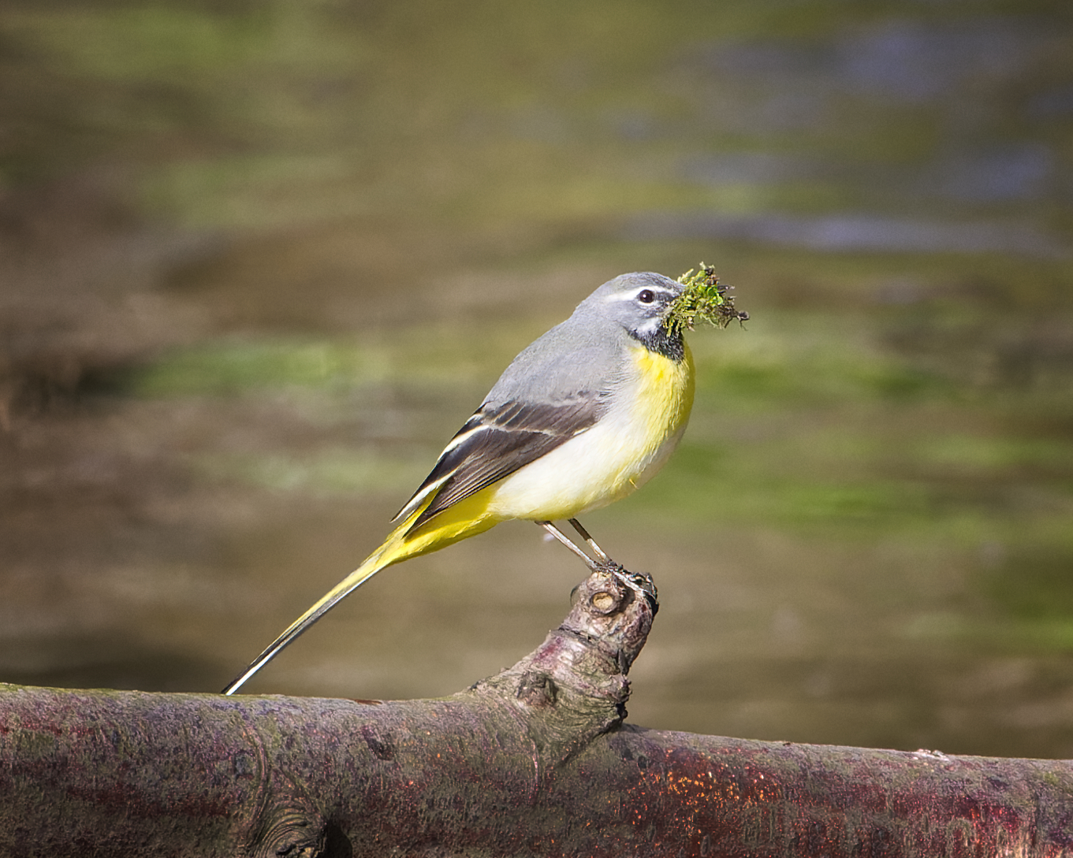

Slide 20
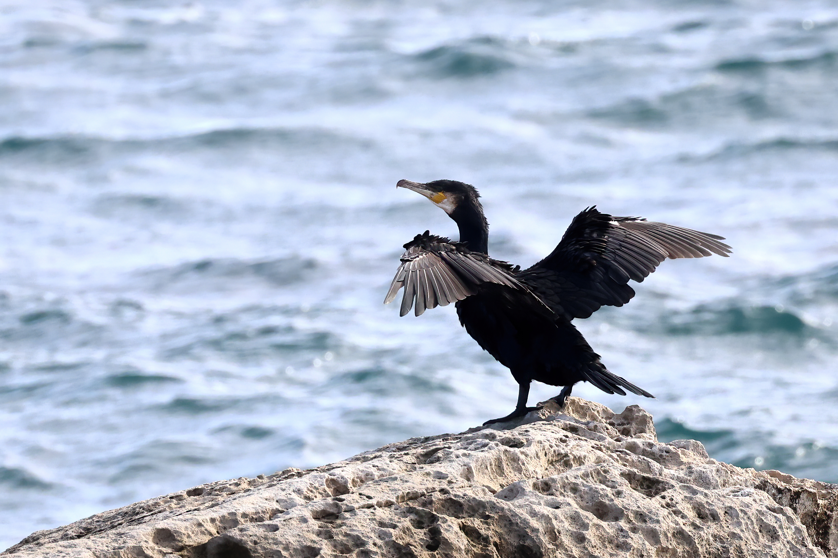

Slide 21
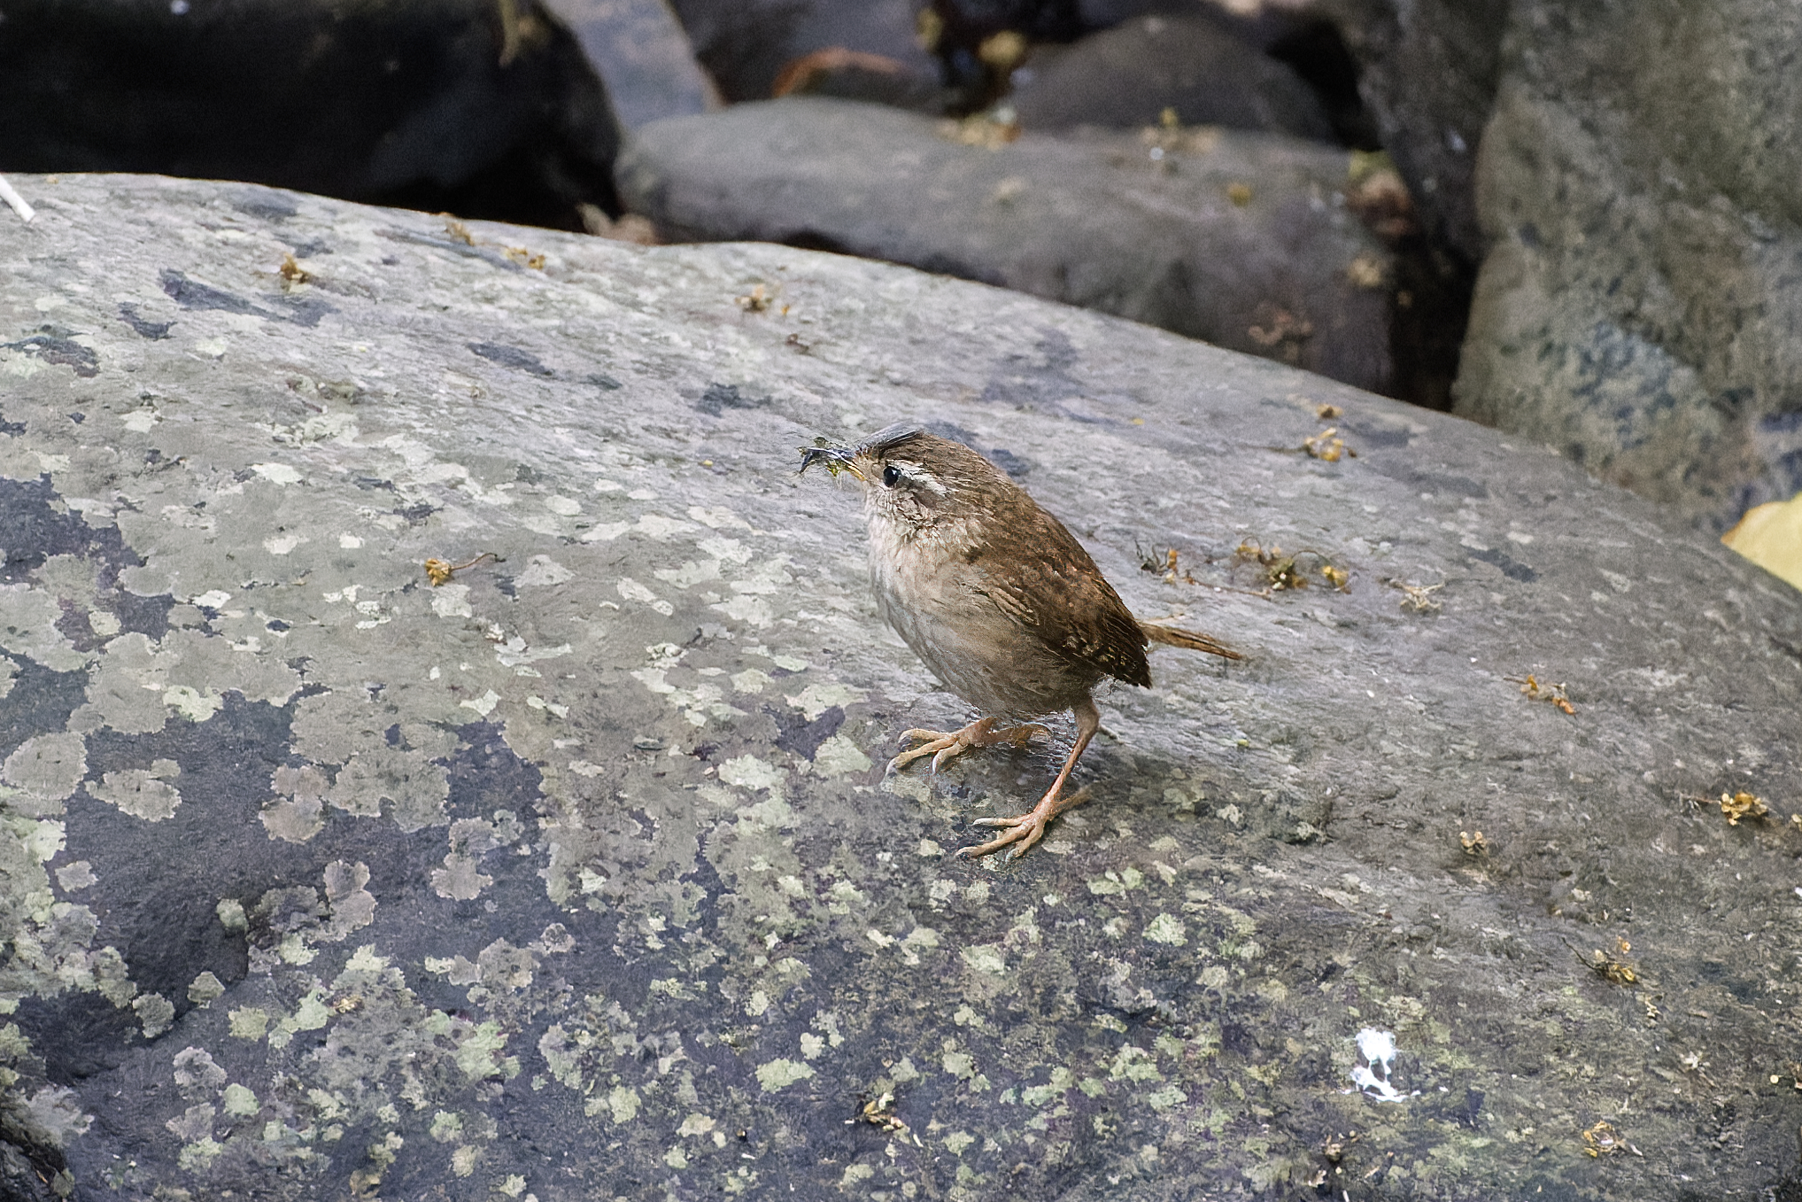

Slide 22
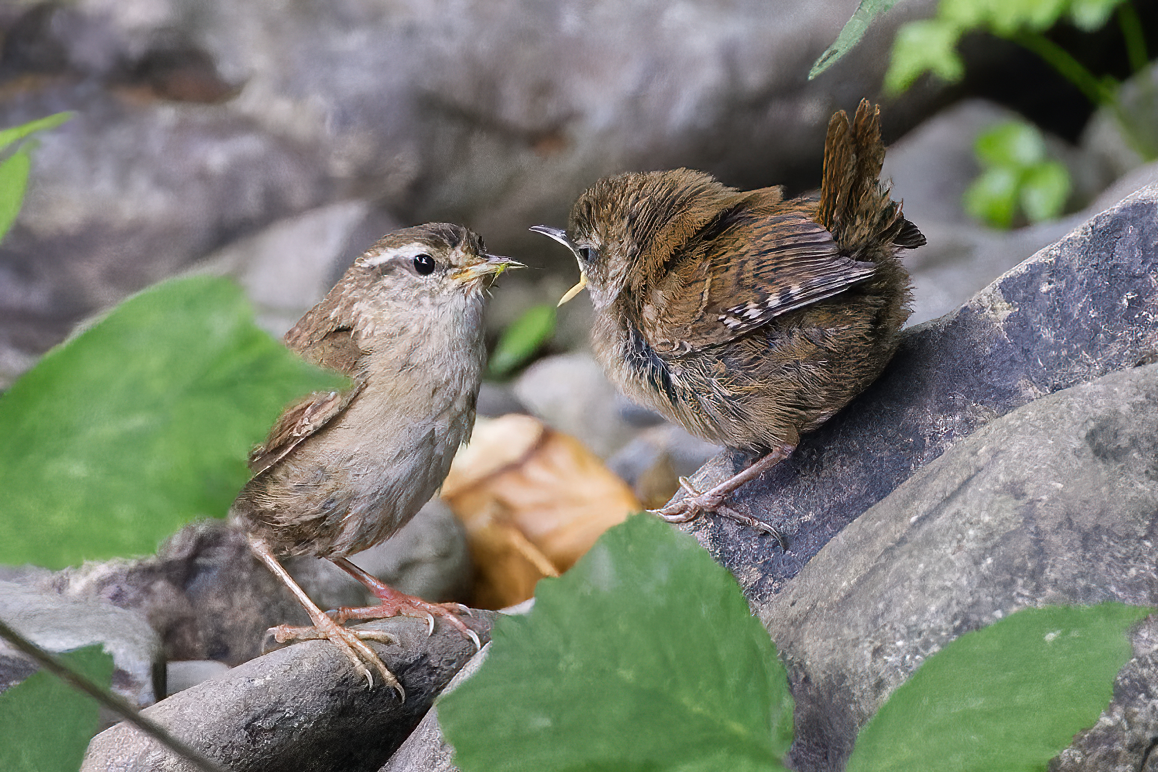

Slide 23
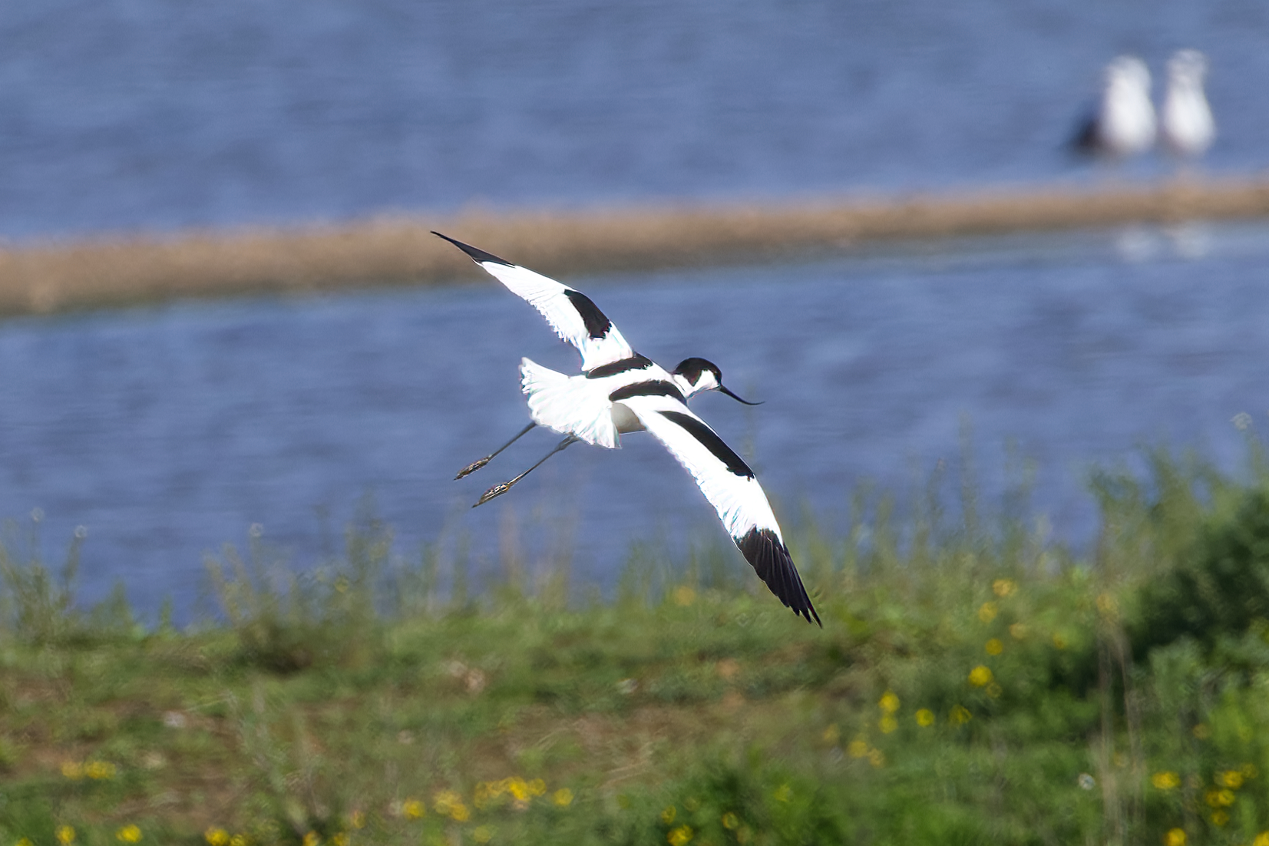

Slide 24
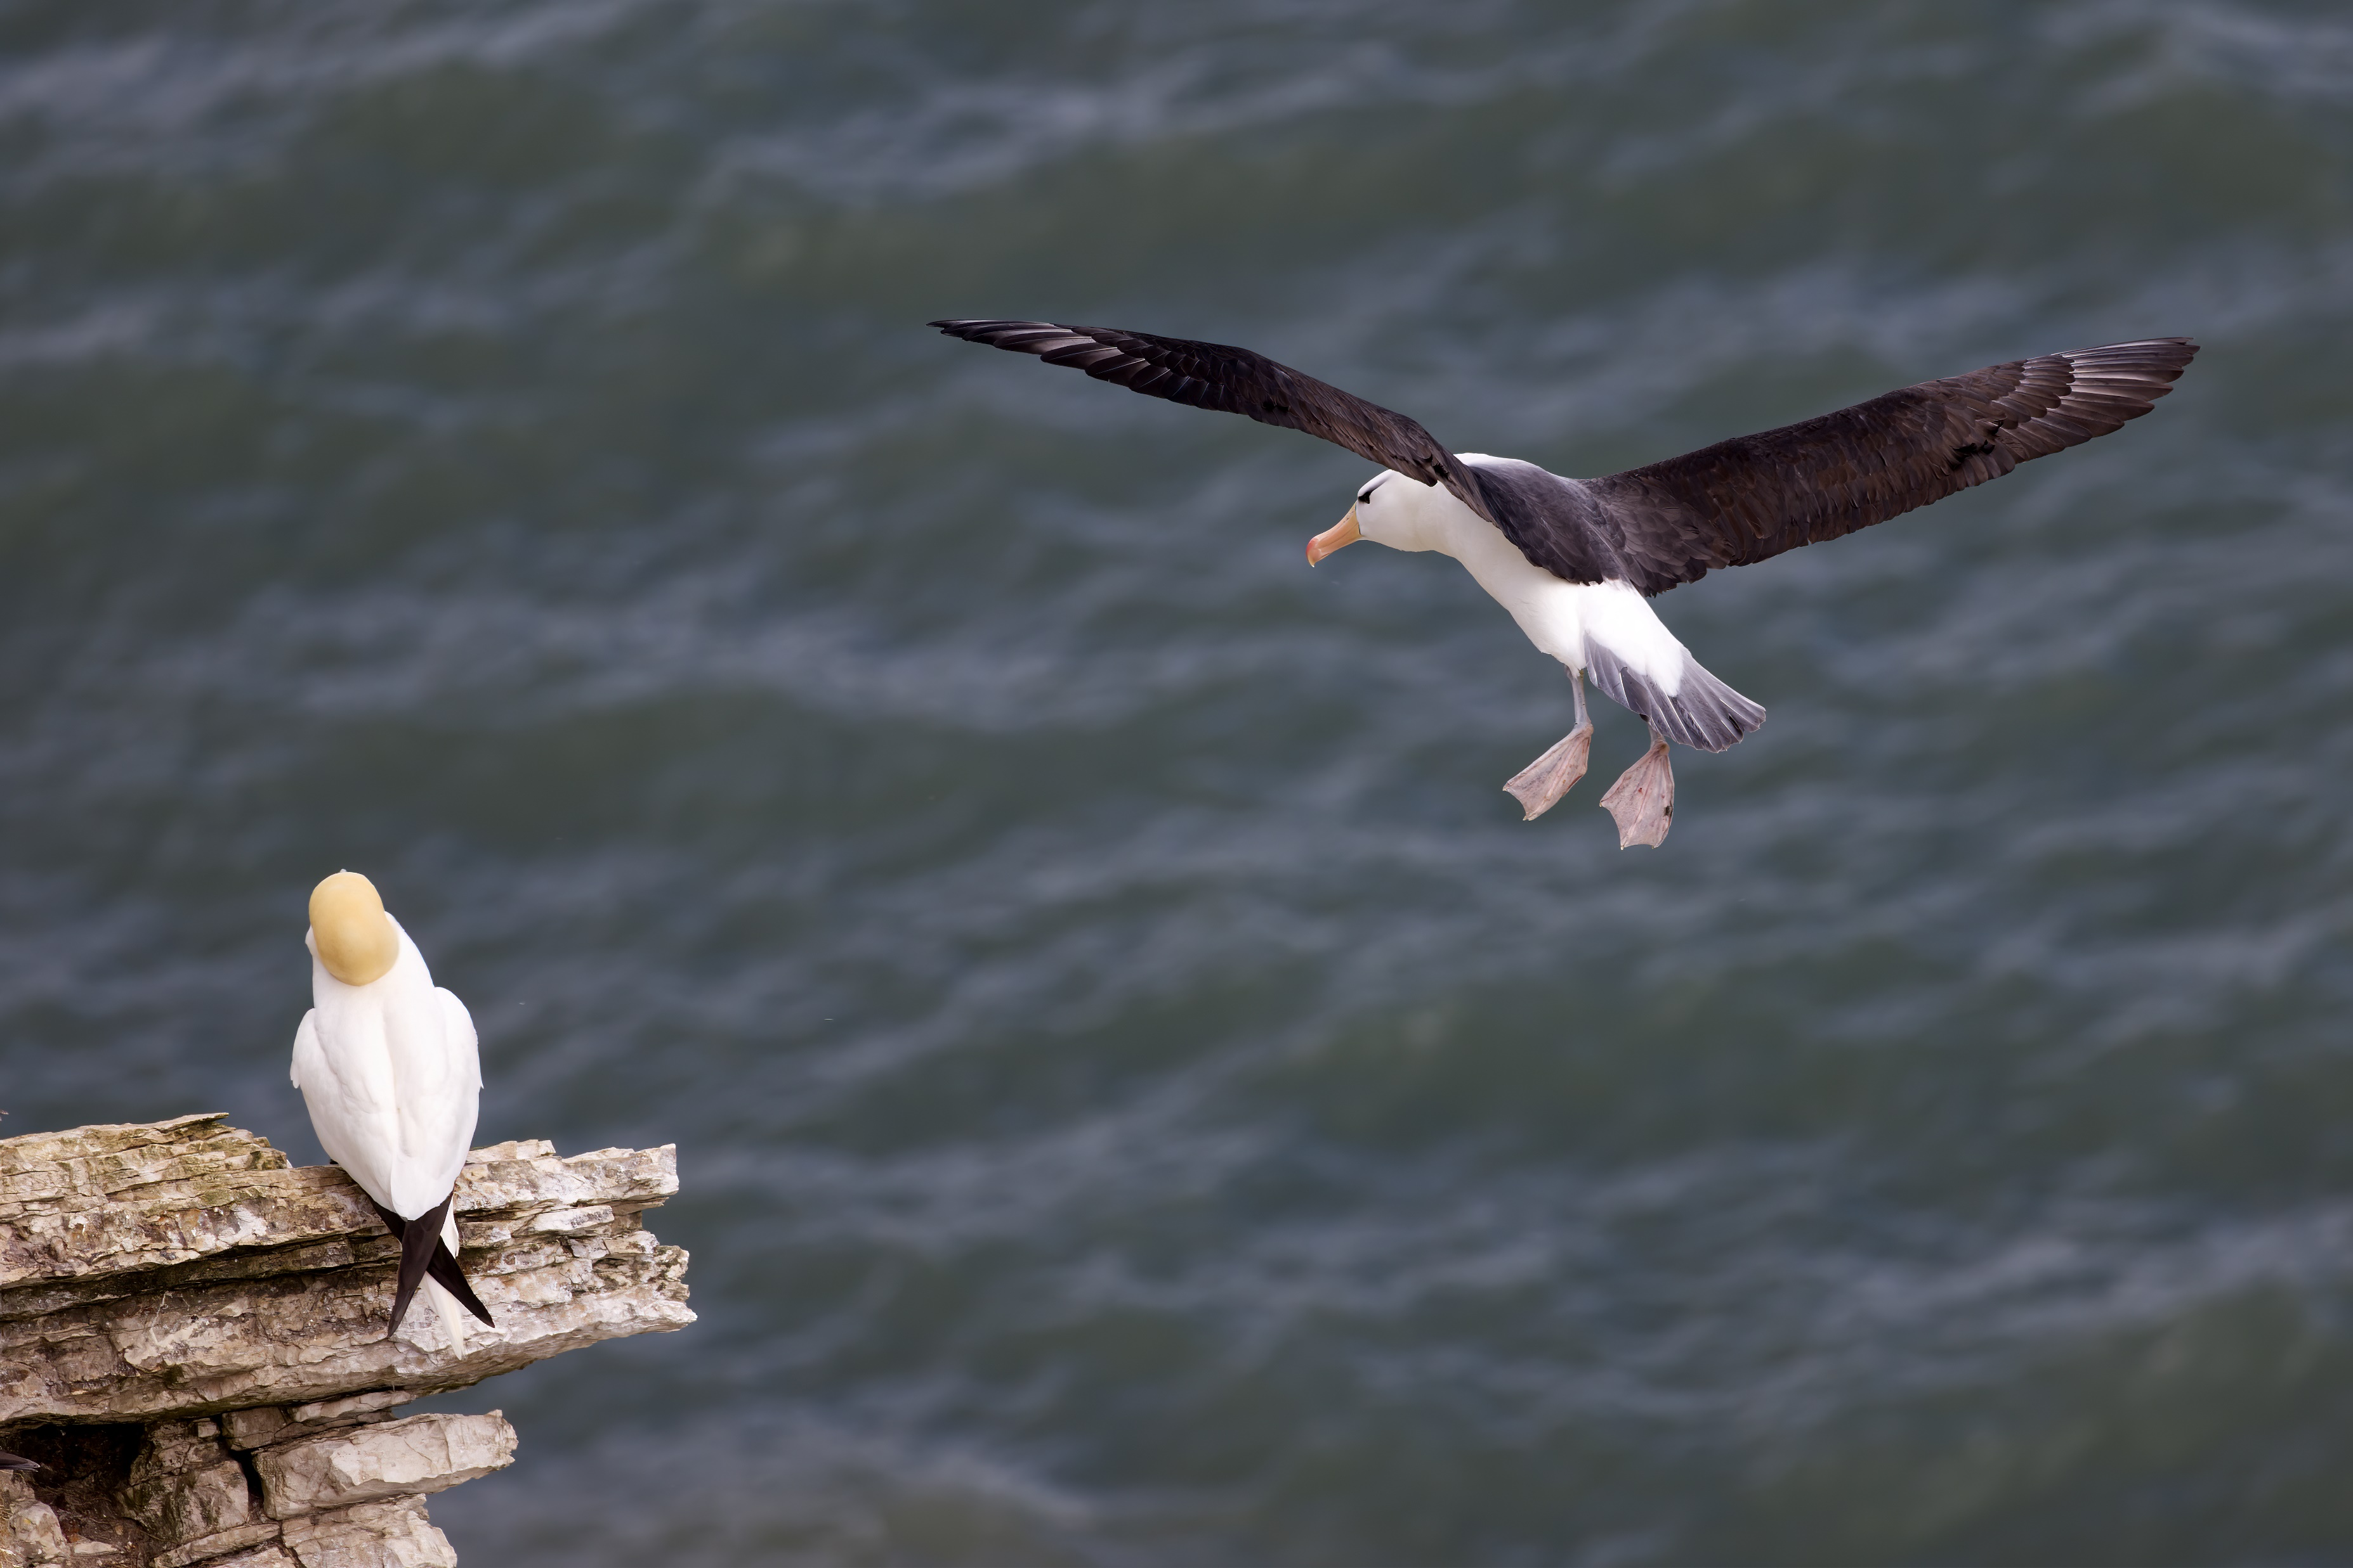

Slide 25
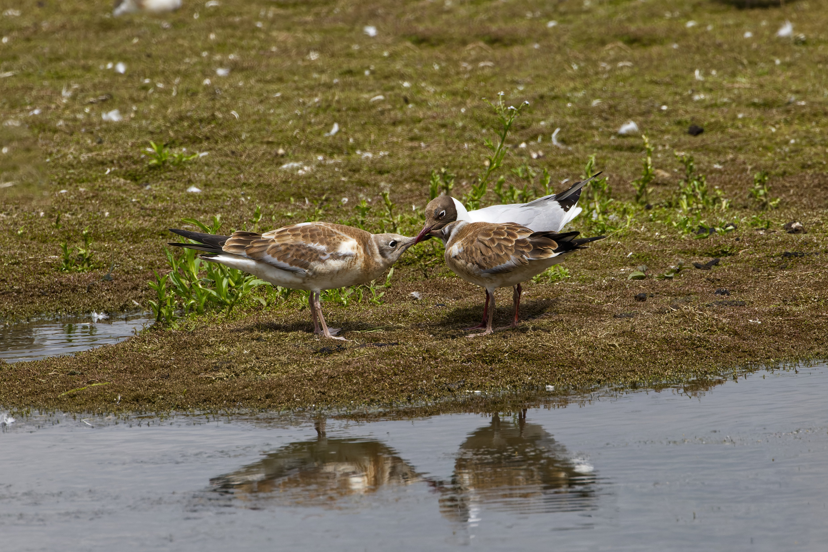

Slide 26
Settings:
- Fast shutter speeds
- Aperture depends on what you want bird or bird + environment
-ISO may need to high!
-Zoom/Long lens

Slide 27
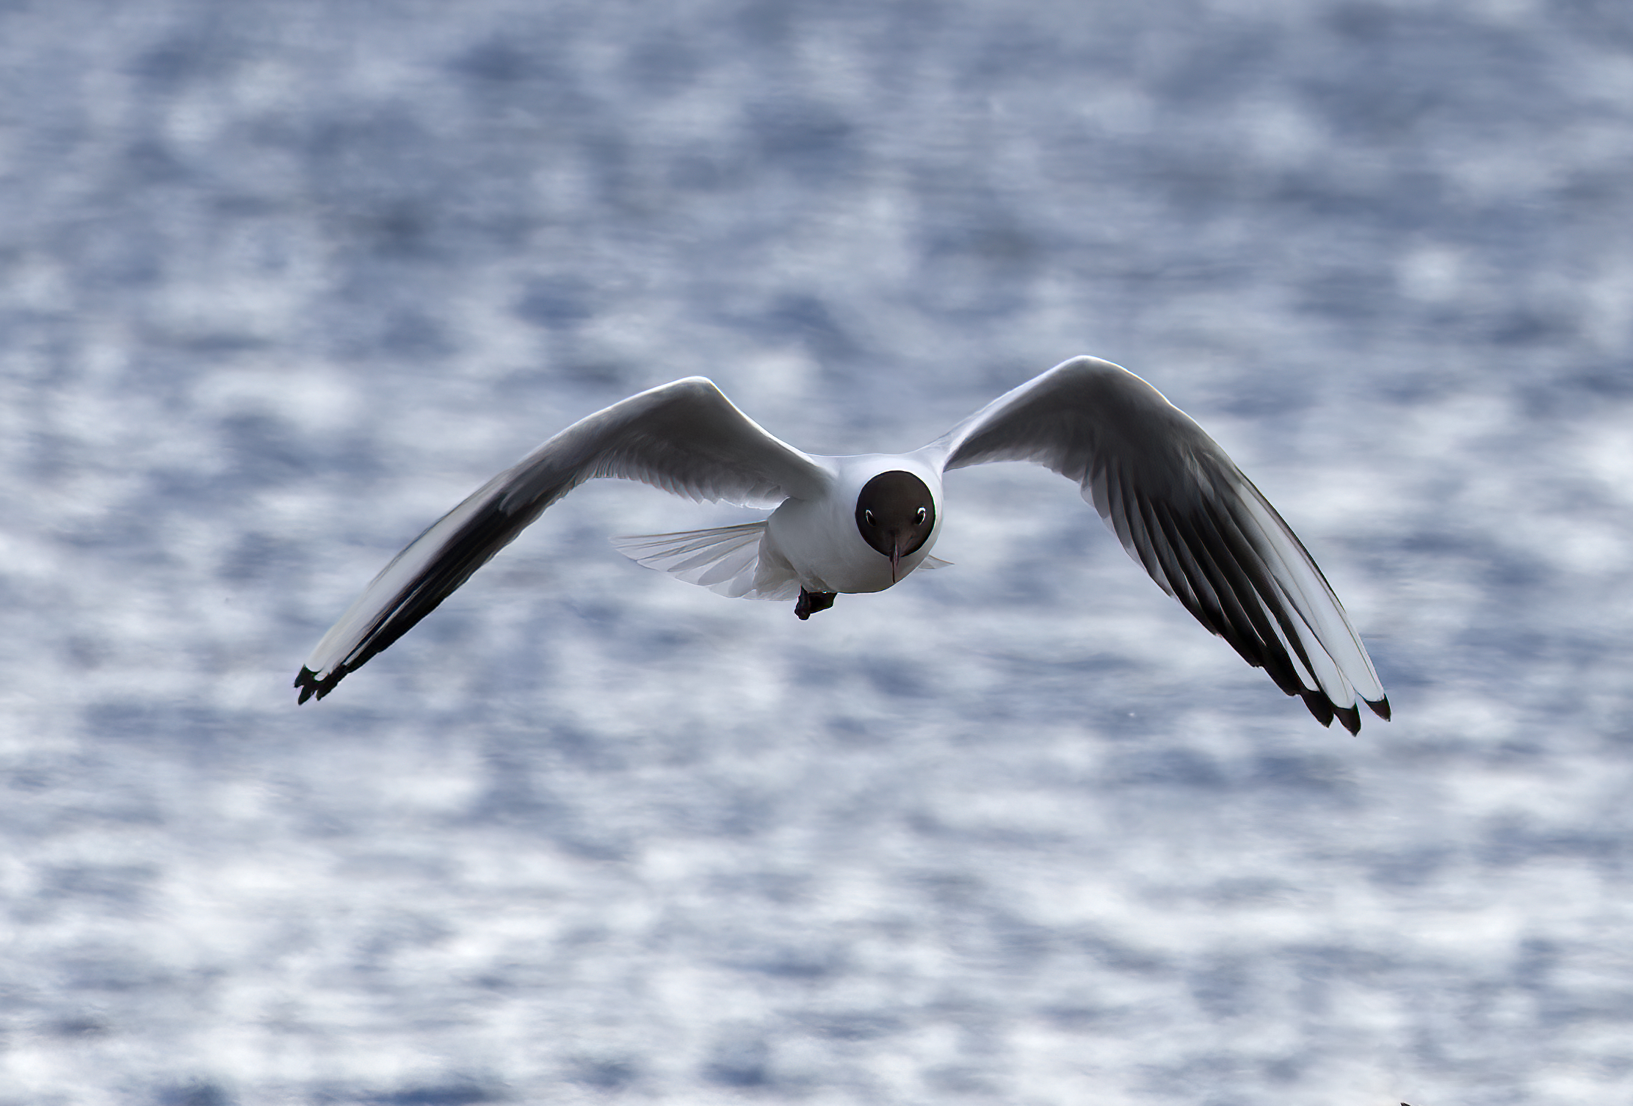

Slide 28
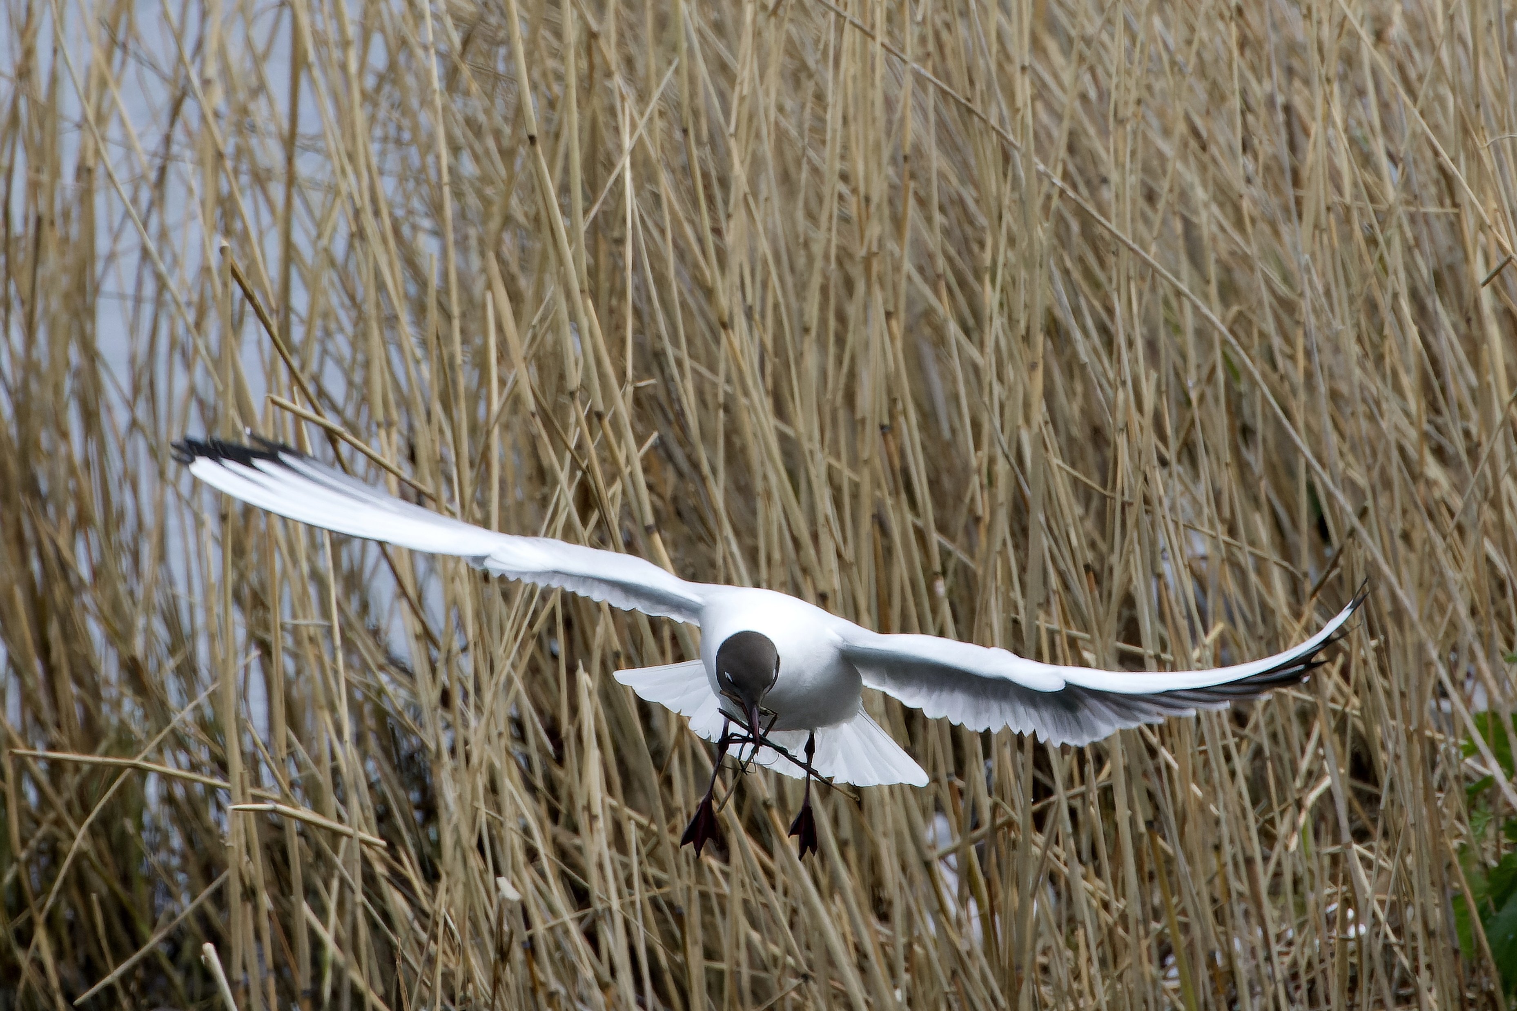

Slide 29
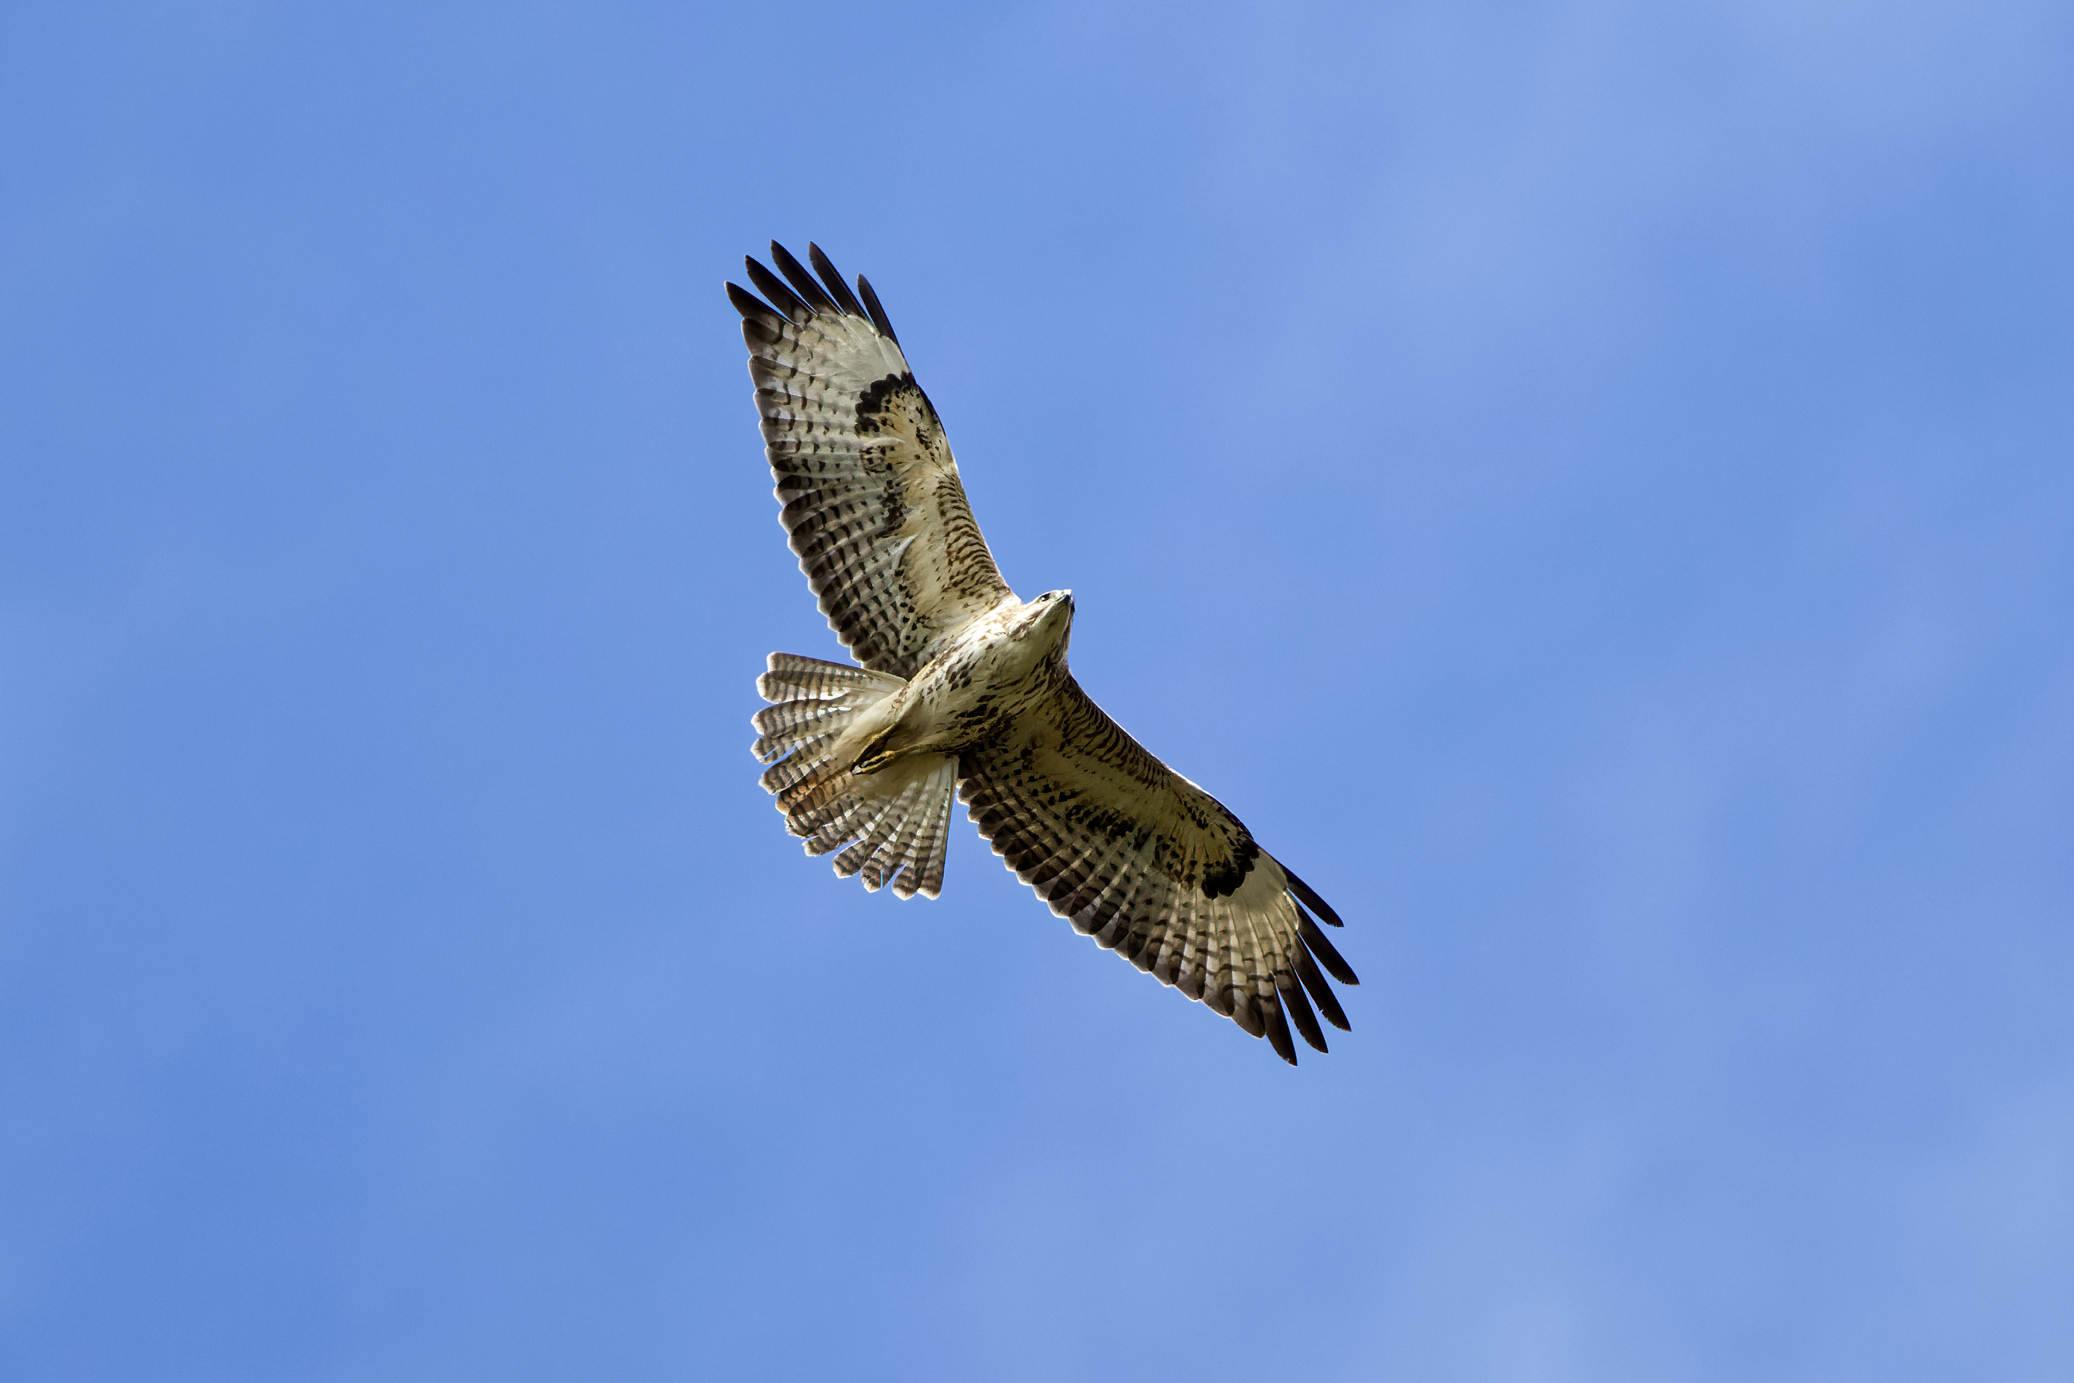

Slide 30
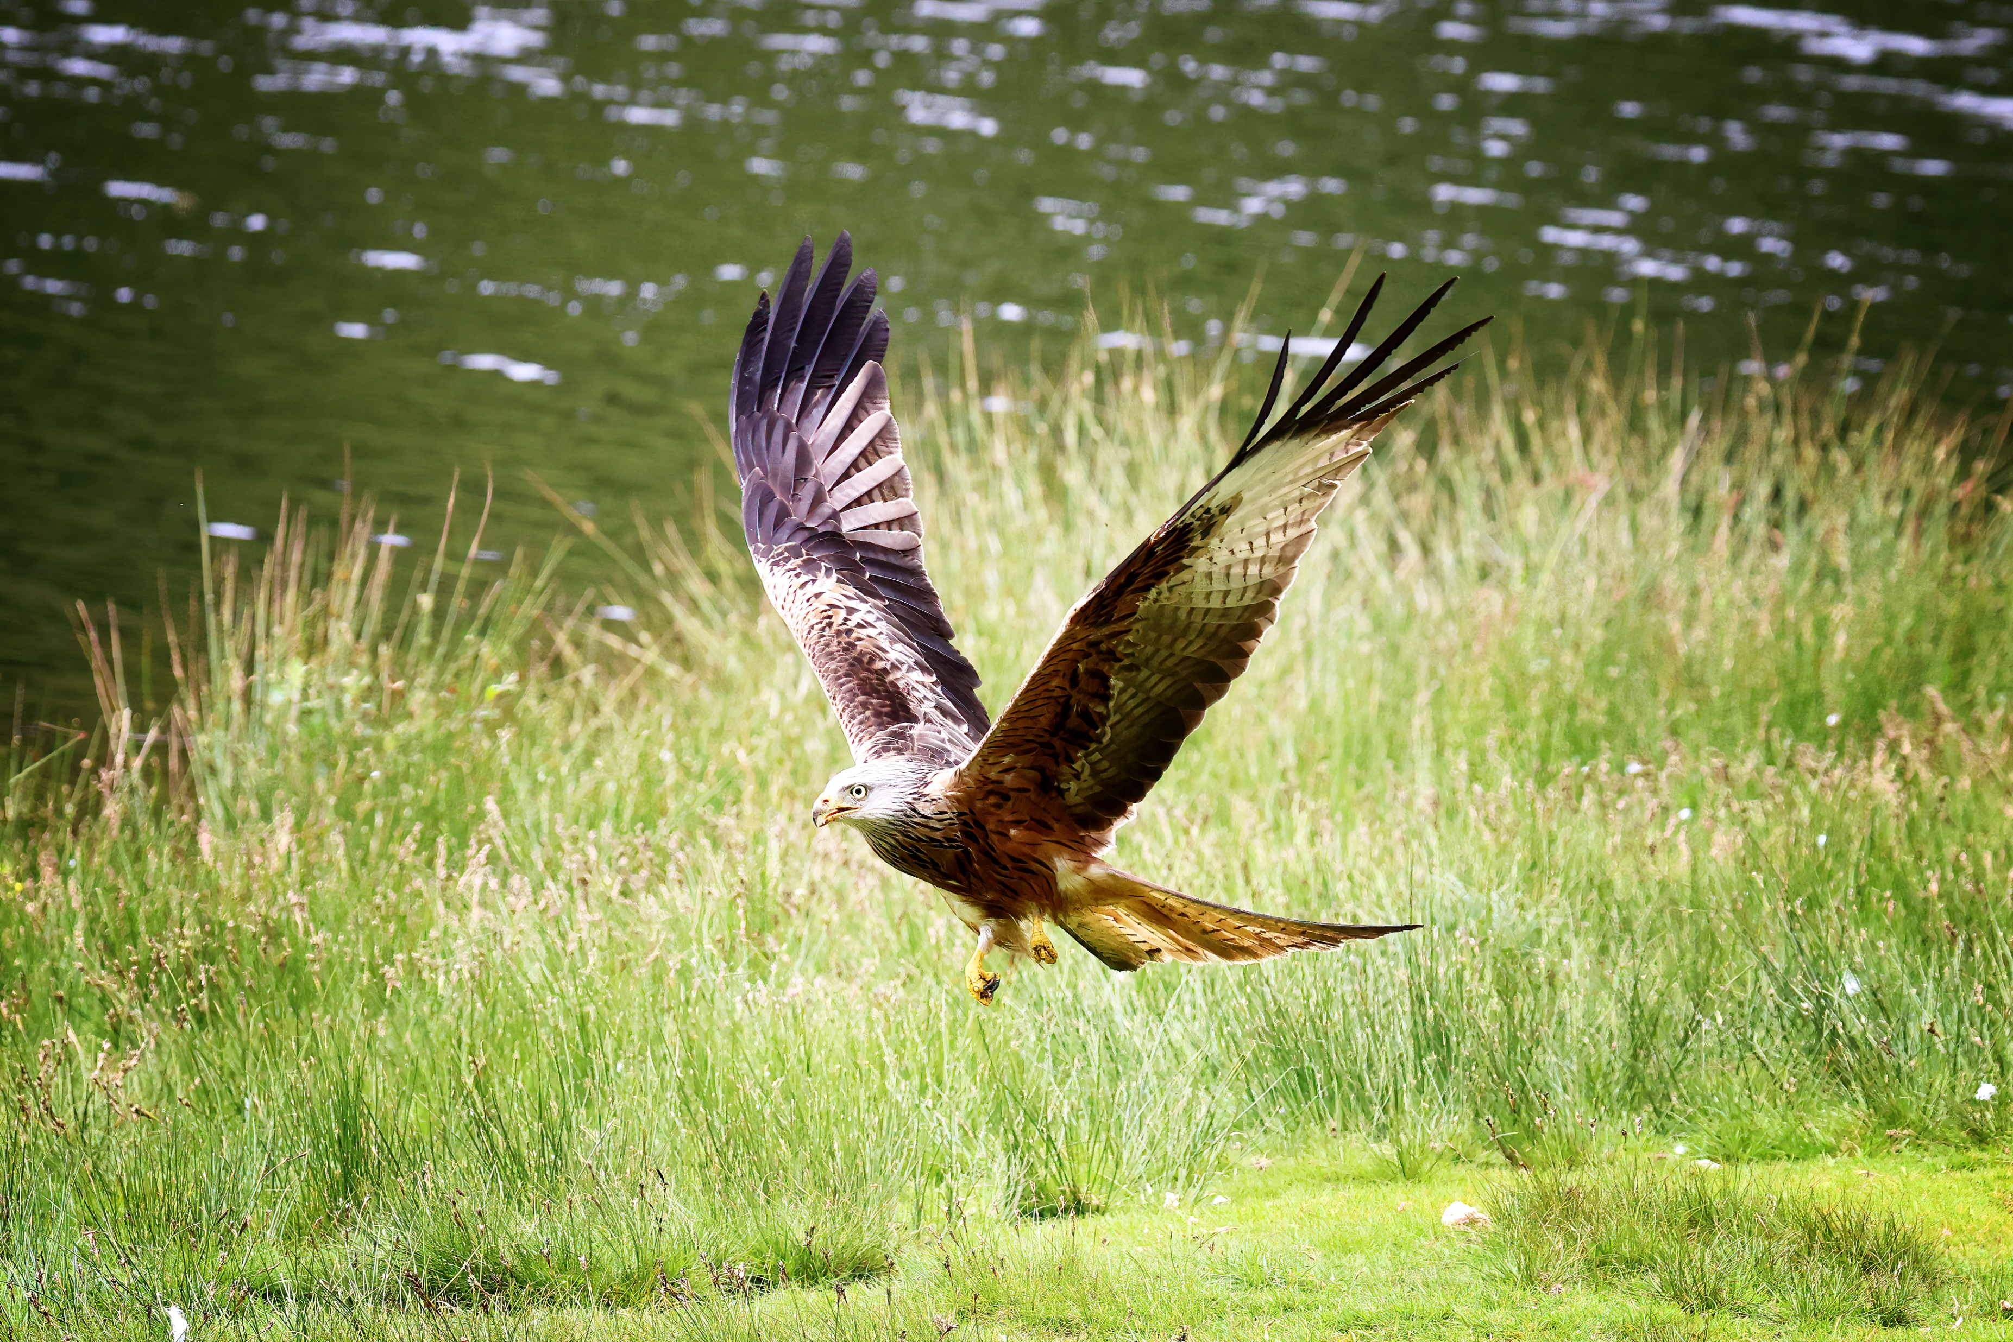

Slide 31
Camera:
- Zoom/Long lens
- Need to be able to change settings quickly
- Burst mode is great

Slide 32
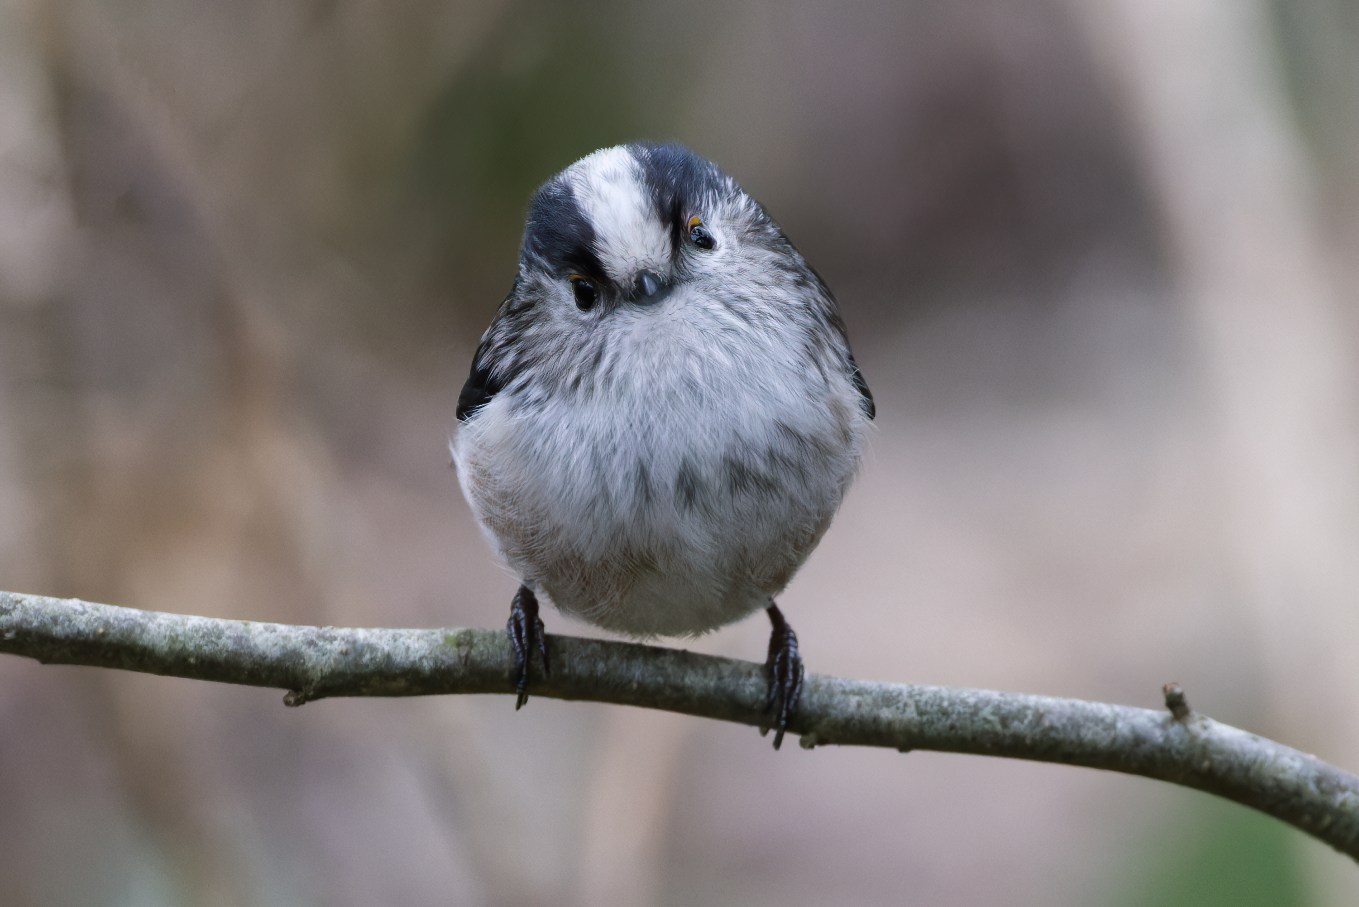

Slide 33
Skills:
- Get to know the bird/species
- Get to know the habitat
- Practice/try new techniques

Slide 34
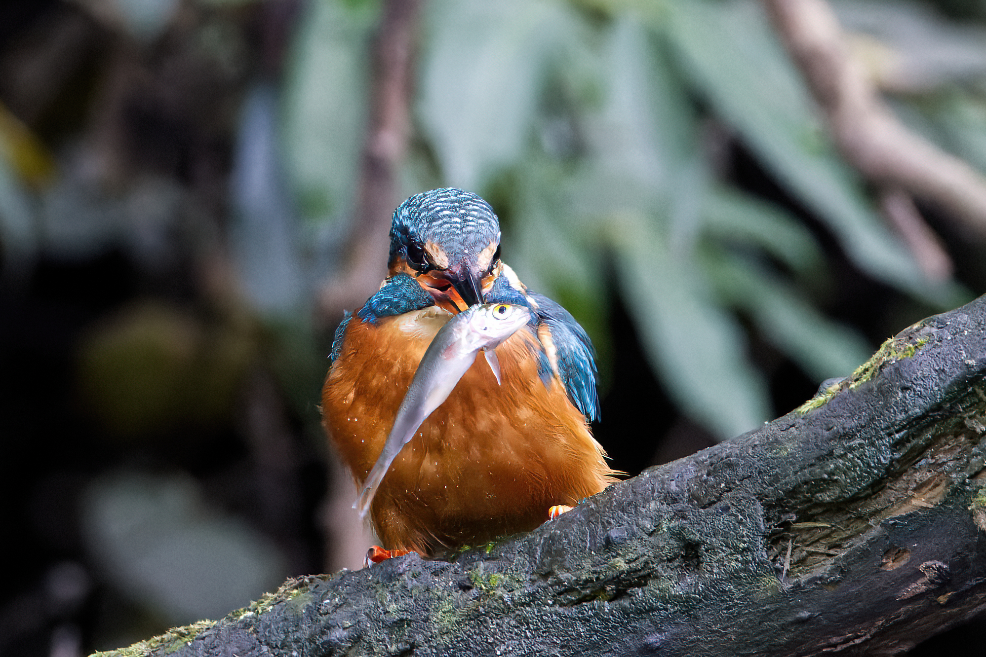

Slide 35
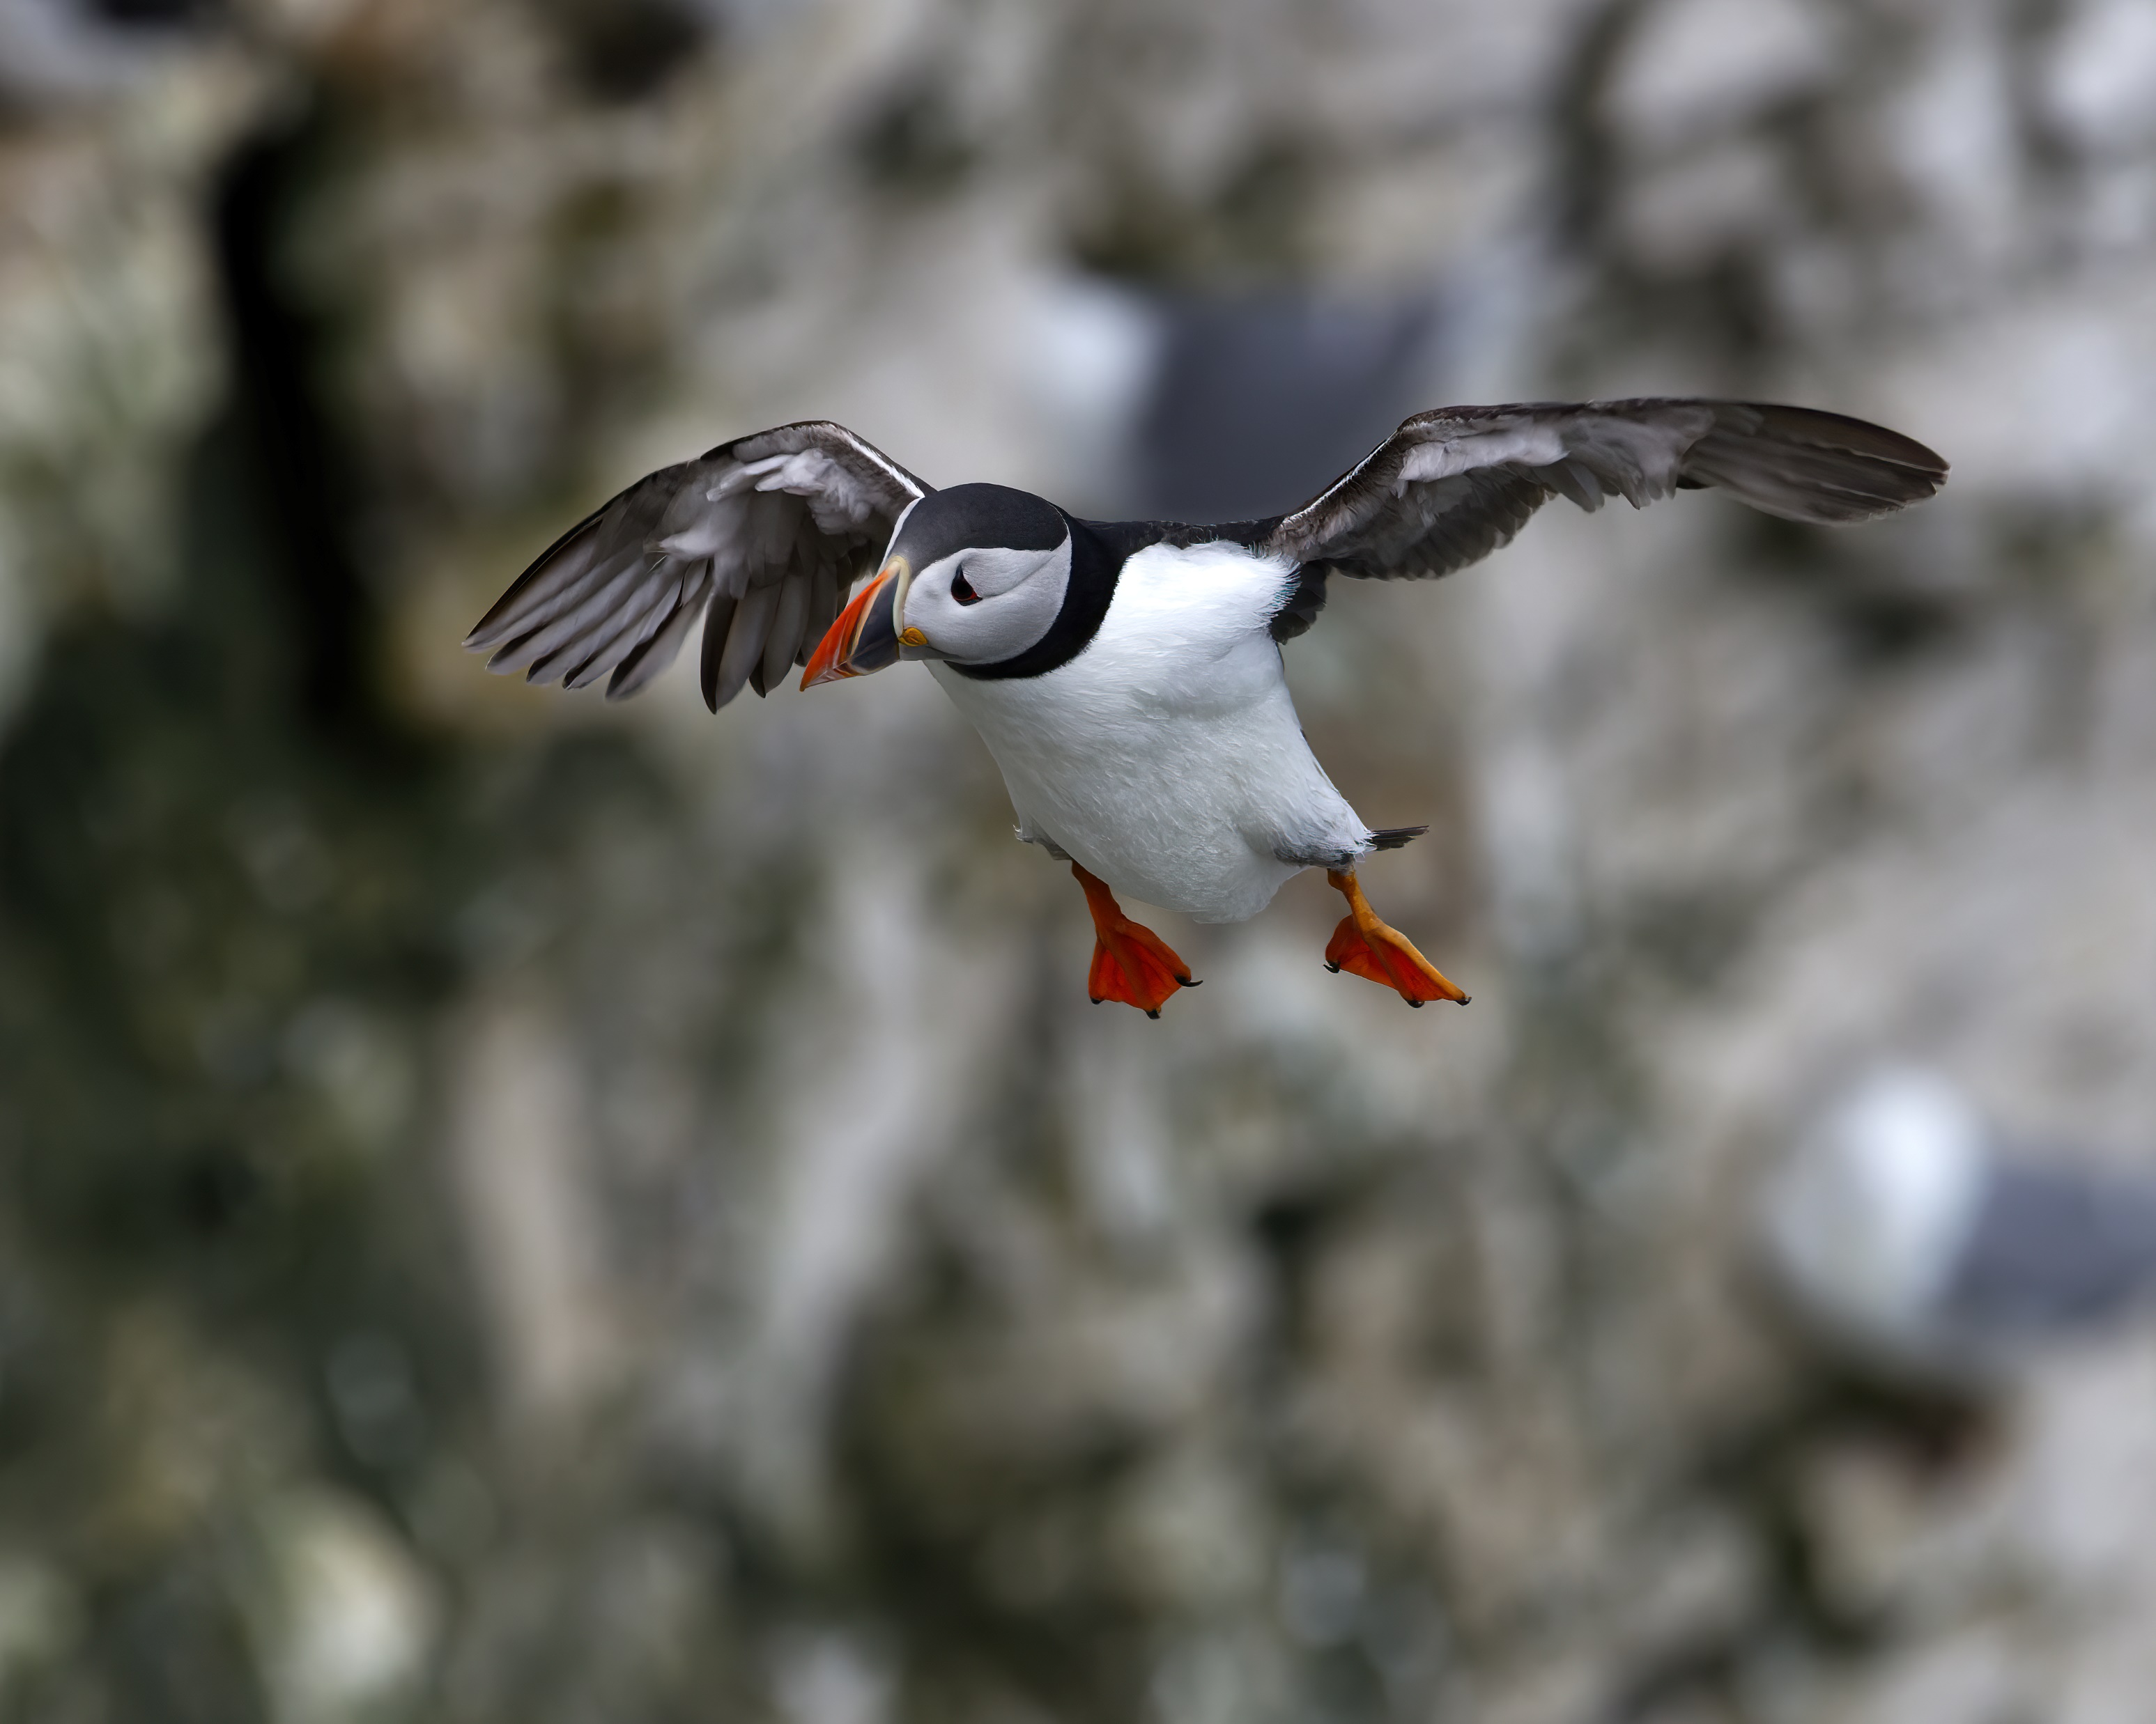

Slide 36
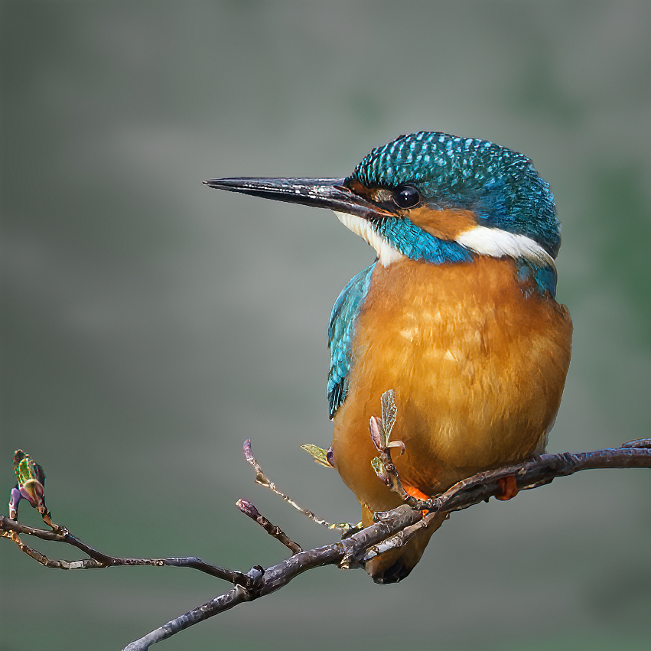

Slide 37
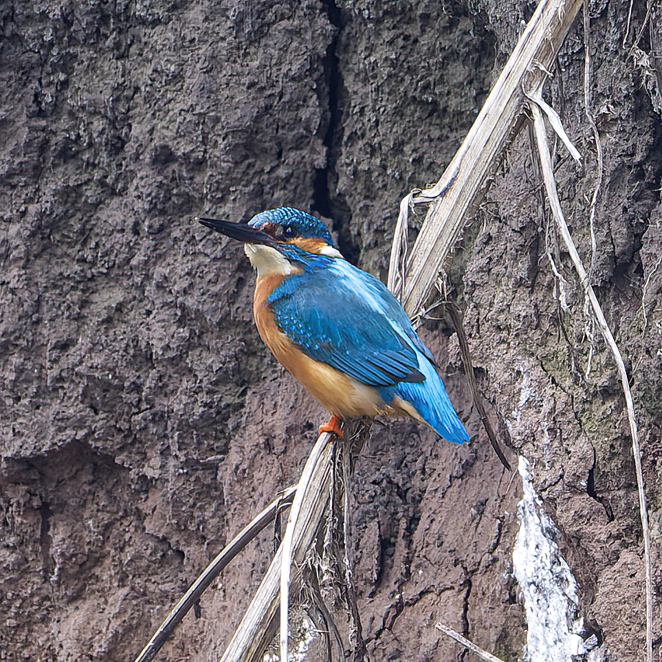

Slide 38
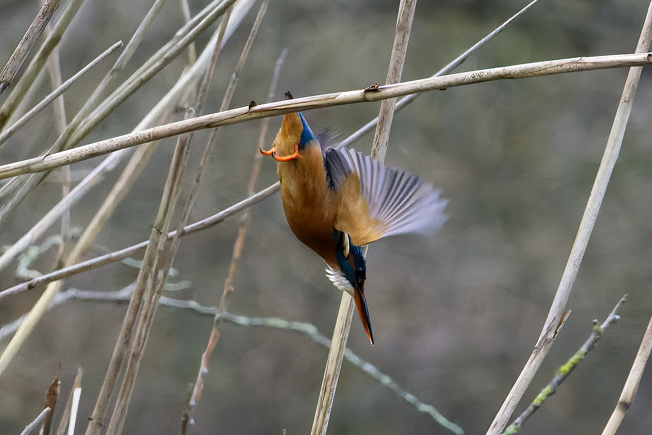

Slide 39
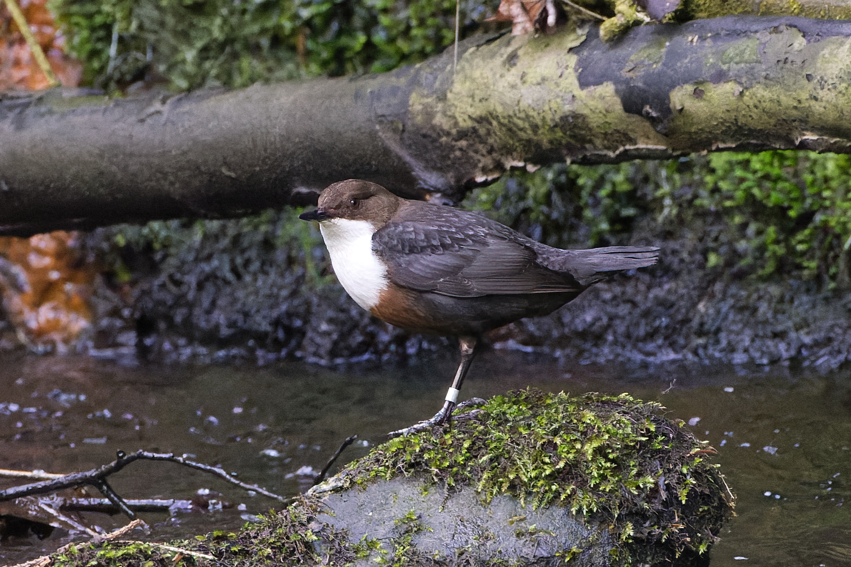

Slide 40
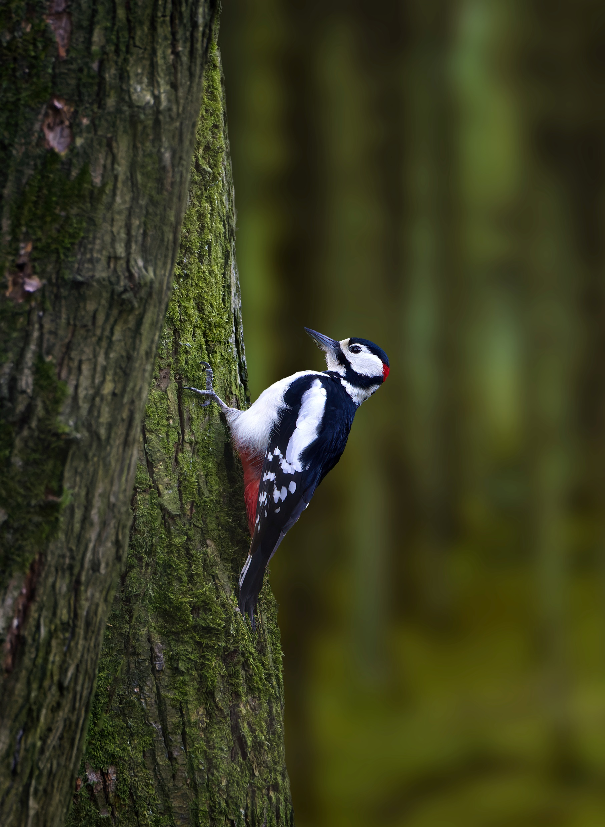

Slide 41
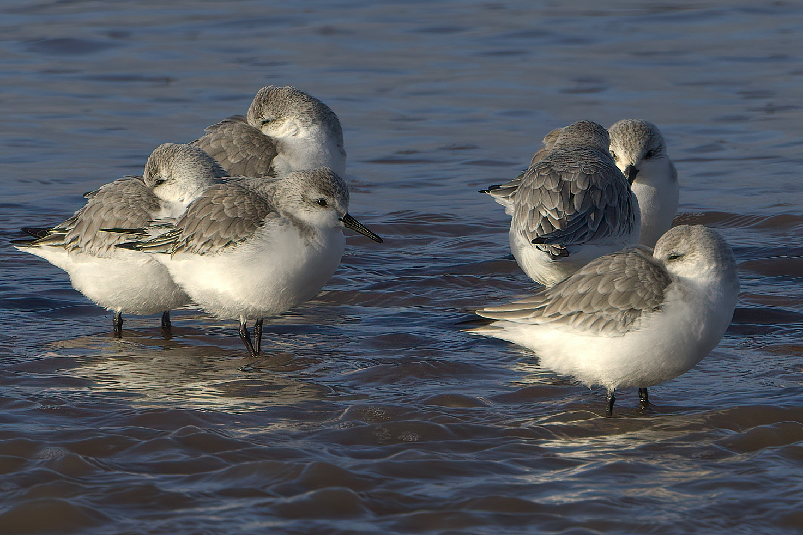

Slide 42
Where to go:
- Garden
- Woodlands
- Nature Reserves RSPB/Staffordshire Wildlife Trust
- JCB
- Further afield Bempton Cliffs (Yorkshire)
Norfolk etc.

Slide 43
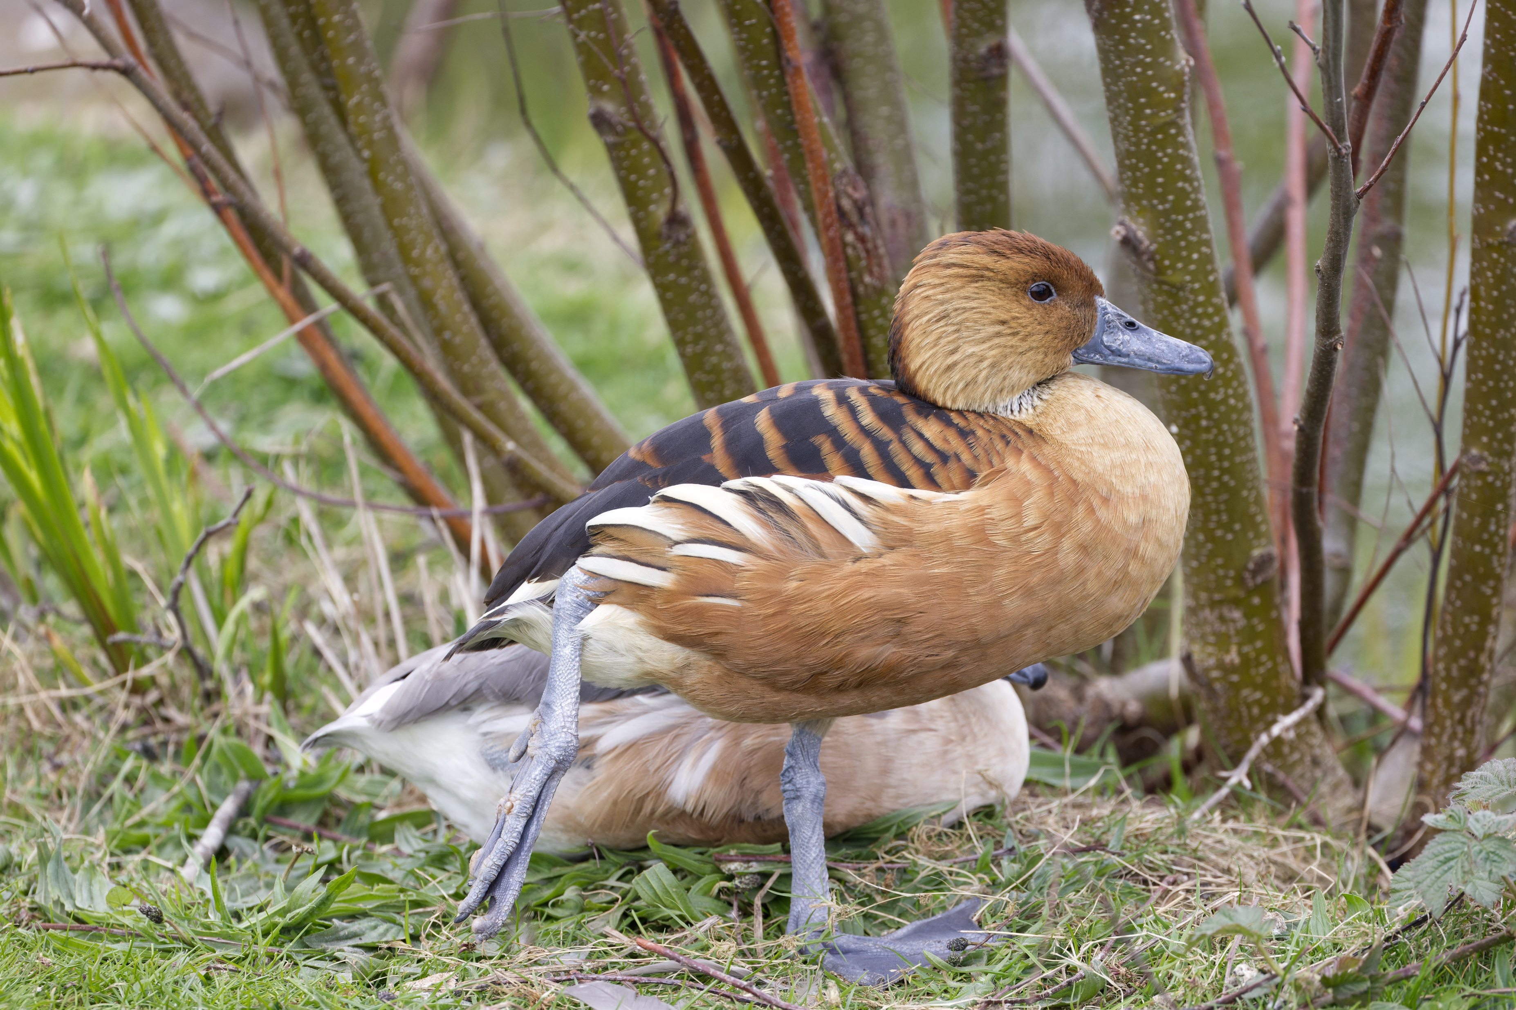

Slide 44
Where to go:
- RSPB Middleton Lakes
- Wolsey Bridge
- Gentleshaw Common (Burntwood)
- George Hayes (Upper Longdon)
- Croxtall Lakes (Alrewas)
- Barton Marina

Slide 45
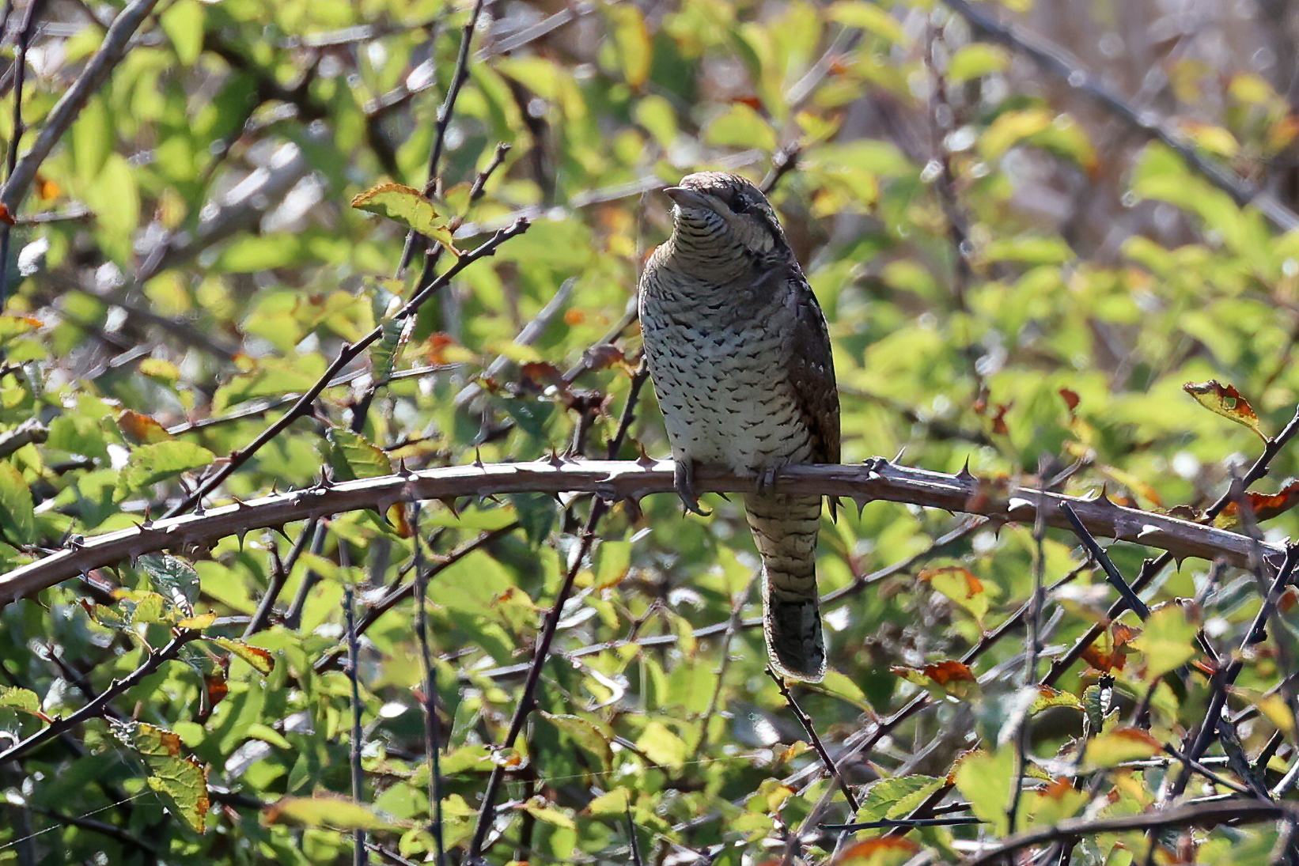

Slide 46
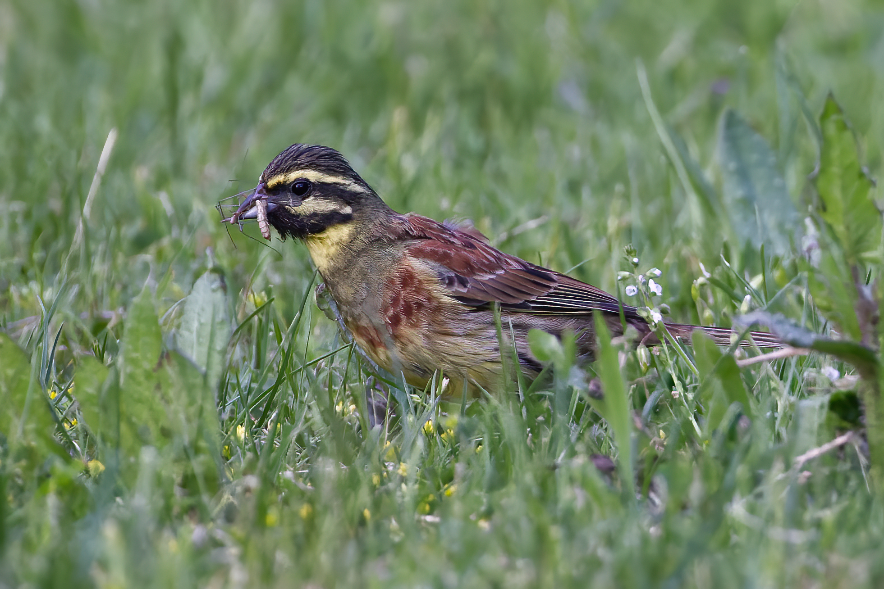

Slide 47
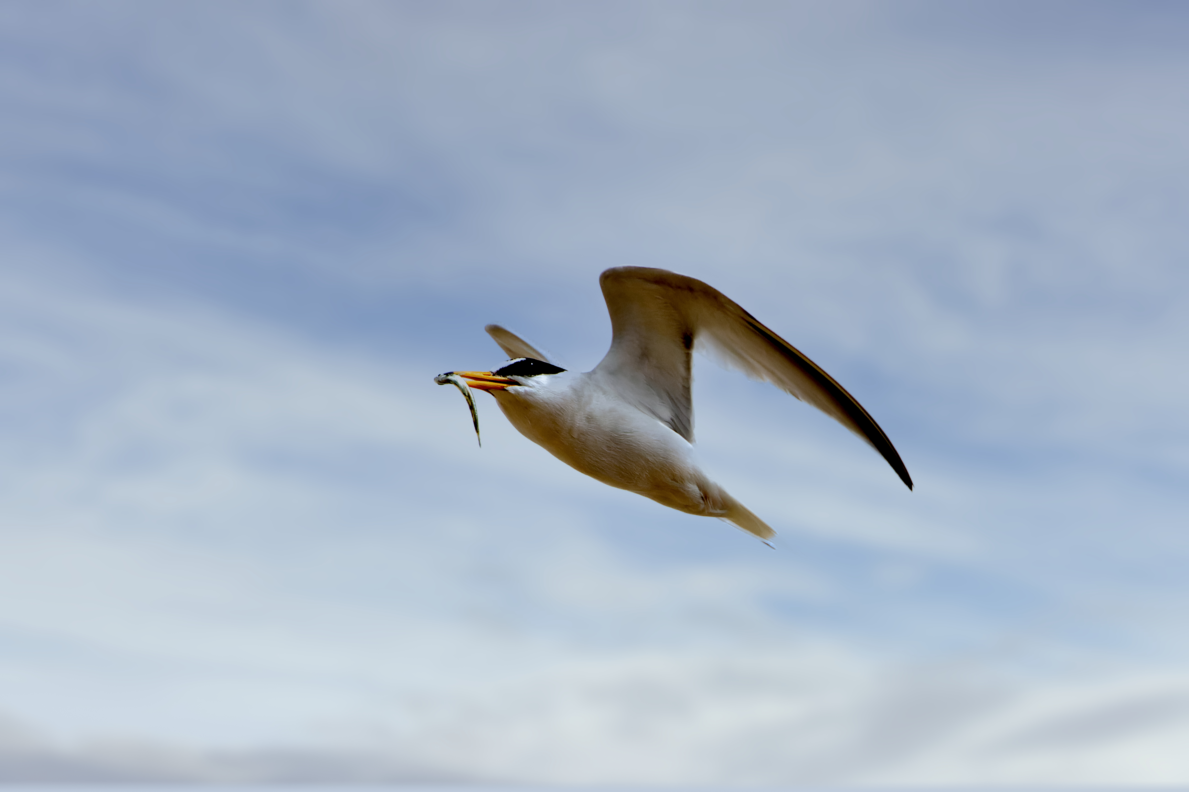

Slide 48
