Slide 1

Genetic Modification
Friend or Foe?
David Raybould Burntwood u3a

Slide 2
Genetic Modification
During the presentation we will look at basic genetics (how the characteristics of all living creatures are defined)
How humankind has sought to change those characteristics for its own benefit.
The benefits and drawbacks of Genetically Modified foods

Slide 3
Genetic Modification
Basic Genetics
(don’t panic it’s very basic)

Slide 4
Genetic Modification
• Genome – the collection of genetic information that defines the structure and function of the organism.
In humans the genome consists of about 21,000 genes around 99.9% are identical only 0.1% unique to the individual.

Slide 5
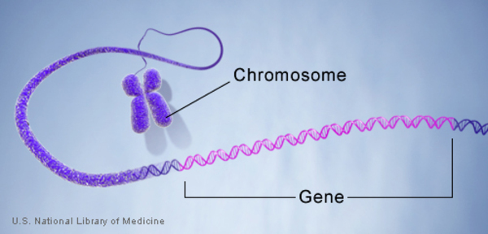
Genetic Modification
• Gene – basic unit of genetic information. Genes determine the inherited characteristics.

Slide 6
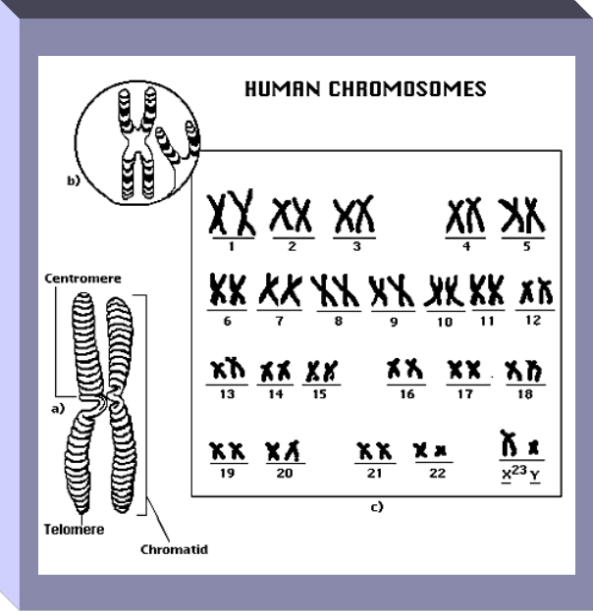
Genetic Modification
. • Chromosomes are the storage units of genes.
DNA tightly wound around spool-like proteins, unwound, end-to-end, they would stretch 6 feet.

Slide 7
Genetic Modification
In humans there are 22 pairs of numbered chromosomes (autosomes) and one pair of sex chromosomes
XX = Female - 900 genes
XY = Male - 55 genes

Slide 8
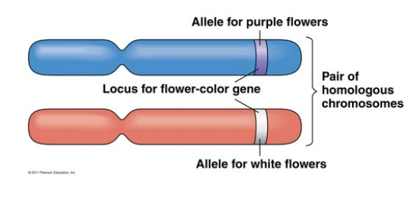
Genetic Modification
Allele = one of two or more different versions of a gene

Slide 9
Genetic Modification
An individual inherits two alleles, one from each parent.
Two alleles the same = homozygous for that allele.
Two alleles are different = heterozygous.

Slide 10
Genetic Modification
Alleles are responsible for expressing traits such as hair colour or eye colour.
They can be dominant where only one of the pair needs to be present to express the trait or
Recessive where both alleles are needed to express the trait

Slide 11
Genetic Modification
• DNA - is a nucleic acid that contains the genetic instructions specifying the biological development of all cellular forms of life.
1. DNA Replicates (makes copies of itself)
2. Encodes information (for proteins to be made)
3. Controls & instructs cells
4. Responsible for Mutations (molecule of heredity)

Slide 12
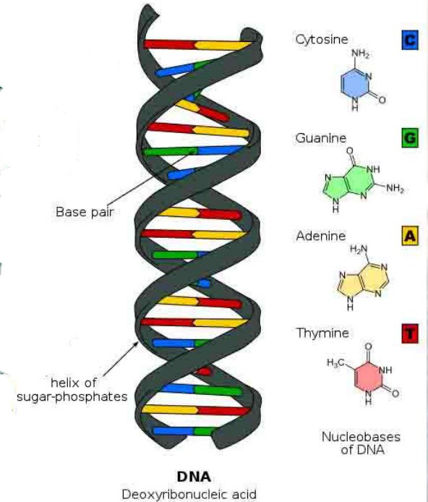
Genetic Modification
DNA - a pair of molecules joined by hydrogen bonds: it is organized as two complementary strands, head-to-toe, with the hydrogen bonds between them.

Slide 13
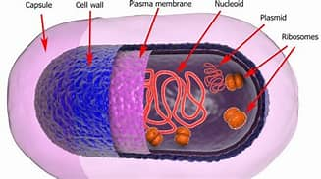
Genetic Modification
Plasmids are tiny circles of DNA that live inside bacteria and other microbes, separate from their main chromosomes.

Slide 14
Genetic Modification
They can carry genes for useful traits, such as antibiotic resistance, and transfer them between cells
Plasmids can be used to insert, modify, or delete genes of interest and using bacteria to manufacture proteins, vaccines, or enzymes.
= DNA VECTOR

Slide 15
Genetic Modification
How humankind has sought to change the characteristics of plants and animals for its own benefit.

Slide 16
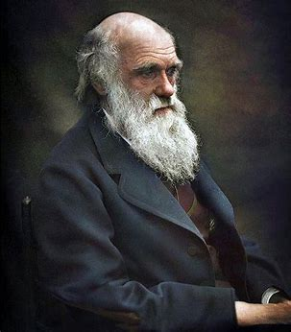
Genetic Modification
Darwin’s law
Most characteristics in the population must be inherited, more offspring must be produced than can survive, and the fittest offspring must be more likely to survive and reproduce.

Slide 17
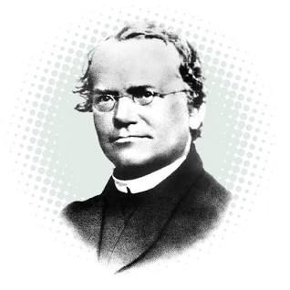
Genetic Modification
Modern plant breeding only dates from the scientific discoveries on genetics of Gregor Mendel published in 1865

Slide 18
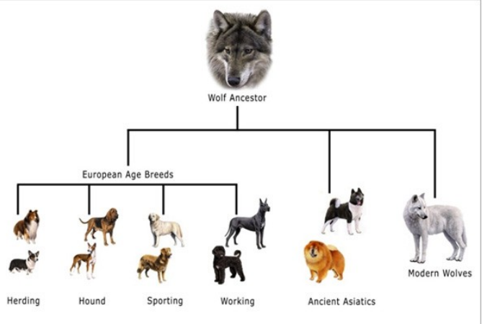
Genetic Modification
Crops, farmed and domesticated animals today are a product of selective breeding.

Slide 19
Genetic Modification
Another example might be an apple grower would like to produce a type of apple which tastes good
but is also resistant to disease. They could do this by crossing a variety of apple known for taste with another type which shows strong resistance to disease.

Slide 20
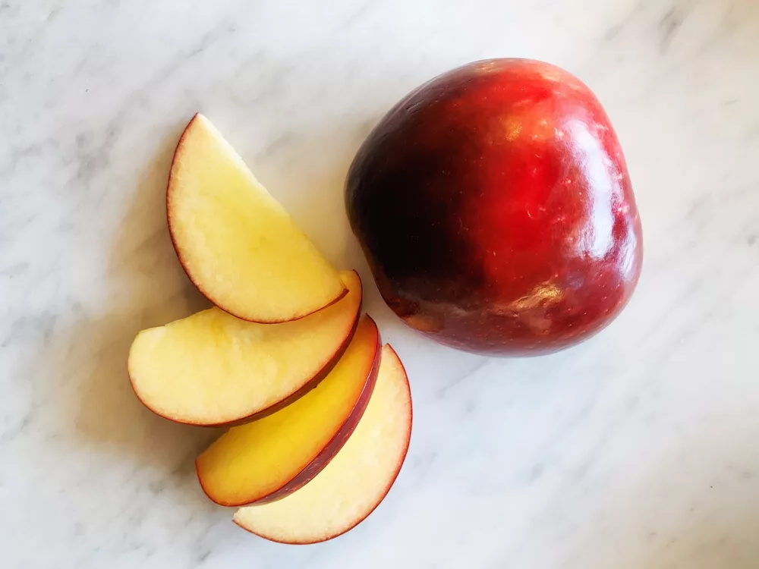
Genetic Modification
Once you know the traits you want, you have to find the right parents.
Apples are not self-fruitful (cannot produce fruit from their own pollen) meaning that in order to get a single apple, you have to pollinate one kind of tree with the pollen from another kind. The Cosmic Crisp, for example, is a cross between the Honeycrisp and Enterprise varieties.

Slide 21
Genetic Modification
Risks of selective breeding include:
Reduced genetic variation can lead to attack by specific insects or disease
Rare disease genes can be unknowingly selected as part of a positive trait
Can create physical problems in specific organisms, e.g. large dogs can have faulty hips due to not being formed correctly

Slide 22
Genetic Modification
Selective breeding also has its limitations and can be a very lengthy and uncertain process.
Enter Genetic Engineering and Genetic Modification

Slide 23
Genetic Modification
Mutations: a change in the coding of a gene
It is a process which occurs naturally either from errors in DNA replication or from the damaging effects of mutagens, such as chemicals and radiation, which react with DNA. May lead to desirable or undesirable changes in the organism.

Slide 24
Genetic Modification
1. Deletion: cell accidentally omits a piece of the
DNA
2. Duplication: cell accidentally makes an extra
copy of the DNA piece
.

Slide 25
Genetic Modification
3. Insertion: cell accidentally adds a piece of
DNA
4. Translocation: cell accidentally puts a piece of
genetic sequence in the wrong place.

Slide 26
Genetic Modification
Through Genetic Modification: humans can combine or alter sections of DNA in order to produce offspring with a specific characteristics that are useful to man.

Slide 27
Genetic Modification
Recombinant DNA technology
1. genes are engineered by scientists into organisms such as microbes or bacteria, for mass-production
2. insertion of select genes into organisms to improve their genotype

Slide 28
Genetic Modification
Example
Since the 1970’s we have been able to put genes into bacteria to make human insulin for diabetics.
The Insulin is then separated from the bacteria & given to diabetics.

Slide 29
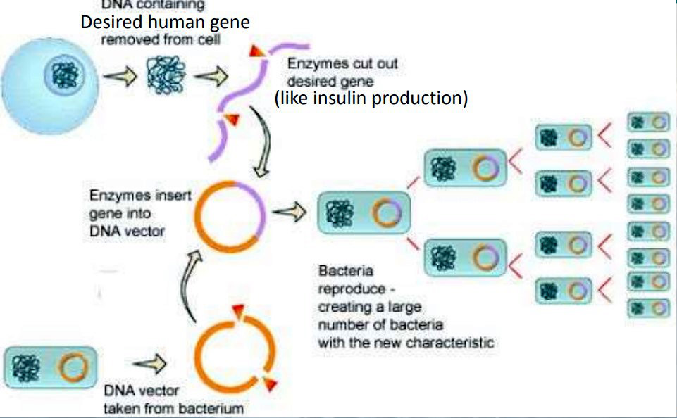
Genetic Modification

Slide 30
Genetic Modification
Other techniques can be used to insert genetic material in a cell other than using plasmids!
Such as the Gene Gun!

Slide 31
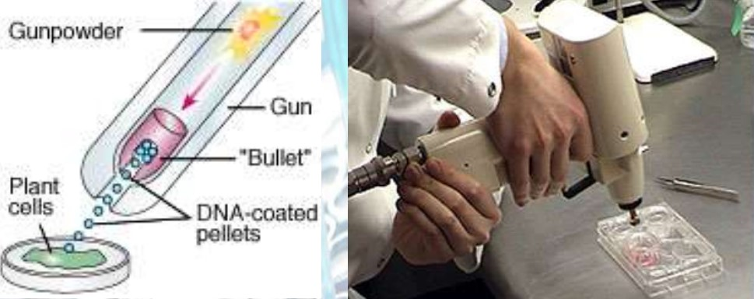
Genetic Modification

Slide 32
Genetic Modification
Using techniques such as these a whole range of genetically modified organisms or even new organisms can be created.
These can have great benefits to mankind or potentially serious drawbacks.

Slide 33
Genetic Modification
Improved taste,
Higher quality,
User acceptability increases
Increase preference for a brand,
Offer valuable nutrients i.e. rice rich in Vit A
Disease resistance,
Pest resistance

Slide 34
Genetic Modification
Improved taste,
Higher quality,
User acceptability increases
Increase preference for a brand,
Offer valuable nutrients i.e. rice rich in Vit A
Disease resistance,
Pest resistance

Slide 35
Genetic Modification
Less time to mature
Increased profitability
Protected from adverse weather conditions
Drought, frost, etc.
Drought resistant crops.
Salt-tolerant crops.
Development of crops that make more efficient use of nitrogen and other nutrients.

Slide 36
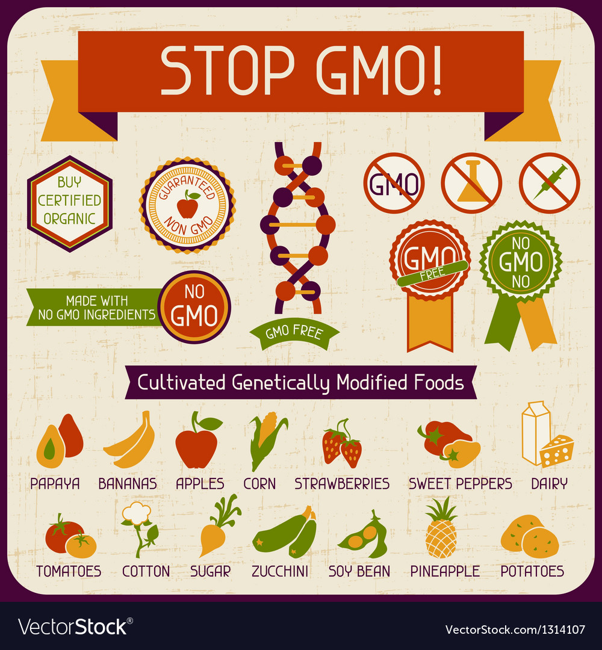
Genetic Modification

Slide 37
Genetic Modification
Allergens (peanuts)
transfer of antibiotic resistance markers
Loss of biodiversity
Genetic transfer to Non target species creating Super weeds or Super Pests

Slide 38
Genetic Modification
Popular local varieties lose their identity and existence.
Extinction of traditional varieties
Violation natural organisms
Tampering nature
Objections to consuming animal genes in plants
Unknown effects

Slide 39
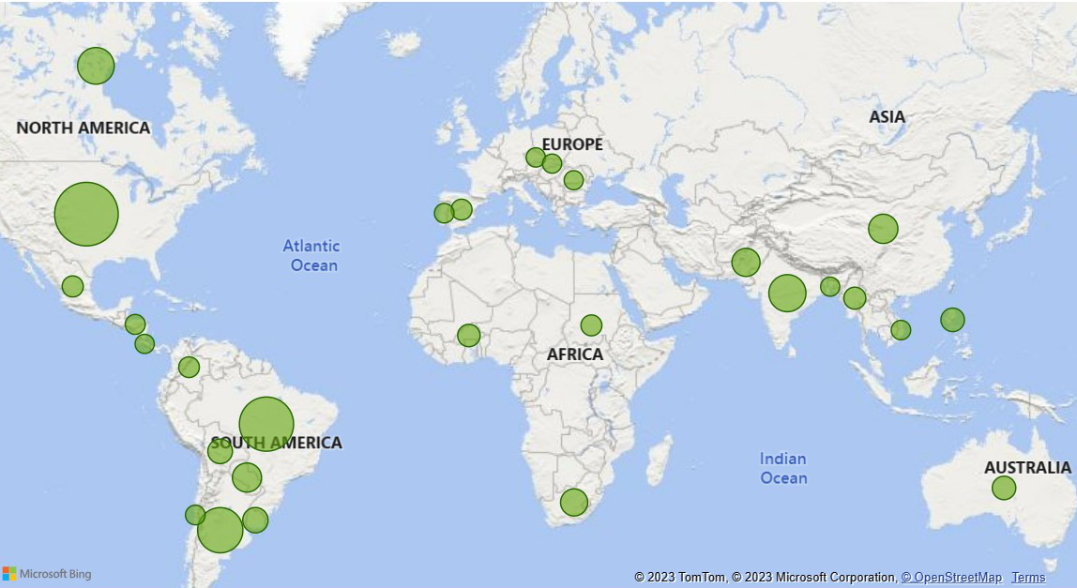
Genetic Modification
Worldwide use of GM foods is expanding rapidly

Slide 40
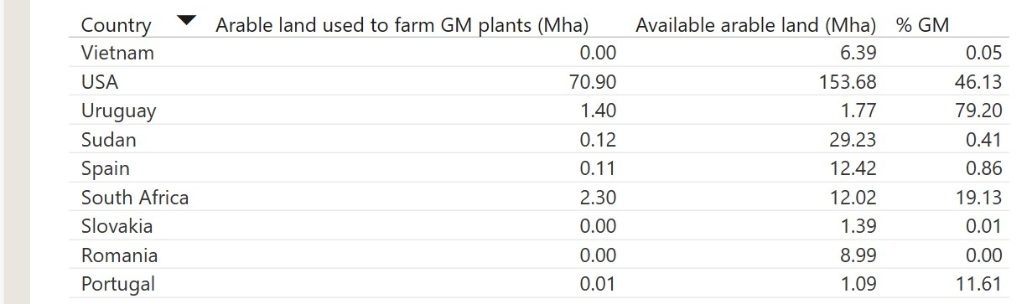
Genetic Modification

Slide 41
Genetic Modification
At present, there are no commercial GM crops grown in the United Kingdom
BUT If you buy:
non-organic eggs,
milk,
yoghurt,
cheese,
meat or
farmed fish
from UK supermarkets, the chances are the animals behind those products were fed GM feed.

Slide 42
Genetic Modification
Thank you for listening

