Slide 1
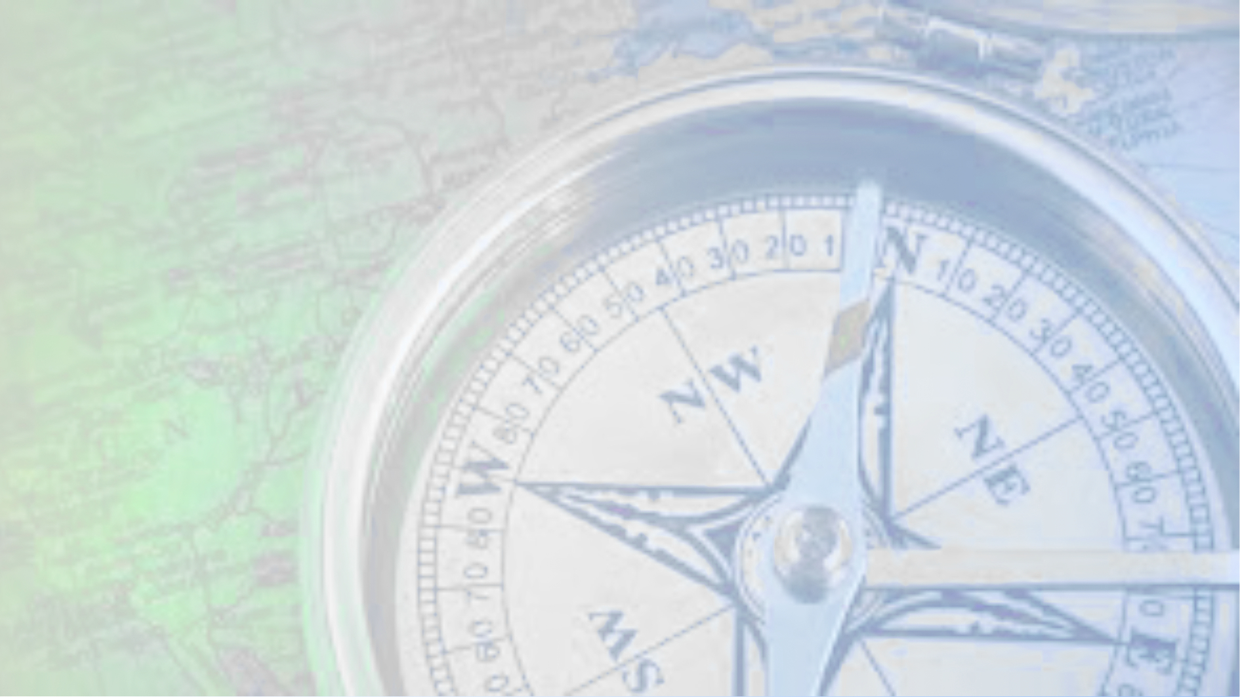
NAVIGATION
4000+ years of progress
© D Raybould 2022

Slide 2

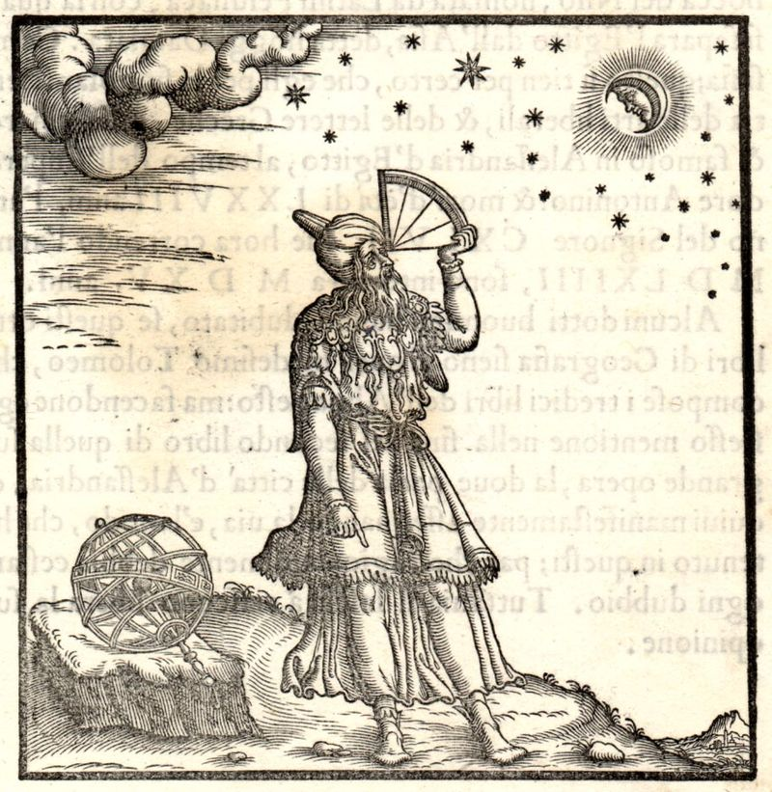
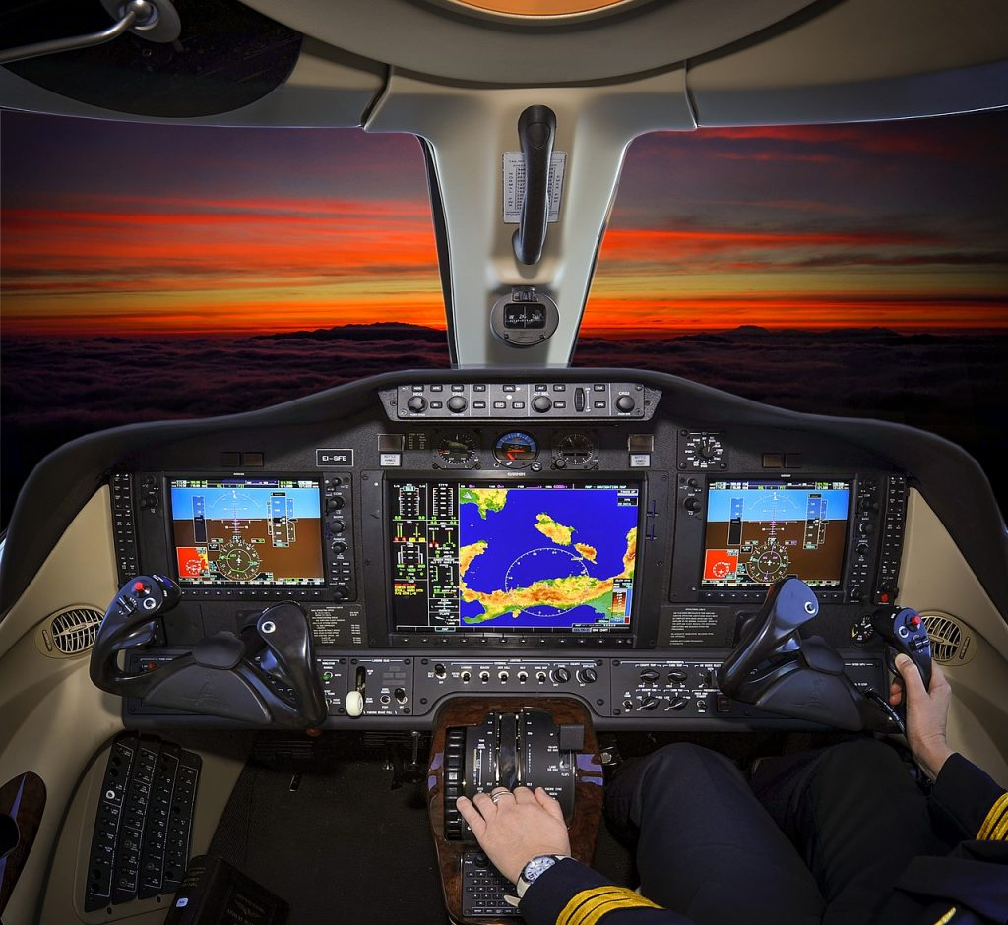

© D Raybould 2022

Slide 3
What is Navigation
Brief History
Tools and systems
© D Raybould 2022

Slide 4
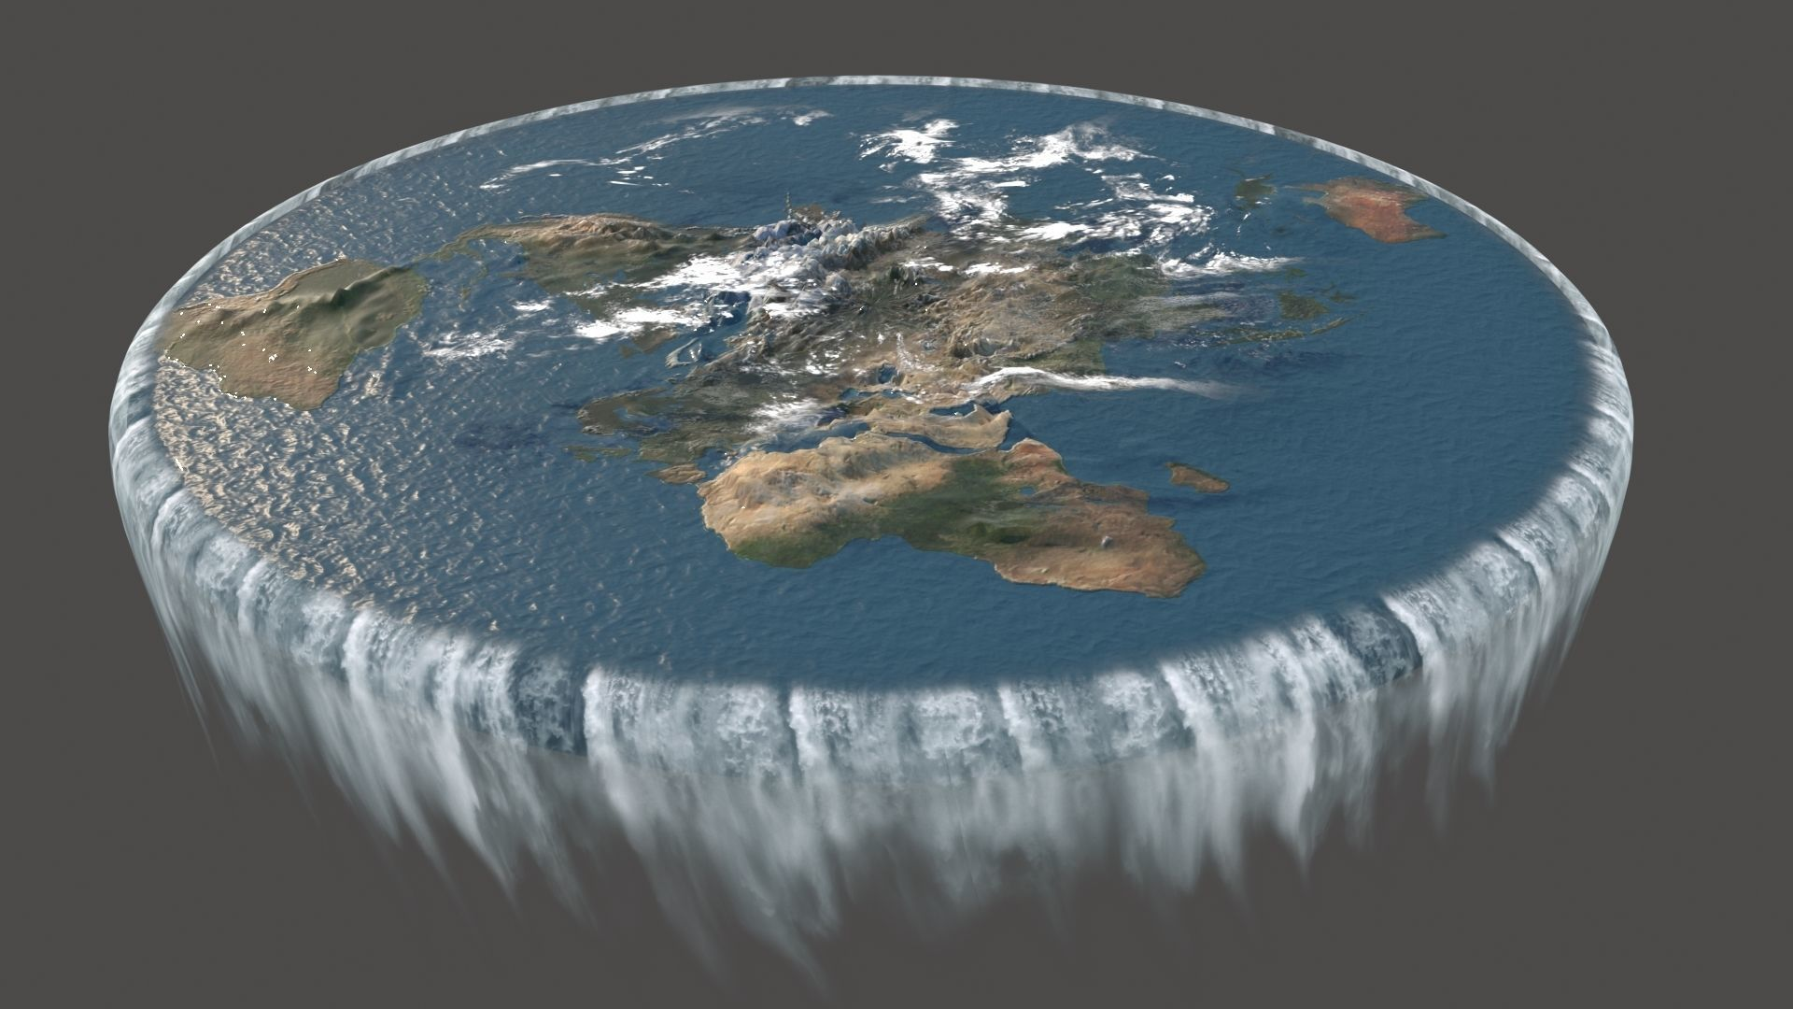
But first a few assumptions!
The Earth is an oblate spheroid. (it flattens at the poles) It definitely isn’t flat! And isn’t the center of the solar system.
© D Raybould 2022

Slide 5
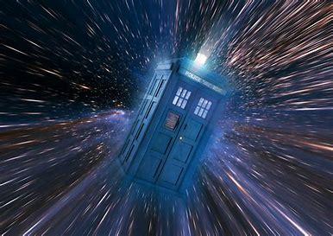
Navigation in the 4th Dimension will be covered next November…………………..
© D Raybould 2022

Slide 6
The word Navigation is a combination of two Latin words “navis” means boat and “agire” means guide .
Traditionally meant the art or science of moving ships and other watercraft safely from one place to another.
Today word Navigation used in a broad sense.
A Navigation system or tool is something that provides useful information to determine the position of a person, boat, car or airplane etc.
© D Raybould 2022

Slide 7
The first record of boats large enough to carry goods for trade is around 3500 B.C.
Marks the birth of the art of navigation.
Stayed close to shore and navigated by sight of landmarks or land characteristics that they could see.
Usually they traveled by day and sought a calm harbor or anchorage at night. They did not have charts but lists of directions, similar to today’s cruising guides.
© D Raybould 2022

Slide 8
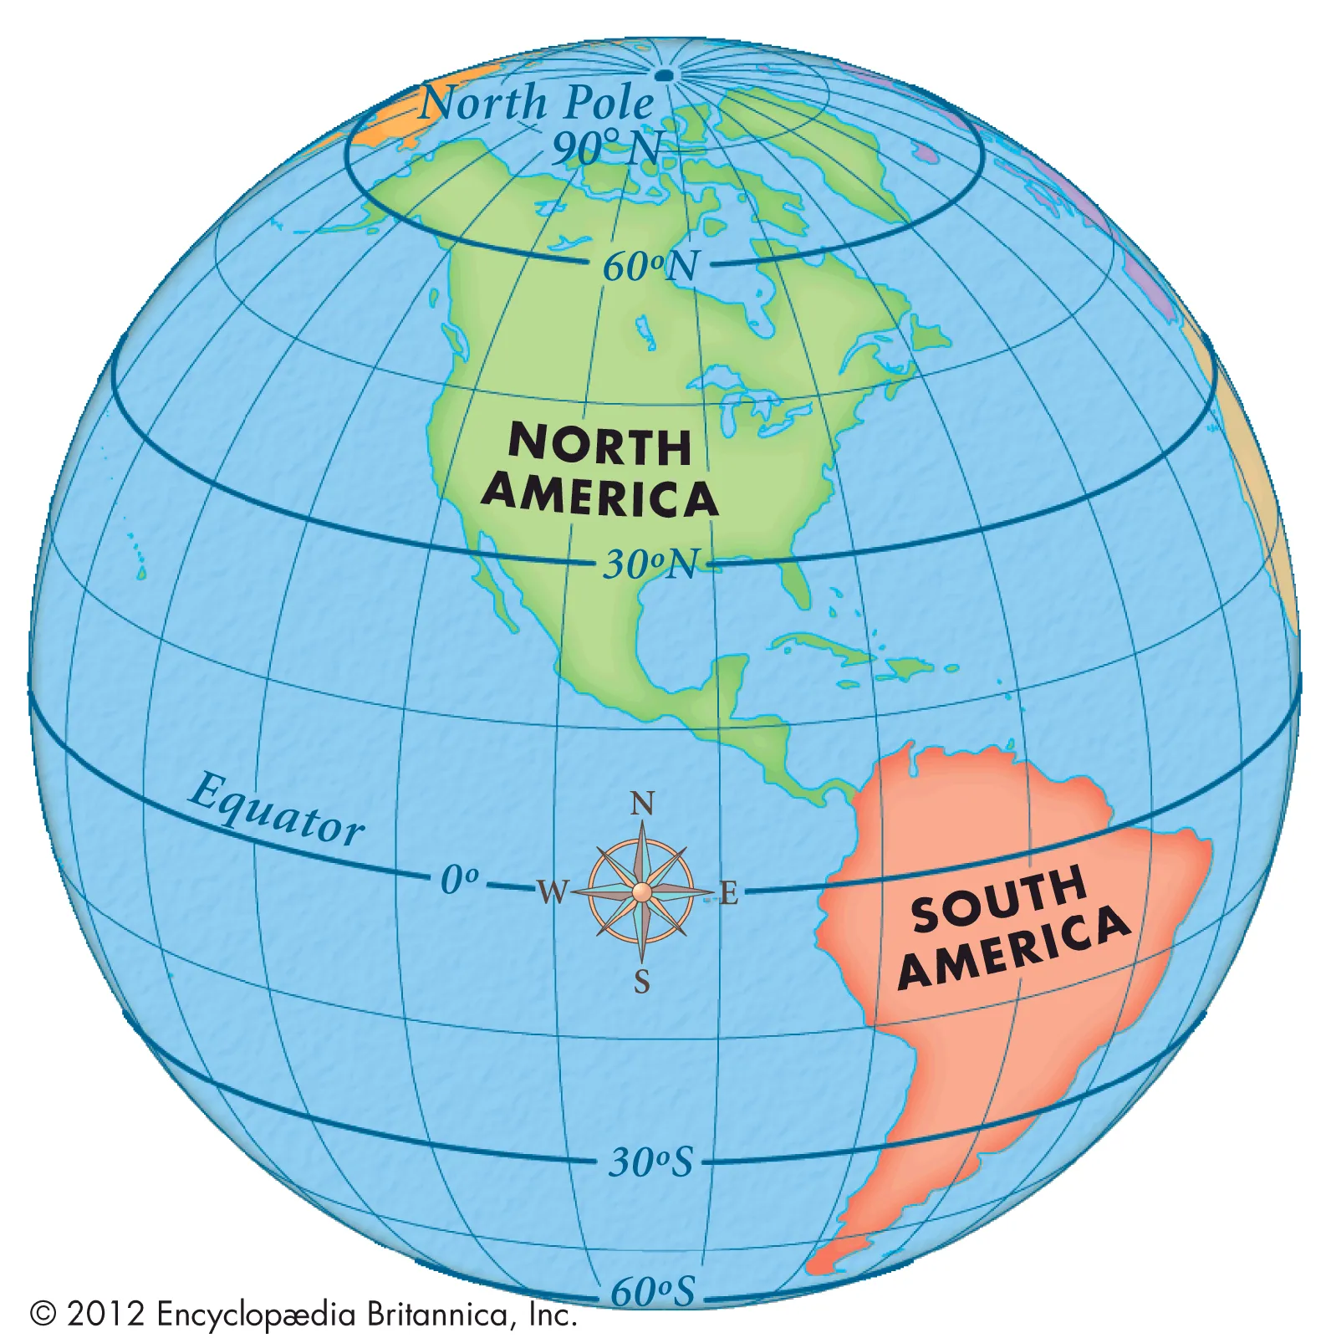
latitude and longitude,
coordinate system by
means of which the position or location of any place on Earth’s surface can be described.
Latitude describes the
Position North/South.
Longitude describes the
Position around the circumference.
© D Raybould 2022

Slide 9
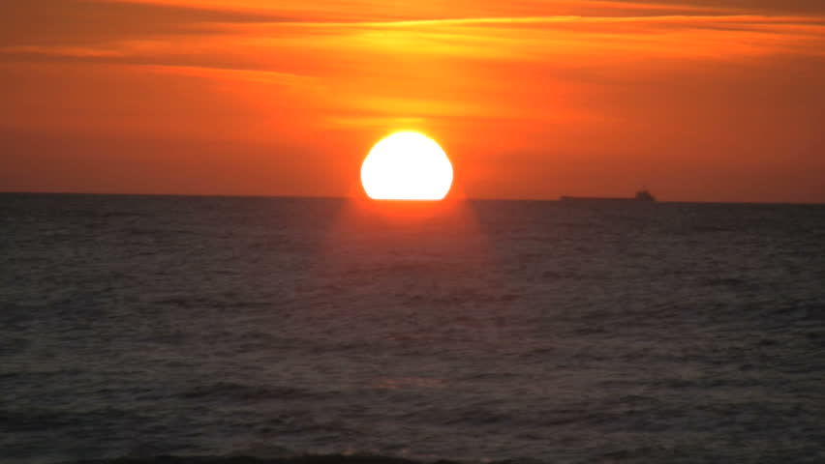
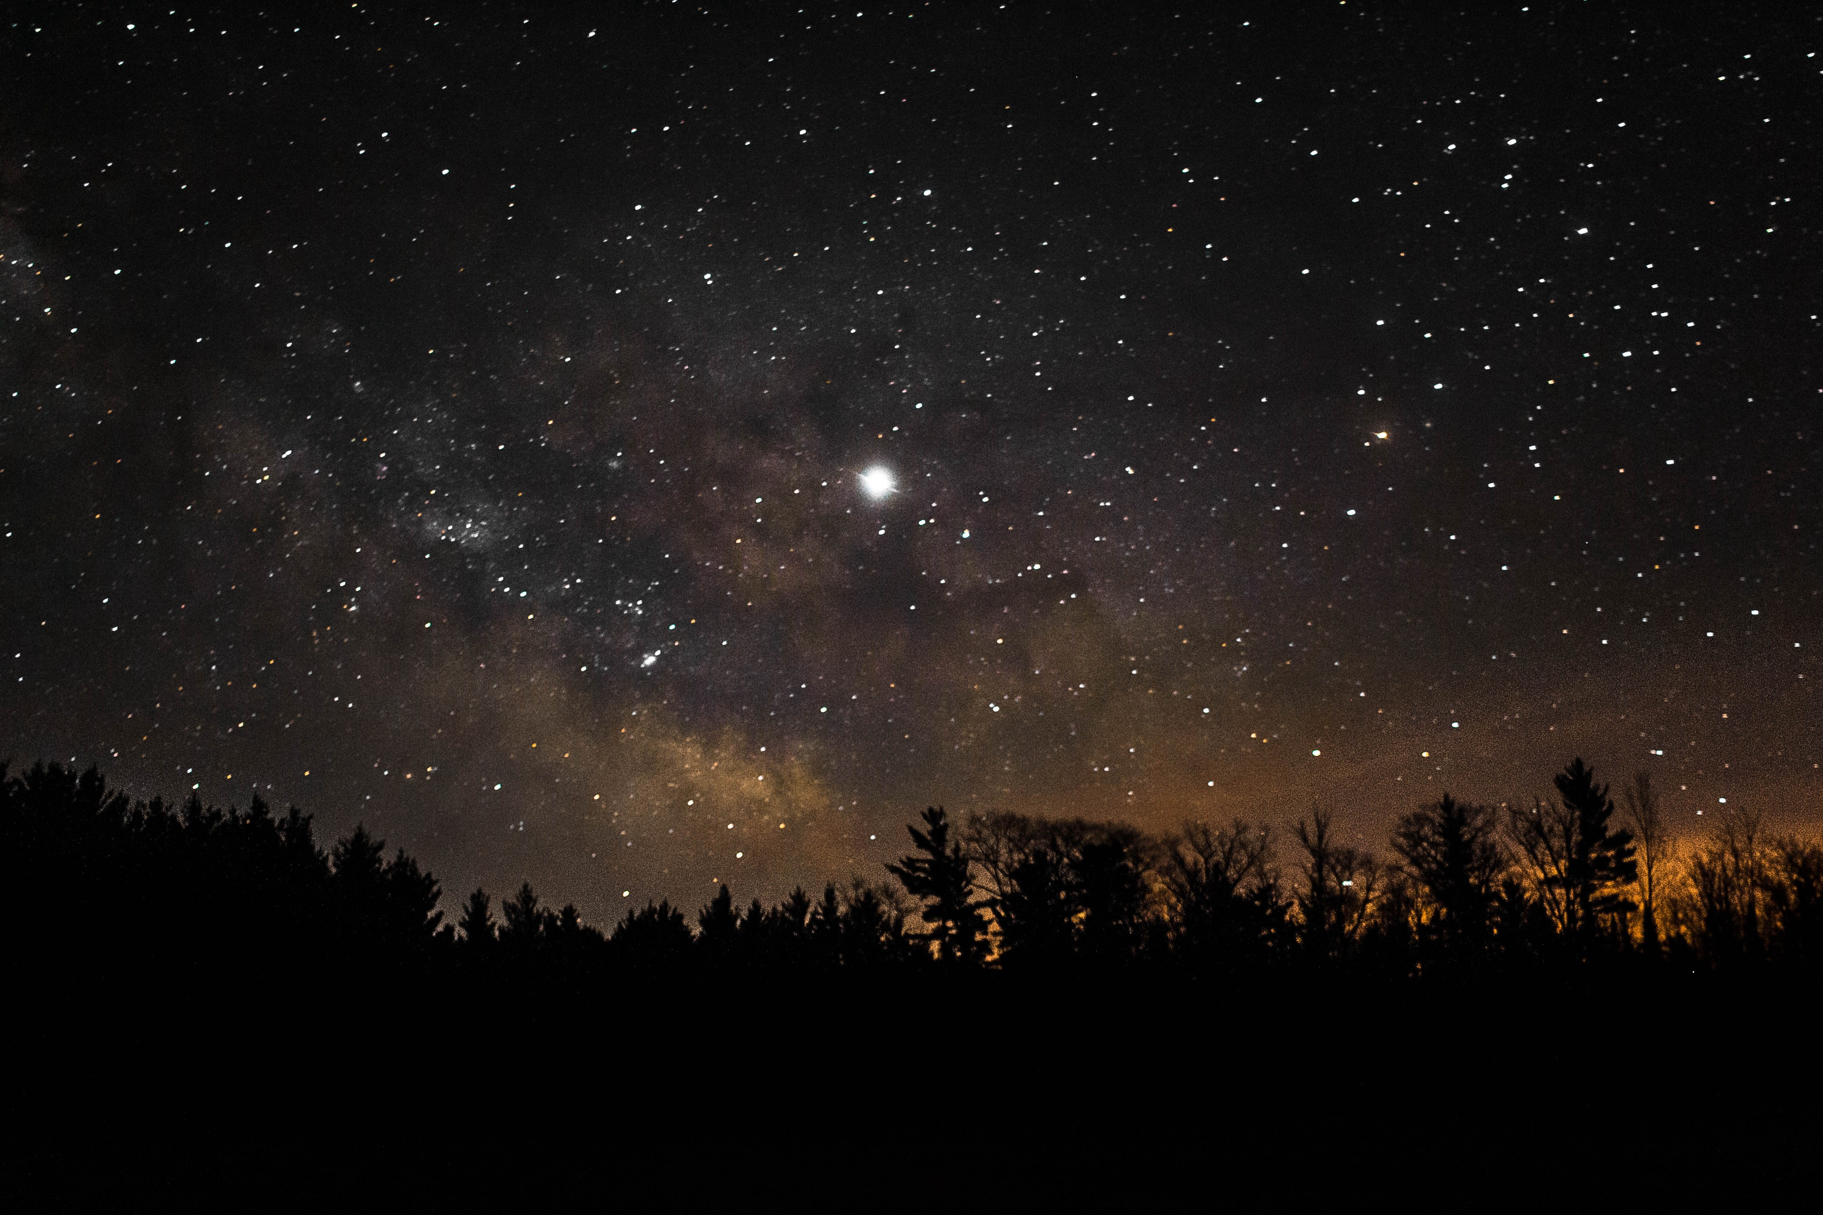
When out of sight of land, the navigator was able to roughly determine his latitude (north/south direction)
by observing the height of the sun during the day and the North Star at night . (Sunstone used for cloudy days)
© D Raybould 2022

Slide 10
Experienced mariners were able to plot their course by major constellations, though this was not an exact science.
Vessels followed the east/west movement of the sun or the track of the stars.
No way to accurately determine longitude and therefore, once out of sight of land, sailors had no real idea how far east or west they were.
© D Raybould 2022

Slide 11
Estimates were made based upon the time it took to get there.
This was a simple form of dead-reckoning still used by navigators today.
Phoenician sailors accomplished navigation in this manner around 2000 B.C. Simple charts and the use of sun and stars would have given them the early navigational edge.
© D Raybould 2022

Slide 12
Using this system, the navigator can determine the distance traveled from one point to another by multiplying the time underway by the speed of the vessel.
Time was measured with a sandglass (Egg Timer) and speed was estimated by watching pieces of seaweed drift by the hull, these early calculations were often way off.
Later a more sophisticated way of judging speed
Was a knotted rope! (17th Century)
© D Raybould 2022

Slide 13
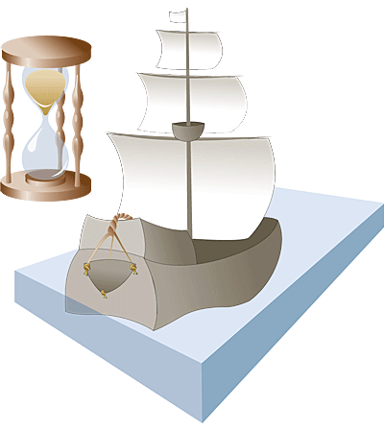
A piece of wood attached to a knotted rope was dropped off the stern of a ship and dragged behind the moving vessel.
However many knots were dragged behind the boat by the piece of wood determined the speed of the ship, and the term “knot speed” was born.
© D Raybould 2022

Slide 14
Knots are still used today,
The nautical mile is based upon the circumference of the Earth.
If the equator was a circle, imagine it divided into 360 degrees like a compass.
Now split each of those 360 degrees into 60 equal parts called “minutes.” The length of each “minute” along the circumference of the Earth is equal to approximately one nautical mile.
© D Raybould 2022

Slide 15
One knot is equal to approximately 1.15 miles per hour.
© D Raybould 2022

Slide 16
Still a bit hit and miss ☺
Floki Vilgjerdarsson, a great Viking explorer credited with the discovery of Iceland carried aboard a cage of ravens.
When he thought land was near, he released one of the birds. If it circled the boat without purpose, land was not near, but if it took off in a certain direction, the boat followed, knowing the bird was headed toward land.
Of course, this only worked if the navigator could get close to land. (And not too close!)
© D Raybould 2022

Slide 17
One of the earliest man-made navigation tools was the mariner’s compass.
Early forms of the magnetic compass date back to the 13th Century.
The navigator would rub an iron needle against a lodestone (naturally magnetized mineral), stick it in a piece of straw and float it in a bowl of water. The needle would point in a northerly direction.
© D Raybould 2022

Slide 18
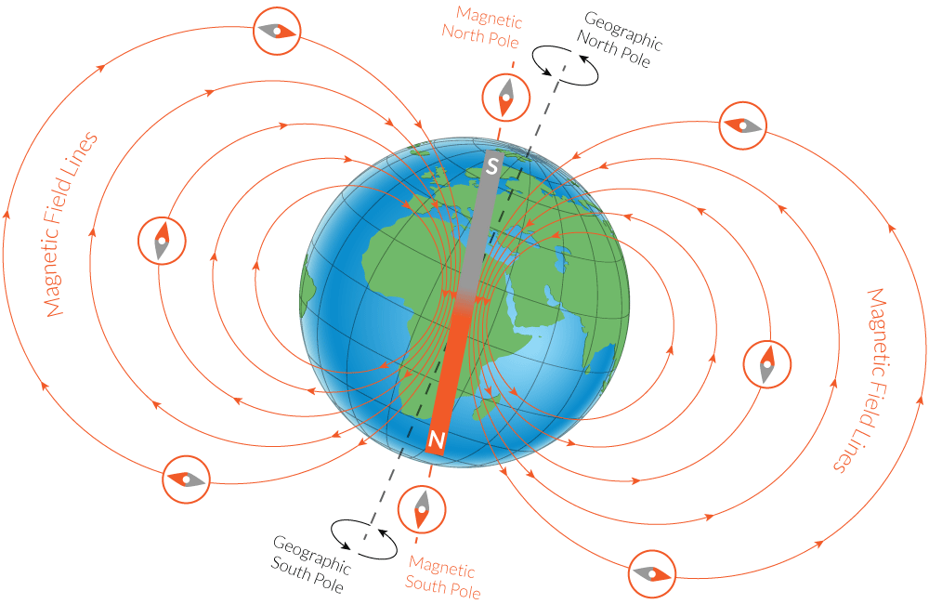
© D Raybould 2022

Slide 19
Early mariners found the compass inconsistent
They did not understand that it pointed to the magnetic north pole, not true north (Magnetic Variation).
At the time, they could not explain these variations and could not put much trust in the readings when navigating an unknown area.
© D Raybould 2022

Slide 20
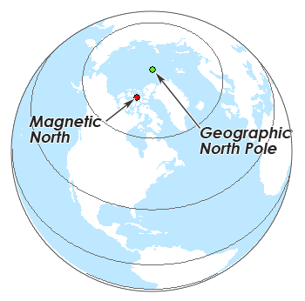
Declination is the difference between True North and Magnetic North (both differ from Grid North)
Magnetic North changes with time!
Coincided Sept 2019……
© D Raybould 2022

Slide 21
True north (geodetic north/ geographic north) is the direction along Earth's surface towards the geographic North Pole or True North Pole.
Compass error also occurs because of magnetic metals in planes, boats, cars etc.
Just to make matters worse Grid North doesn’t match either and refers to the alignment of grid lines on a map.
© D Raybould 2022

Slide 22
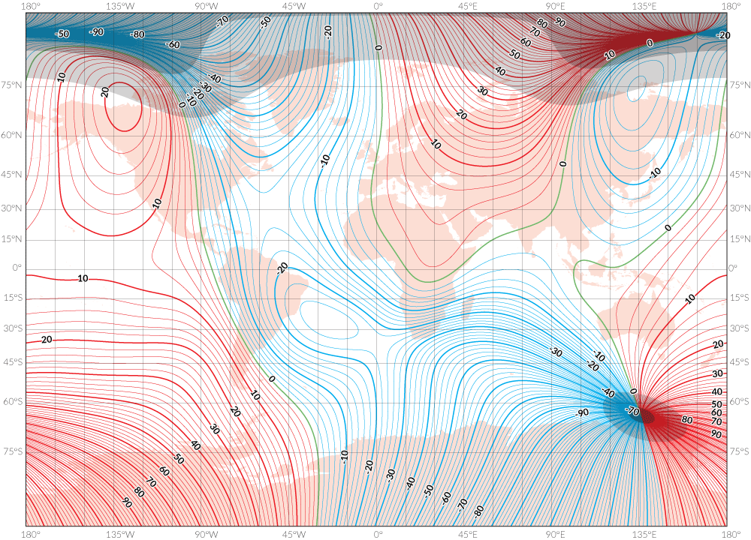
If that wasn’t enough
the Earth’s
magnetic field is not
uniform across the
globe and dips and
Undulates!
© D Raybould 2022

Slide 23
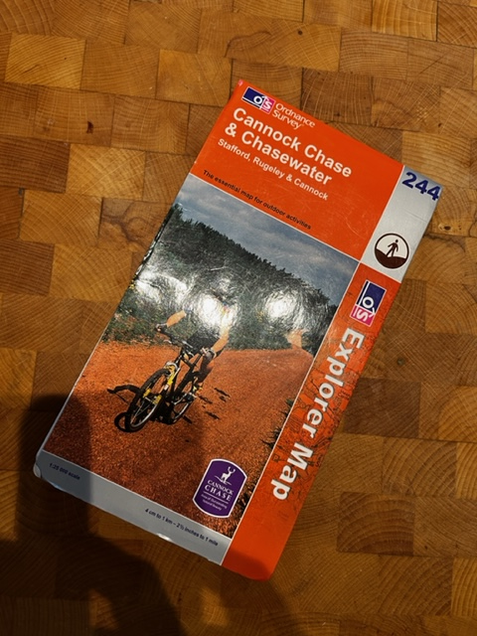
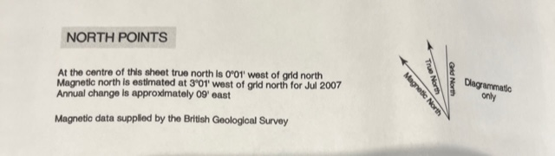
© D Raybould 2022

Slide 24
So with a compass or other means of judging direction and an idea of speed we can work out our position relative to a starting point.
We use this method of dead reckoning in our everyday lives “Walk West on that street for 100 yards and the shop will be on your left”
Pirates probably did the same when burying treasure describing direction and distance from a fixed landmark on their treasure map………
© D Raybould 2022

Slide 25
Celestial navigation is a step up from dead reckoning using the position of stars, constellations, moon, sun, and horizon to calculate position.
It is very useful on the open ocean, where there are no landmarks.
© D Raybould 2022

Slide 26
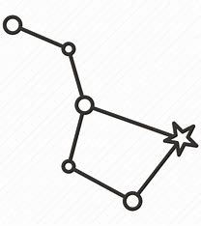

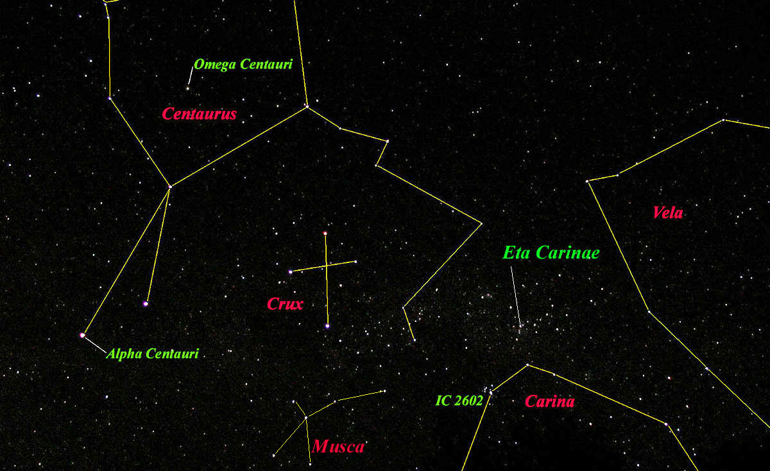
Big Dipper or
Plough
Constellation of Ursa Major
The Southern Cross
The Crux
© D Raybould 2022

Slide 27
Various methods to determine Longitude were used over the years such as observing Lunar Eclipses and comparing them with astronomical tables for reference. This proved to be highly inaccurate, Christopher Columbus tried this method on his voyages with huge errors.
It was not until the advent of accurate clocks and the telescope that any accuracy could be guaranteed.
© D Raybould 2022

Slide 28
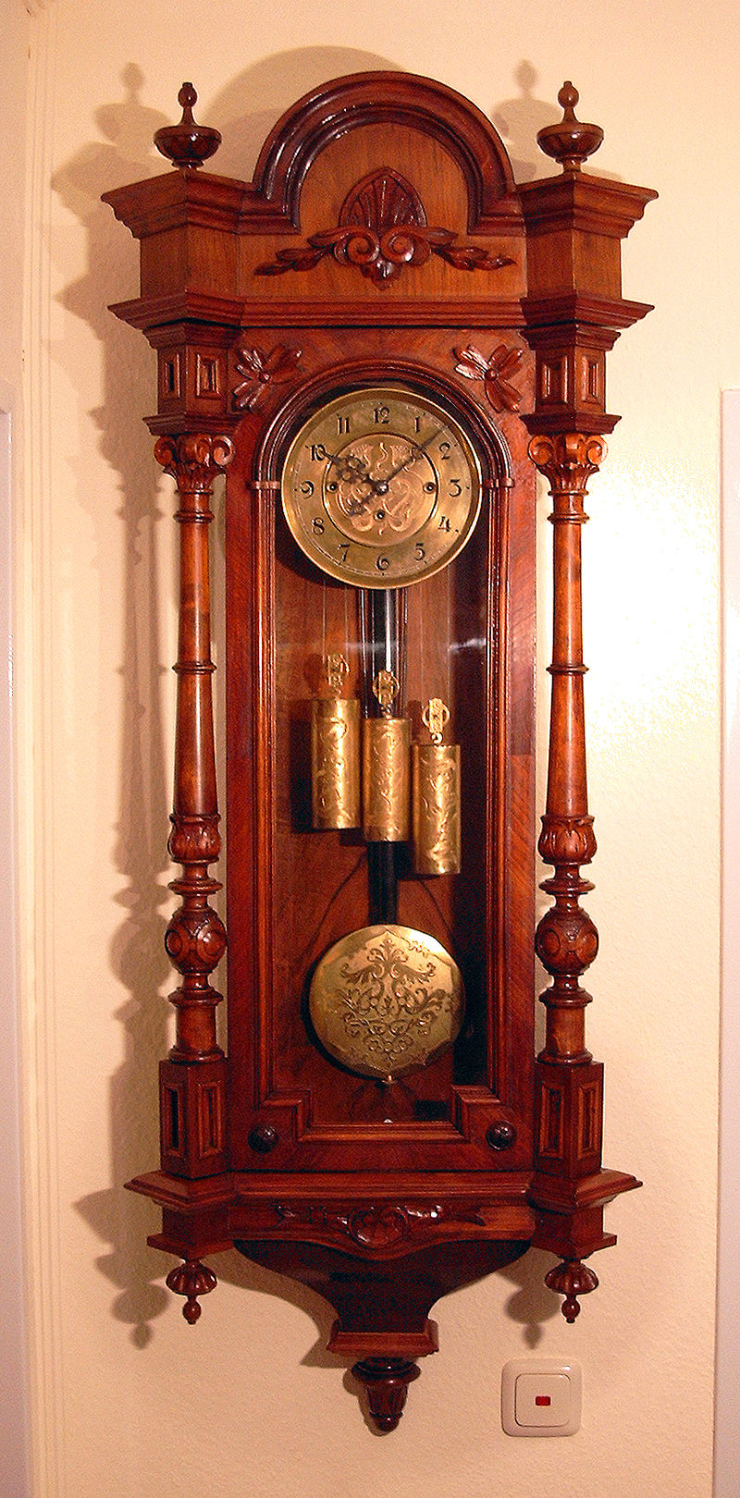
From its invention in 1656 by Christiaan Huygens, inspired by Galileo Galilei, until the 1930s, the pendulum clock was the world's most precise timekeeper.
Precision is relative, early pendulum clocks were accurate to about 10 seconds a day. Still a 30 fold improvement on early clocks!
© D Raybould 2022

Slide 29
From the start, Huygens intended his clocks to be used for determination of longitude at sea. However, pendulum clocks did not tolerate the motion of a ship sufficiently well, and after a series of trials he decided that other approaches would be needed
© D Raybould 2022

Slide 30
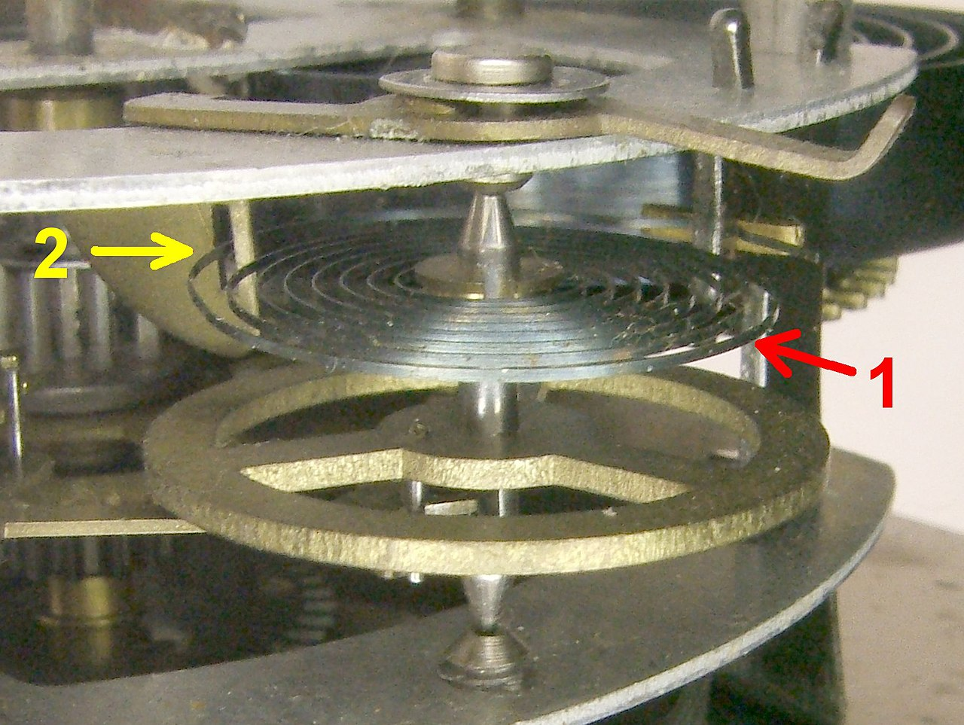
Around 1660 the balance spring method of maintain the accuracy of clocks and watches was invented leading to vast improvements in time keeping. (0.5S/Day)
As an aside modern atomic clocks have an error of 1S/100M Years….
© D Raybould 2022

Slide 31
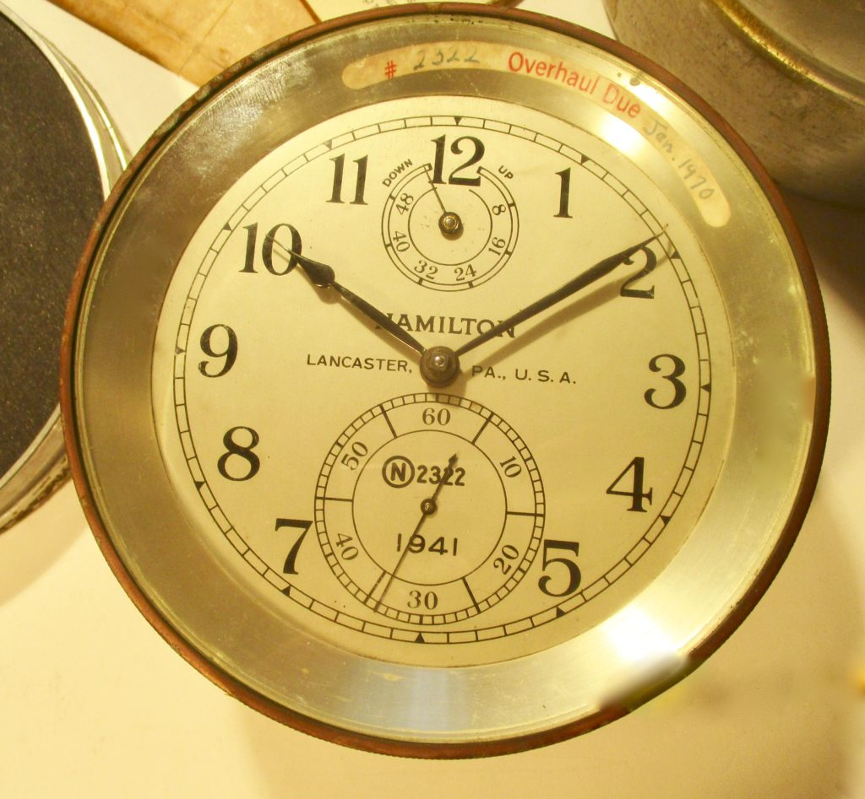
© D Raybould 2022

Slide 32
In 1609 Galileo made his first telescope.
He began a series of astronomical discoveries that included the satellites of Jupiter.
Improvements in optics, calibrated mountings, optical grids, and micrometers increased the range of events that could be accurately observed to determine longitude.
© D Raybould 2022

Slide 33
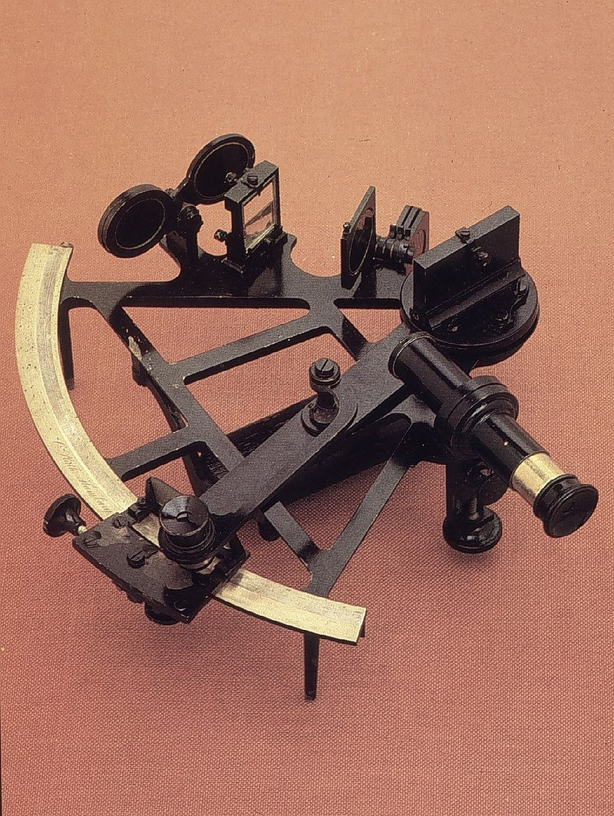
These gave rise to the sextant!
This combined with an accurate way of determining the time allowed the accurate measurement of Longitude.
Used to precisely measure angle between objects.
© D Raybould 2022

Slide 34
Steps to determine Longitude:
Determine an absolute time of an event (UTC/GMT)
Compare the corresponding local time (Ignore BST etc.)
Each hour of difference of local time corresponds to a 15 degrees change of longitude (360 degrees divided by 24 hours).
© D Raybould 2022

Slide 35
This is a massive simplification of the process and omits any consideration of the issues involved:
How do you determine Absolute time?
How do you ensure everyone has the correct absolute time?
Developments in wired and wireless telegraphy helped to ensure standardization by the use of time signals.
WWV Time Station 1 Hour Full Cycle - No Loop Radio ASMR - YouTube
© D Raybould 2022

Slide 36
The advent of wireless telegraphy paved the way for vast improvements in navigational accuracy.
Direction finding……..
The principle should be very familiar to anyone who has used a MW (Medium Wave) radio where the radio has to be turned to get the best signal because it contains a directional antenna using a ferrite rod.
© D Raybould 2022

Slide 37
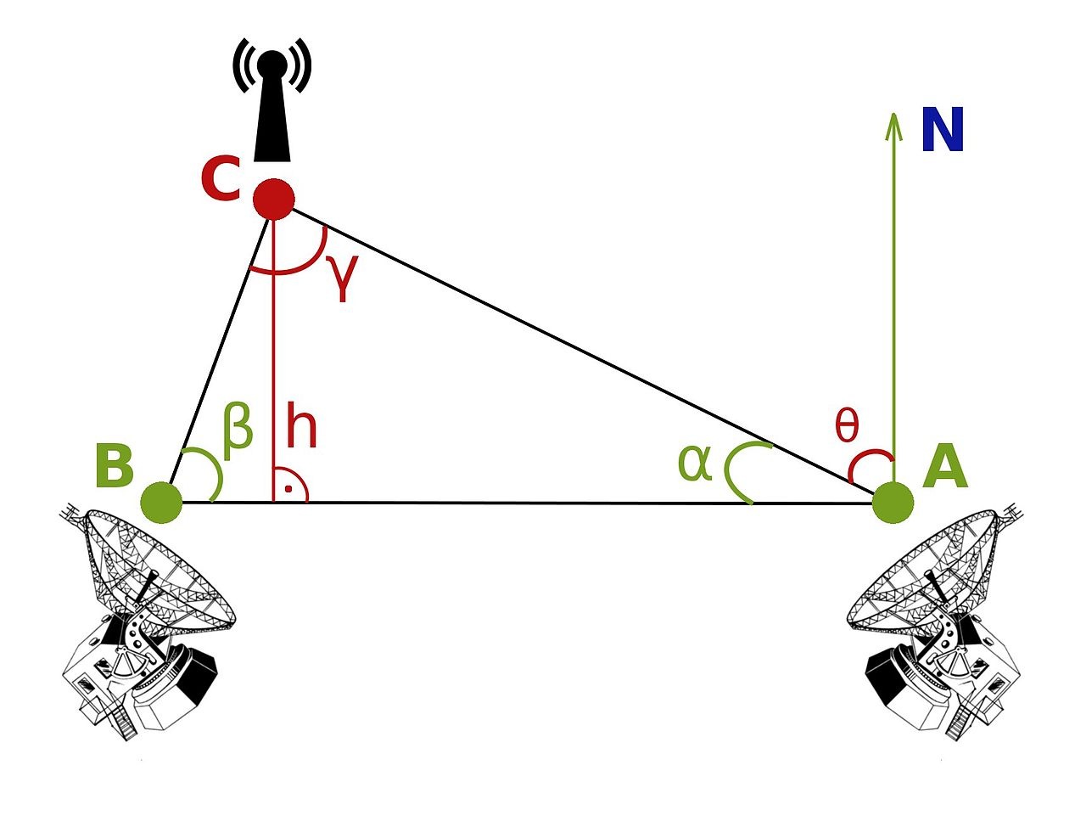
If ‘C’ was a ship and ‘A’ and ‘B’ transmitters then a position for ‘C’ could be triangulated.
© D Raybould 2022

Slide 38
Various enhanced Radio Direction Finding systems were developed; hastened by World War II
LORAN, short for Long Range navigation, was a radio navigation system developed in the United States
UK's Gee system operated at lower frequencies in order to provide an improved range up to 1,500 miles (2,400 km) with an accuracy of tens of miles.
© D Raybould 2022

Slide 39
Global Positioning System
© D Raybould 2022

Slide 40
GPS has its origins in the Sputnik era
Scientists were able to track the satellite with shifts in its radio signal known as the "Doppler Effect." (change in frequency of a wave in relation to an observer who is moving relative to the wave source. Think of an ambulance siren)
United States Navy conducted satellite navigation experiments in the mid 1960's to track US submarines
© D Raybould 2022

Slide 41
In the early 1970's, the Department of Defense (DoD) wanted to ensure a robust, stable satellite navigation system would be available.
The DoD decided to use satellites to support their proposed navigation system. Launching its first Navigation System satellite in 1978. The 24 satellite system became fully operational in 1993.
Multiple GPS systems are now in use and are very familiar to us, even our smart phones use GPS to tell us where we are and get us where we are going.
© D Raybould 2022

Slide 42
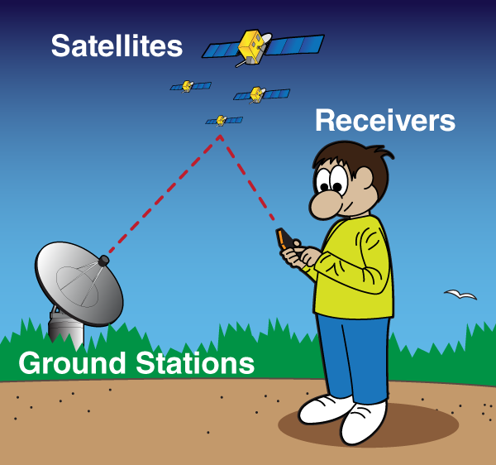
Satellites act like the stars in constellations—we know where they are supposed to be at any given time.
ground stations use radar to make sure they are actually where we think they are.
Once the receiver calculates its distance from four or more satellites it knows where the receiver is.
© D Raybould 2022

Slide 43
1. Command center transmits orbital data, time corrections, and location of other satellites in the GPS constellation.
2. GPS satellites simultaneously transmit synchronized time and orbital data to Earth.
3. GPS receivers compute location using orbital data and the difference in arrival times of the signals of at least 4 satellites.
© D Raybould 2022

Slide 44
So far we have only considered Navigation on the surface of the Earth.
What if we want to climb a mountain and want to know how high we have climbed or a pilot of an aircraft wants to know he isn’t going to collide with another aircraft.
Both need a way to work out how far above the Earth’s surface they are.
© D Raybould 2022

Slide 45
Air pressure decreases with an increase of altitude
(At Sea level it weighs 14.5 pounds per square inch)
We can use an aneroid barometer to measures the atmospheric pressure and from this the height above the surface of the Earth
© D Raybould 2022

Slide 46
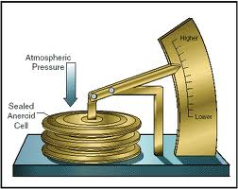
© D Raybould 2022

Slide 47
Because altimeters are calibrated on the mean pressure at sea level and the atmospheric pressure varies with temperature they can be inaccurate (not something a pilot wants when trying to land on a runway in fog another method of determining the height above ground is needed.)
Commercial planes are equipped with a radio altimeter, an airborne electronic device capable of measuring the height of the aircraft above terrain immediately below the aircraft.
© D Raybould 2022

Slide 48
Measures altitude above the terrain presently beneath an aircraft or spacecraft by timing how long it takes a beam of radio waves to travel to ground, reflect, and return to the craft.
© D Raybould 2022

Slide 49
How Do Commercial Aircrafts Use Navigation systems?
© D Raybould 2022

Slide 50
GPS – Global Positioning System
The primary navigation source for commercial airline pilots.
Most accurate and allows aircraft to perform maneuvers down to an accuracy of 0.1 Nautical Miles
There are GPS black spots where there may not be enough satellites in range to obtain position.
© D Raybould 2022

Slide 51
The Inertial Reference System
is a self-contained system that is able to track the aircraft position with no external reference.
Uses accelerometers and gyroscopes to calculate any movement and acceleration of the aircraft across its three axis.
By telling the system where the aircraft is at the start of the flight using Latitude and Longitude the system has all the information it needs to perform without external support.
© D Raybould 2022

Slide 52
Radio beacons
Send out radio beams which tell pilots the aircraft’s range and direction from the radio aid.
This allows the aircraft’s computer system to calculate the aircraft’s location.
The more radio signals detected, the more accurate the estimated position.
Many different types of beacons
© D Raybould 2022

Slide 53
Using a combination of Navigational Aids modern aircraft can navigate safely and land without any input from the pilot/s
How they do this is complex and too detailed to cover in this talk other than the absolute basics.
Thank you for listening…………………..
© D Raybould 2022

Slide 54
© D Raybould 2022

