Slide 1



Dr Keeley Brookes
“Genes, Dementia and Me”

Slide 2
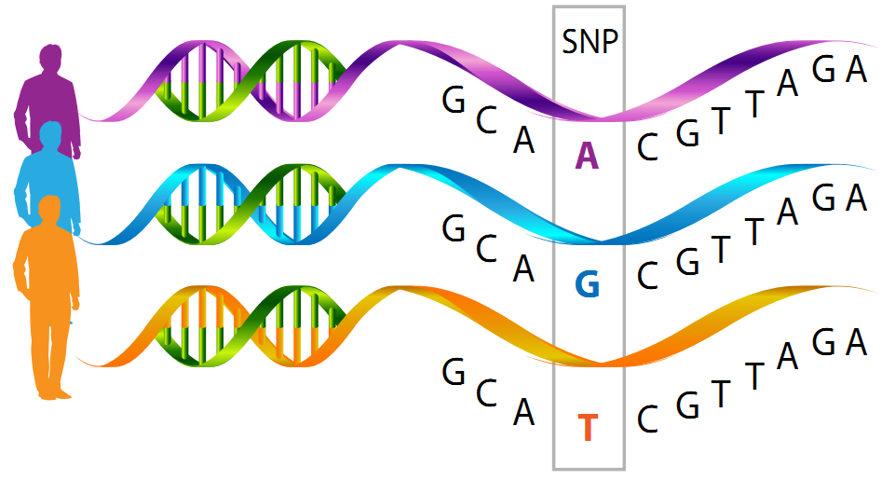

Slide 3


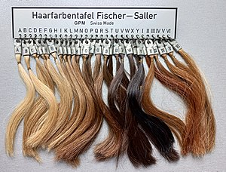
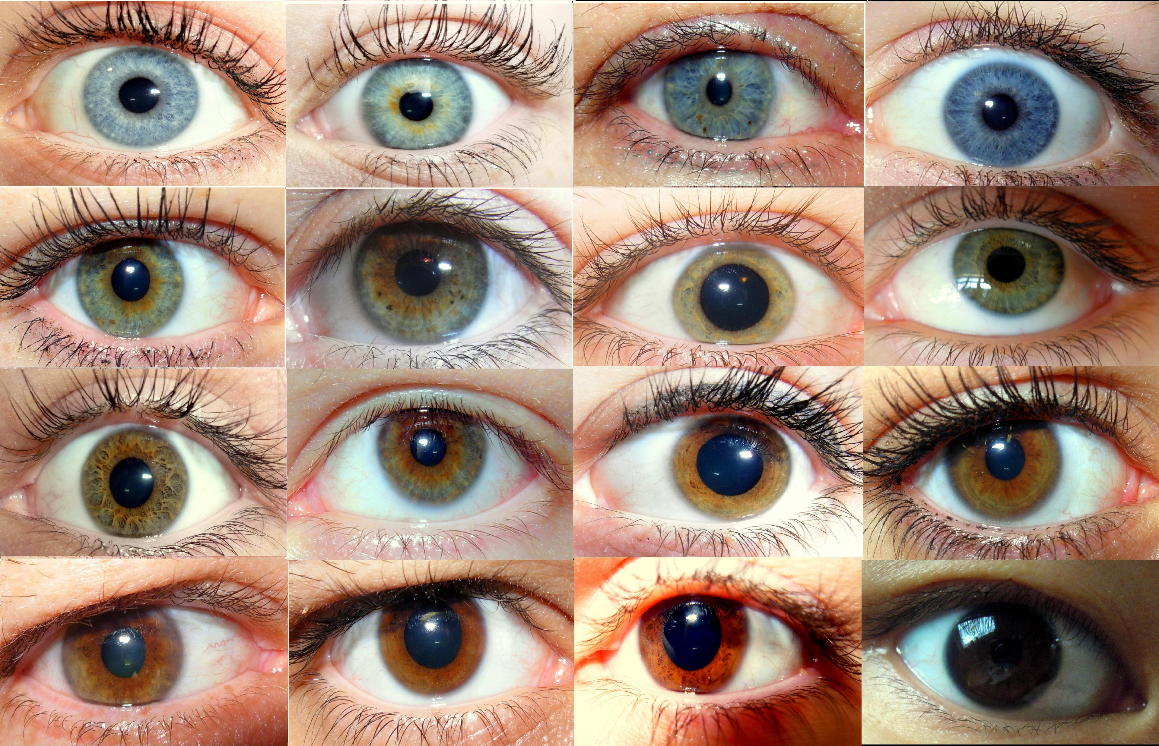
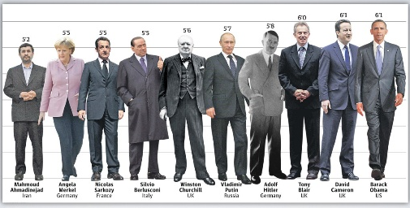


Slide 4

Dementia
Memory Problems
Trouble thinking coherently
Issues with speaking
Behavioural changes
Frontal Temporal Lobe Dementia
Alzheimer’s Disease
Dementia with Lewy Bodies
Vascular Dementia
2/3

Slide 5
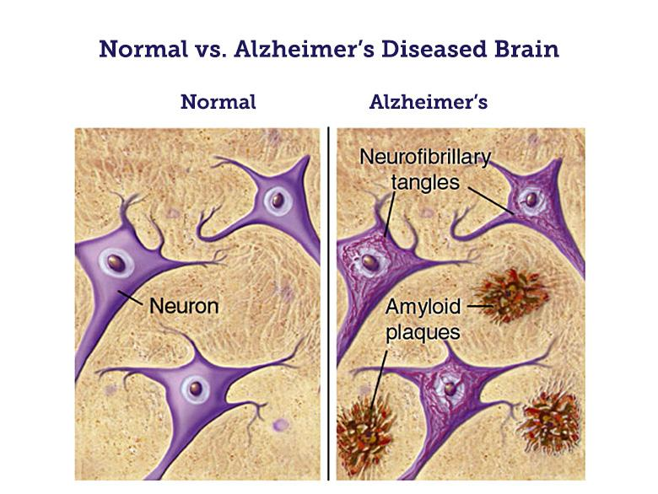
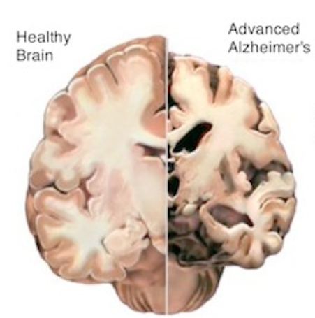

Slide 6
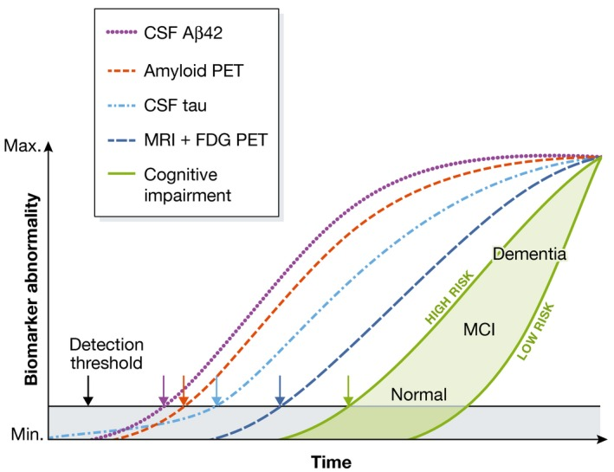
Selkoe DJ, Hardy J. The amyloid hypothesis of Alzheimer's disease at 25 years. EMBO Mol Med. 2016;8(6):595–608. Published 2016 Jun 1. doi:10.15252/emmm.201606210
Drugs need to be given early to be effective

Slide 7
Identify who might get dementia before they show symptoms

Slide 8
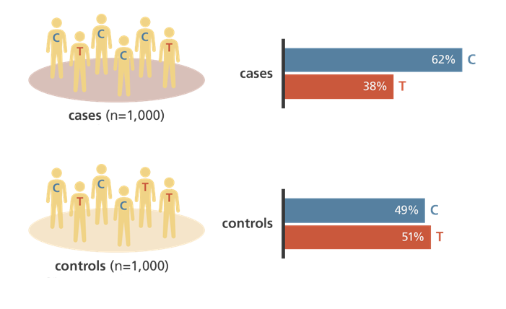
Genetics contributes as much as 80% to AD
Sequence is stable
DNA is everywhere!
Cheap & Quick
Non-invasive

Slide 9
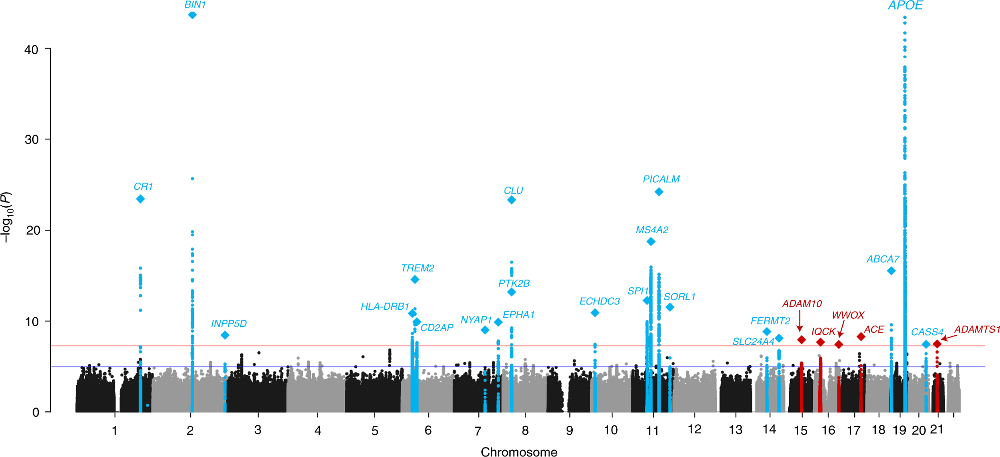
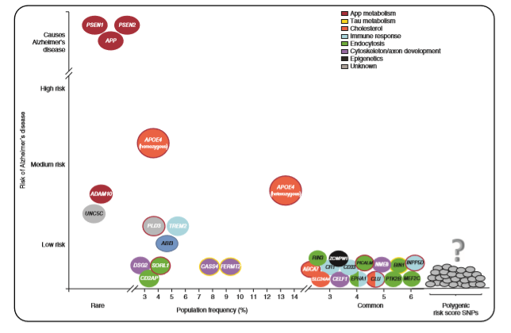

Slide 10
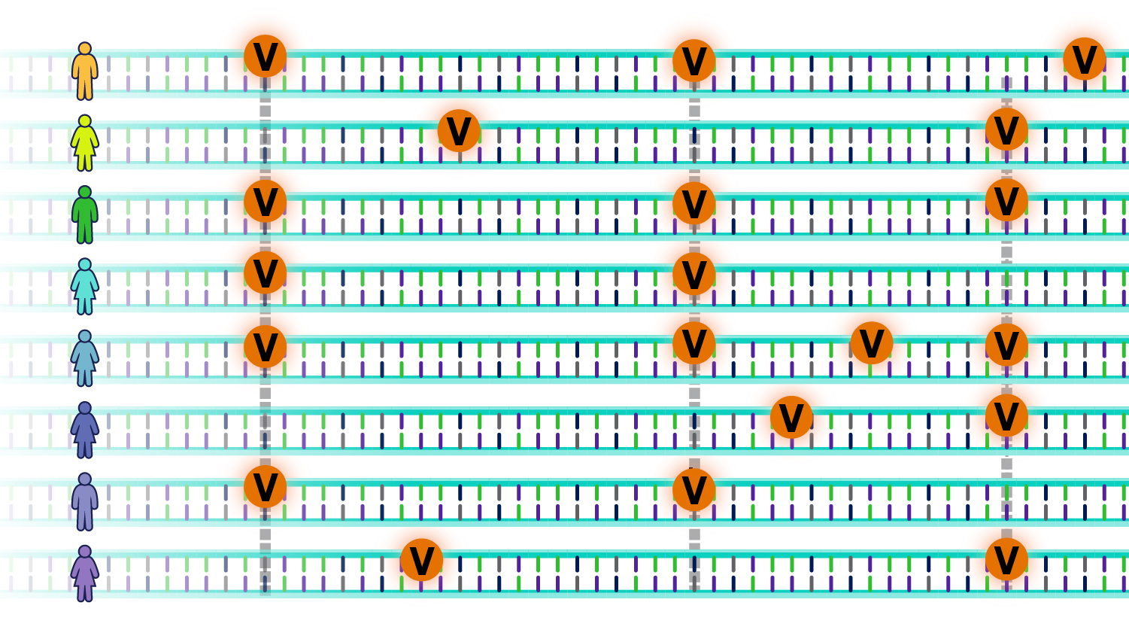
Polygenic Risk Score
2.34 =
1.23 =
2.25 =
1.12 =
3.56 =
0.95 =
1.56 =
0.23 =

Slide 11
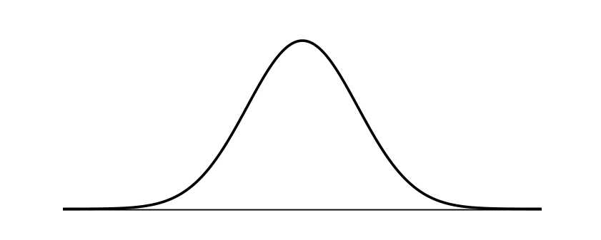
Polygenic Risk Score
Summation of most important gene variants associated with AD into a single score per person
Risk of dementia
Polygenic risk scores

Slide 12

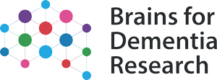


A DNA bank of 1422 samples (out of ~3200)
1095 samples with genotyping data from the NeuroChip array (n=466,947 variants)
Coming soon:
  1422 samples with genotype data from Neurobooster array (n=1.9 million variants)
Alzheimer’s disease

Slide 13
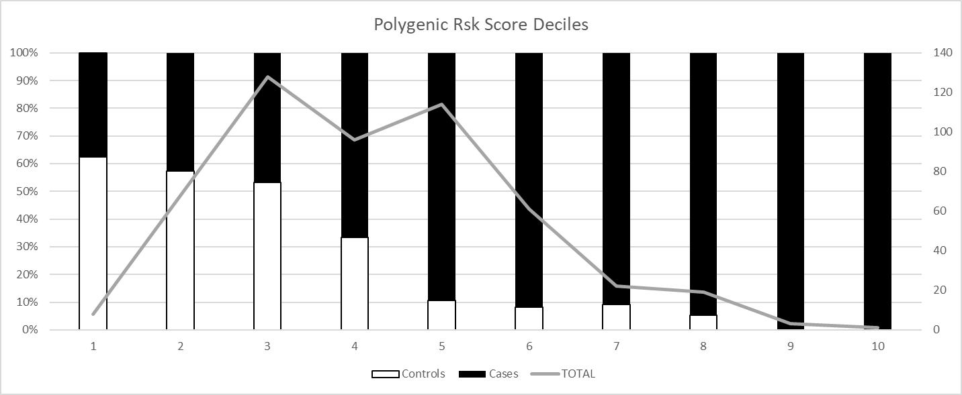
Polygenic Risk Score Deciles
76% Accuracy – 56 SNPs (including APOE)

Slide 14
Issues :
Only good at identifying AD at very extreme of scores
Can not identity the “individually” of genetic backbone
Not very good at distinguishing between dementias
The genes versions used are different between studies
  People use different cut-offs for variant importance
Models don’t replicate between cohorts
  Cohort from USA – 59%

Slide 15
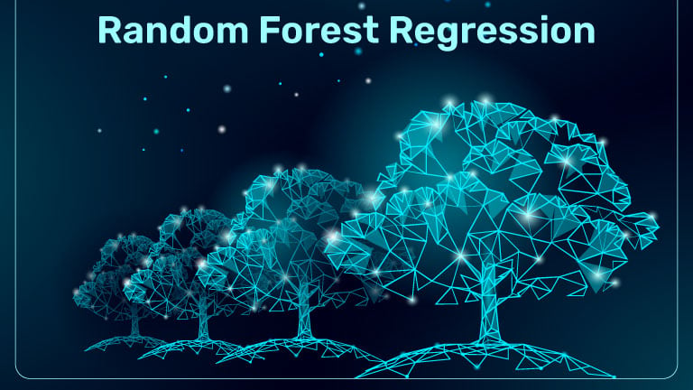
No pre-determined importance of gene variants
Produces 100s of models and then selects the best one
Allows the individually of genetic backbone to be consider
Creates a “Decision Tree”
A machine learning approach

Slide 16


APOE:R
82% accurate
APOE: P
HLA
PTK2B
MS4
ZCWPW1
CASS4
PICALM
CD2AP
NME8
PTK2B
EPHA1
CELF1
CD2AP
AD
AD
Control
AD
AD
AD
Control
AD
AD
Control
AD
Control
Control
Control

Slide 17
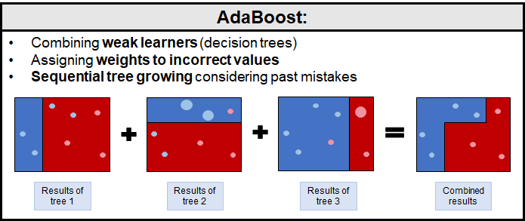
Next Steps?
Apply this to my bigger dataset
  Computer Science!
Improve the model with “AI”
  “Boosting”
REPLICATION !
Can it distinguish between other types of dementia?
Can it help us identify new biological targets for therapeutic intervention?
Personalised medicine?

Slide 18
Thank You for listening
Any Questions?
Keeley.brookes@ntu.ac.uk
Questions, Information
Lab tours

